Slide 1
10
Divorce, Remarriage, and Blended Families
Slides by Joanna Pepin

Slide 2
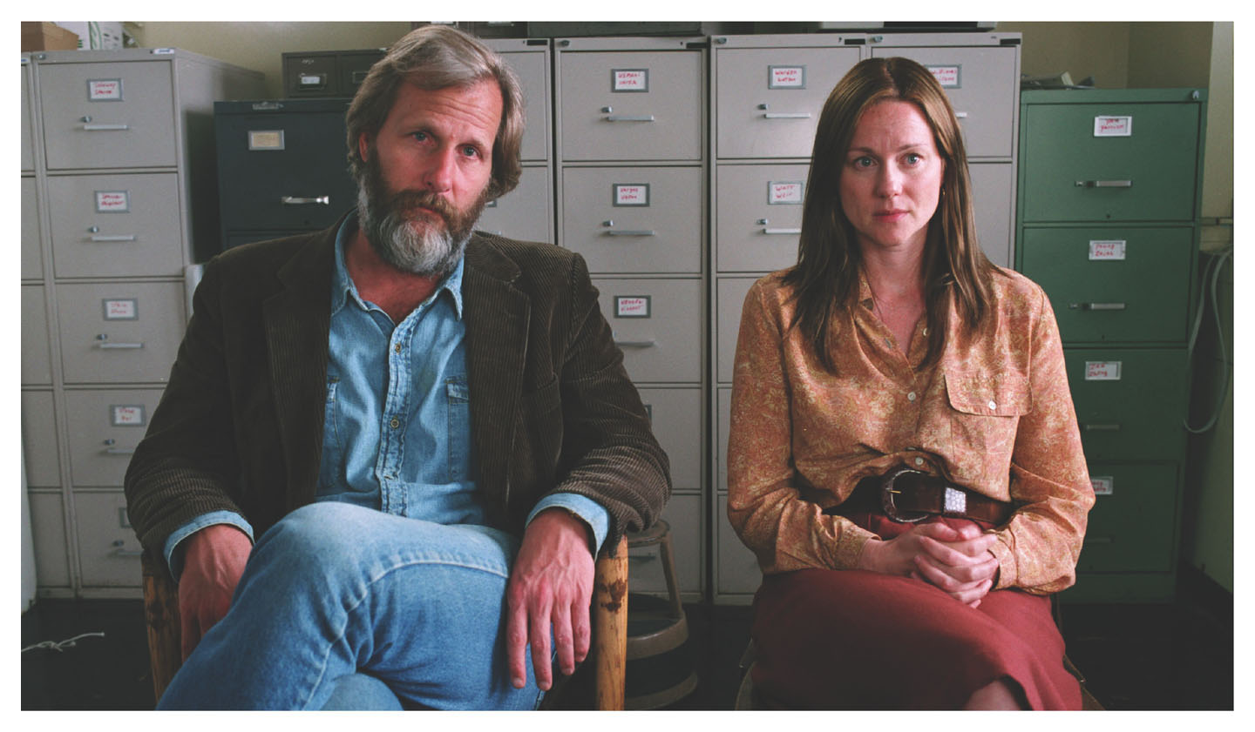
Divorce, Remarriage, and Blended Families
Notes:
Divorce has become an increasingly normal part of the relationship process for many individuals.
This is partly a result of the rise of individualism in modern society.
Marriage is now viewed more as an expression of personal fulfillment than a social obligation.
And this view of marriage and divorce has become increasingly accepted in modern society.
But how do we reconcile the personal freedoms of the individual with the social constraints of the institution of marriage?
Many critics of divorce are concerned about the unstableness of modern marriage and divorce and the uncertainty it creates.
As with any aspect of social change and transition, there are risks and consequences.
This may be especially so for children in families affected by divorce.

Slide 3
Divorce, Remarriage, and Blended Families: For the Children
For the Children’s Sake
Notes:
One of the central concerns of divorce is the stress it may place on individuals, especially children.
Some parents try to delay or prevent divorce for the children’s sake; other parents want a divorce for the children’s sake.
There are several ways to view the social phenomenon of divorce.
Some individuals view divorce as liberation; others view divorce as the collapse of the institution of marriage.
The increase of divorce and remarriage in modern society can be connected to the three themes of the textbook: family diversity, social class inequality, and social change.
The increase in divorce and the increasing acceptance of divorce have changed the institution of marriage for everyone, whether or not they are personally involved with divorce.
In this chapter, Cohen discusses three areas of divorce:
The history and recent trends of divorce
The causes and consequences of divorce
The topics of remarriage and blended family arrangements

Slide 4
Divorce, Remarriage, and Blended Families: Marital Dissolution Definition
For the Children’s Sake
Church and State
Marital Dissolution: The end of a marriage through permanent separation or divorce
Notes:
In modern society, the state as an institutional arena has taken more and more authority and control away from the church, especially where divorce is concerned.
Church authority, in general, has become increasingly less powerful with the rise of the nation state.
The modern family is much more under the control of state authority than it is under the control of religious authority.
In modern society, religion is more of a matter of personal choice, and not a social requirement.
To discuss the history of divorce, Cohen defines several sociological terms related to divorce.
Divorce as a legal procedure is not the only phenomenon of interest to sociologists.
Sociologists are also concerned with all manner of marriage dissolutions.
Marital dissolution is the end of a marriage through permanent separation or divorce.
This term is used in lieu of divorce at times because some couples who separate do not follow through and get a legal divorce.

Slide 5
Divorce, Remarriage, and Blended Families: Separation
For the Children’s Sake
Church and State
Separation: The formal or informal separation of married spouses into different households
Notes:
A separation is the formal or informal separation of a married couple.
In some cases, a separation is a legal process; in other cases, it may be informal.
Some states require a legal separation before a divorce can be granted.

Slide 6
Divorce, Remarriage, and Blended Families: Divorce
For the Children’s Sake
Church and State
Divorce: The legal dissolution of marriage according to the laws of the state
Notes:
Divorce “is the legal dissolution of marriage according to the laws of the state.”
Again, the word state is being used in the text to refer to the state as an institutional arena.
Some researchers also use the term relationship dissolution to apply to the separation of a couple in a committed relationship who has never been married (especially when those relationships include children), because the process is similar in many ways to divorce.
Divorce has a long history and is not limited to modern relationships or marriage.
There are many examples of divorce throughout history (e.g., upper-class couples in the Roman Empire, ancient Jewish laws permitting divorce).

Slide 7
Divorce, Remarriage, and Blended Families: Annulment of Marriage
For the Children’s Sake
Church and State
Annulment of Marriage: A legal or religious determination that the marriage was never valid
Notes:
Annulment of marriage is a religious or legal determination that a marriage was never valid.
An annulment voids a marriage, and the marriage is then treated as if it never occurred at all.
Divorce was quite common among upper-class couples in the Roman Empire. But by the time of early Christianity, religious authorities introduced strong rules against divorce.
Separation by mutual agreement or desertion occurred, but individuals could not legitimately remarry unless they were granted an annulment by the Church.
Catholic doctrine allows an individual to remarry only if the first marriage has been annulled; divorce is not permitted.
That history is what makes annulment important to understand.
Annulments are very difficult to obtain and they are very uncommon, although they are still legally granted today in rare circumstances.
Annulments remain important for some Catholics, who may still have a very negative view of divorce.
Annulments are an important part of the history of marriage dissolution because they highlight the influence of religious institutions and the Church on the institution of marriage.
Although the church has less authority than it did in the past, vestiges of its authority and social influence still exist.
Today, the institutional arena of the state has much more power and authority over the institution of marriage than do religious institutions.
The shift from religious authority to state authority also corresponds to the shift from marriage as a social arrangement to one of individual expression and individualism.

Slide 8
Divorce, Remarriage, and Blended Families: Divorce Rates and Trends
For the Children’s Sake
Church and State
Divorce Rates and Trends
Notes:
Divorce rates are much higher than they were 150 years ago.
Divorce rates peaked around 1980 before beginning to decline.
The percentage of marriages that will end in divorce is calculated at between 40 to 50 percent (Schoen and Canudas-Romo 2006).
Many people would like to know the answer to the question, “What is the divorce rate?”
There are actually two questions inherent within that question.
What does divorce rate actually mean?
What is the divorce rate number?
However, there is no one simple answer to this question or one single definition of divorce rate.
There are no systematic divorce tabulations, and many numbers calculated by different groups are just estimations.
The best estimates are calculated from the American Community Survey.
There are also three different divorce rate numbers: the crude divorce rate, the refined divorce rate, and the divorce-marriage ratio.

Slide 9
Divorce, Remarriage, and Blended Families: Crude Divorce Rates
For the Children’s Sake
Church and State
Divorce Rates and Trends
Crude Divorce Rate
Notes:
The crude divorce rate is simply the number of divorces that have occurred in one year in the entire population.
It is used to tell how common divorce is in the entire country.
It is also useful as a rough comparison to ascertain long-term historical trends even back when the data were not as plentiful.
Currently, the crude divorce rate in the United States is 3.9 divorces for every 1,000 people in the country.

Slide 10
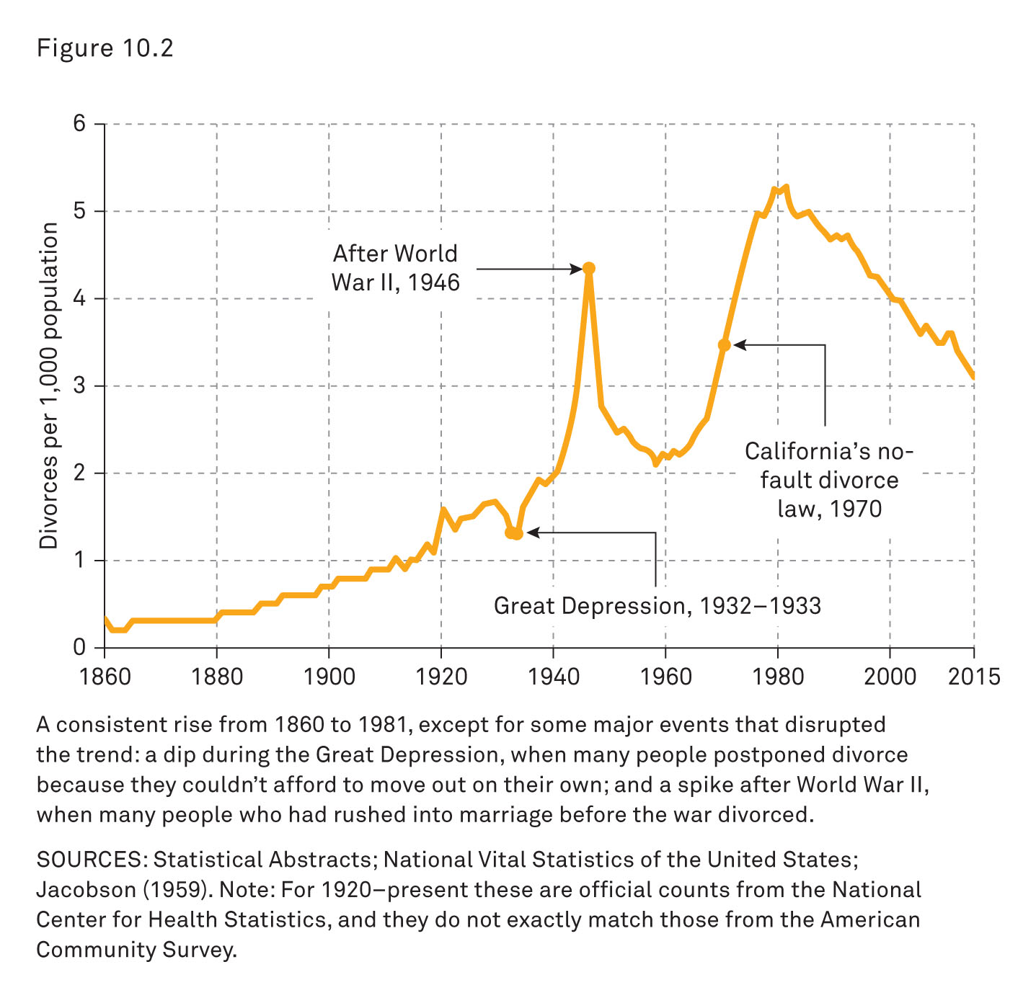
Divorce Rates and Trends
Notes:
This figure shows the crude divorce rate from 1860 to 2015 (Statistical Abstracts; National Vital Statistics of the United States; Jacobson 1959).
There has been a consistent increase in the crude divorce rate from 1860 to 1981, with the exception of a few notable events that disrupted the overall trend (e.g., the Great Depression, World War II).
It is often useful to look at sociohistorical events and analyze how they influenced the overall rate of divorce.
For example, it is noted that during the Great Depression, many individuals postponed divorce because they could not afford to live on their own.
Similarly, after World War II, there was a significant spike in the divorce rate when many couples who had quickly married before the war divorced now the war was over.

Slide 11
Divorce, Remarriage, and Blended Families: Refined Divorce Rate
For the Children’s Sake
Church and State
Divorce Rates and Trends
Crude Divorce Rate
Refined Divorce Rate
Notes:
The refined divorce rate tells us how many divorces there are for every 1,000 married couples in the country.
This rate tells us how common divorce is among married couples specifically, not just in the entire population.
This figure can be further broken down by education, race, ethnicity, and so on.

Slide 12
Divorce, Remarriage, and Blended Families: Divorce-Marriage Ratio
For the Children's Sake
Church and State
Divorce Rates and Trends
Crude Divorce Rate
Refined Divorce Rate
Divorce-Marriage Ratio
Notes:
This number is what many people refer to as the divorce rate.
It is the probability or odds of a married couple getting divorced in the future.
Although it is impossible to predict the future, there are two measures that can help provide a good generalization:
Look at the marriage and divorce history of older people today.
Calculate what would happen if a recent year happened over and over again.
Regardless of how divorce is calculated or counted, its occurrence is still much higher than it was for the past 150 years.

Slide 13
Divorce, Remarriage, and Blended Families: Divorce Revolution
For the Children’s Sake
Church and State
Divorce Rates and Trends
The Divorce Revolution
Notes:
During the period from 1960 to 1980, there was a dramatic increase in divorce that was termed the divorce revolution (Weitzman 1985).
Divorce reform
The liberalization of family law and the rise of no-fault divorces
Spread during the 1970s
Went from legal control to the voluntary arrangement between individuals
Marriage was legally recognized as a voluntary contract between two individuals.
New laws, voluntary arrangement
Reforms to the legal system were influenced by the feminist movement and geared toward emancipating women from traditions and laws that reinforced gender inequality.
Legal to get a divorce for personal reasons rather than making an accusation or charge against the other party
Either spouse could demand a divorce and did not need a specific reason

Slide 14
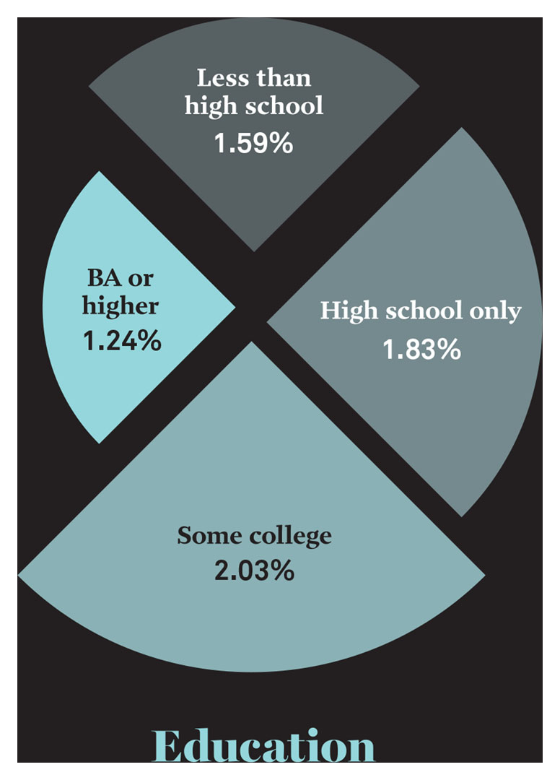
The Story behind the Numbers: Differences in Divorce Rates #1
Notes:
This figure shows the percentage of marriages that ended in divorce in 2015, broken down by level of education.
Source: Cohen’s tabulation of data from the 2015 American Community Survey (Ruggles et al. 2016).
Use this slide before or after the next slide for peer instruction.

Slide 15
The Story behind the Numbers: Question 1
1. In 2015, there were 1.1 million divorces. What percentage of people with only a high school degree got divorced?
1.4 percent
1.7 percent
1.8 percent
2.4 percent
Notes:
Answer: C
Discussion: Divorces are less common among college graduates than among those with other levels of education. Perhaps this is, in part, due to them being older when they get married. The longer people have been married, the less likely they are to divorce.
In class discussion, small group sessions, or as an individual-response exercise, have students respond to each of the following questions.
Note: there are four questions or categories in all.
Instructors may choose any number of slides for this particular “Story behind the Numbers” exercise.
Have students use clickers or colored cards to answer each question.
Alternately, have students respond to each other in small groups and compare answers.
The questions may be used all together or individually (time permitting).
The instructor may choose to display the aggregate responses either before or after discussion.
Or the instructor may choose to simply display the aggregate responses with no discussion (and leave the reflection to the students).

Slide 16
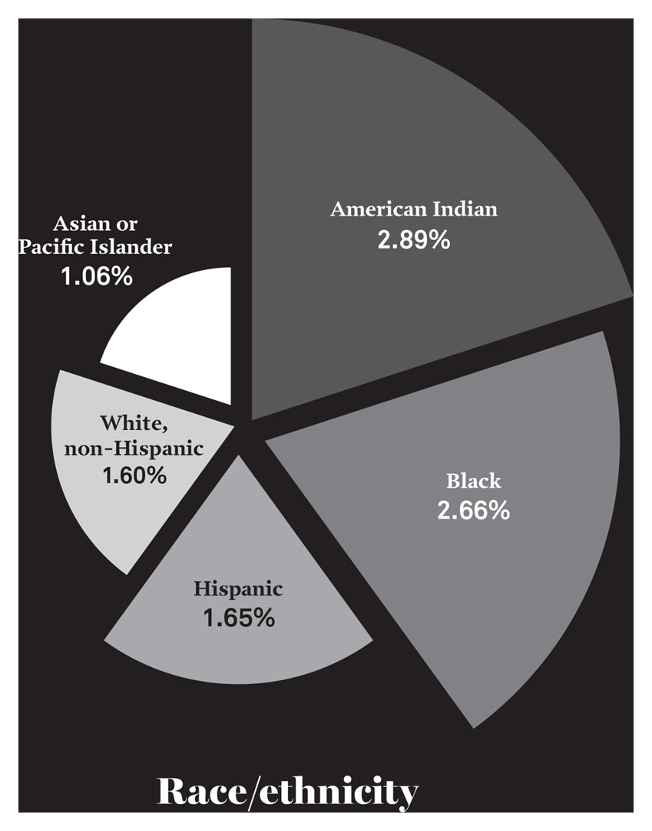
The Story behind the Numbers: Differences in Divorce Rates #2
Notes:
This figure shows the percentage of marriages that ended in divorce in 2015, broken down by race or ethnicity.
Source: Cohen’s tabulation of data from the 2015 American Community Survey (Ruggles et al. 2016).
Use this slide before or after the next slide for peer instruction.

Slide 17
The Story behind the Numbers: Question 2
2. In 2015, there were 1.1 million divorces. What percentage of American Indian couples divorced in 2015?
1.66 percent
1.65 percent
2.03 percent
2.89 percent
Notes:
Answer: D
In class discussion or small-group sessions, or as an individual-response exercise, have students respond to each of the following questions.
Note: there are four questions or categories in all.
Instructors may choose any number of slides for this particular “Story behind the Numbers” exercise.
Have students use clickers or colored cards to answer each question.
Alternately, have students respond to each other in small groups and compare answers.
The questions may be used all together or individually (time permitting).
The instructor may choose to display the aggregate responses either before or after discussion.
Or the instructor may choose to just display the aggregate responses with no discussion (and leave the reflection to the students).

Slide 18
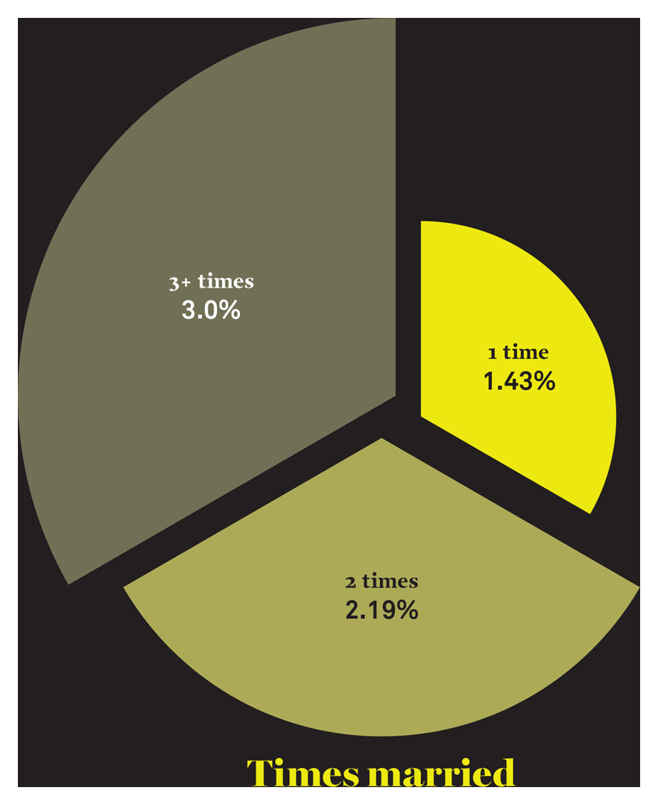
The Story behind the Numbers: Differences in Divorce Rates #3
Notes:
This figure shows the percentage of marriages that ended in divorce in 2015, broken down by the number of times survey responders were married.
Source: Cohen’s tabulation of data from the 2015 American Community Survey (Ruggles et al. 2016).
Use this slide before or after the next question (slide) for peer instruction (PI).

Slide 19
The Story behind the Numbers: Question 3
3. In 2015, there were 1.1 million divorces. What is the divorce percentage in 2015 of individuals who had only been married one time?
1.43 percent
2.69 percent
3.30 percent
Notes:
Answer: A
In class discussion or small-group sessions, or as an individual-response exercise, have students respond to each of the following questions.
Note: there are four questions or categories in all.
Instructors may choose any number of slides for this particular “Story behind the Numbers” exercise.
Have students use clickers or colored cards to answer each question.
Alternately, have students respond to each other in small groups and compare answers.
The questions may be used all together or individually (time permitting).
The instructor may choose to display the aggregate responses either before or after discussion.
Or the instructor may choose to just display the aggregate responses with no discussion (and leave the reflection to the students).

Slide 20
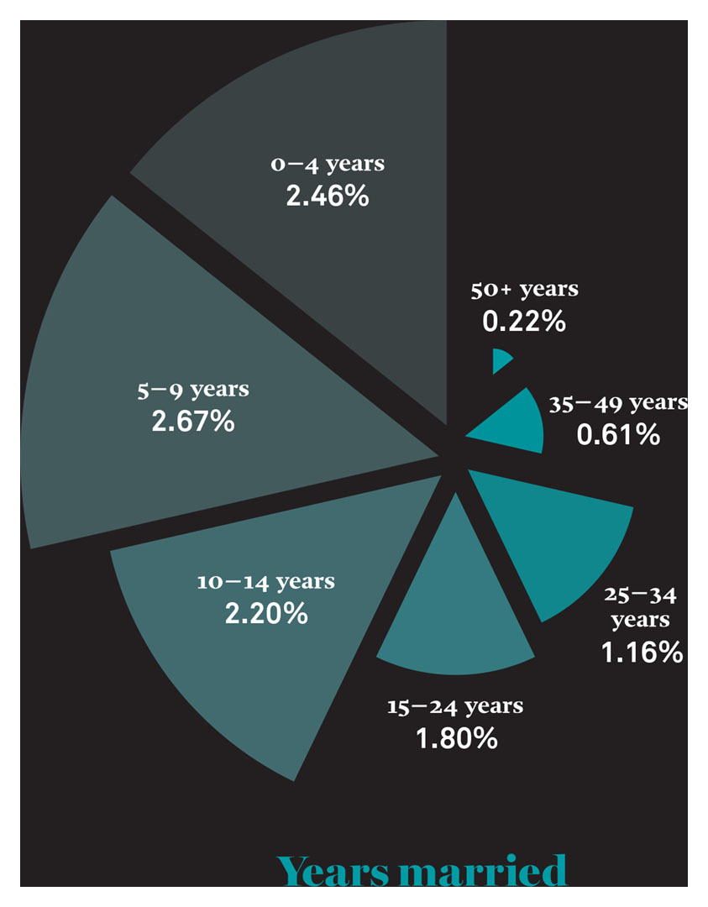
The Story Behind the Numbers: Differences in Divorce Rates #4
Notes:
This figure shows the percentage of marriages that ended in divorce in 2015, broken down by the number of years married.
Source: Cohen’s tabulation of data from the 2015 American Community Survey (Ruggles et al. 2016).

Slide 21
The Story behind the Numbers: Question 4
4. In 2015, there were 1.1 million divorces. What is the divorce percentage for couples who had been married for four years or less in 2015?
0.22 percent
1.37 percent
2.23 percent
2.46 percent
Notes:
Answer: D
In class discussion, small-group sessions, or as an individual-response exercise, have students respond to each of the following questions.
Note: there are four questions or categories in all.
Instructors may choose any number of slides for this particular “Story behind the Numbers” exercise.
Have students use clickers or colored cards to answer each question.
Alternately, have students respond to each other in small groups and compare answers.
The questions may be used all together or individually (time permitting).
The instructor may choose to display the aggregate responses either before or after discussion.
Or the instructor may choose to just display the aggregate responses with no discussion (and leave the reflection to the students).

Slide 22
Causes of Divorce: Matching Process
The Matching Process
Notes:
Although there are many causes of divorce, a sociological perspective can be useful for organizing them into categories for understanding.
Divorce can be very private and personal, but the process is also shaped by larger social forces.
There are patterns of divorce that can be studied.
For example, divorce is more common among people with less education, those who have been married previously, African Americans, and Native Americans.
However, different aspects of marriage also affect divorce.
The nature of marriage is affected by the ways in which individuals come together and form couples.
Cohabitation is an important consideration for many researchers.
The age of the individuals when they first get married is also an important consideration.

Slide 23
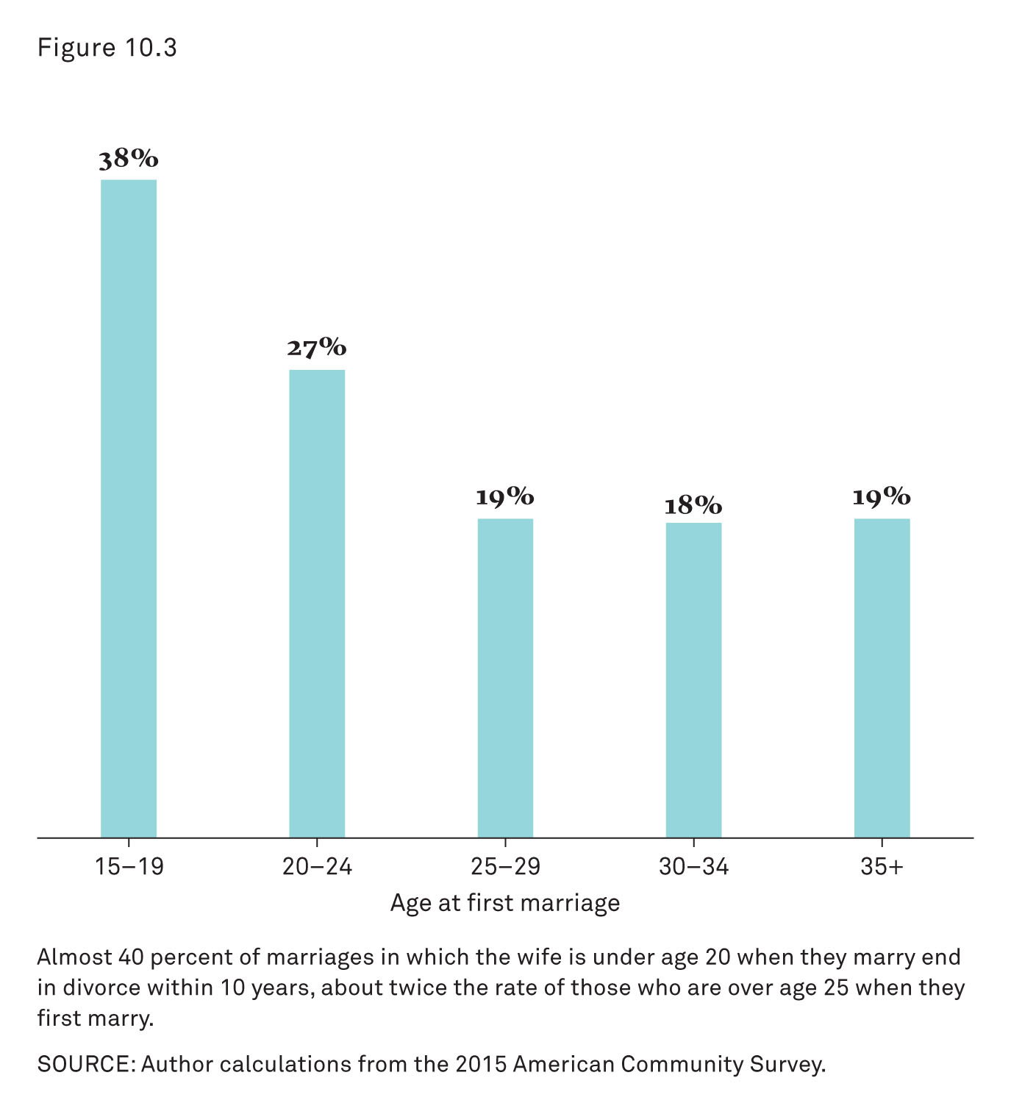
Causes of Divorce: Percentage of Divorce within the first 10 years of marriage
Notes:
This figure shows chance of divorce within the first 10 years, by wife’s age at marriage.
Almost 40 percent of marriages in which the wife is younger than 20 years when they marry end in divorce within 10 years.
This is about twice the rate of those who are older than 25 years when they first marry.
Source: Author calculations from the 2015 American Community Survey.

Slide 24
Causes of Divorce
The Matching Process
Relationship Dynamics
Couples are more likely to divorce when
they describe themselves as unhappy in their marriages.
they spend less time alone with each other.
they disagree frequently about household tasks, money, time together, sex, and in-laws.
Notes:
Conflict and unhappiness are common elements in marriages that end in divorce.
However, there are other elements of marriage relationship dynamics that can be identified as risk factors.
When studying relationship dynamics, there are key factors for divorce (Bulanda and Brown 2007).
Marriage dynamics risk factors

Slide 25
Causes of Divorce: Heated Arguments
The Matching Process
Relationship Dynamics
Couples are more likely to divorce when
they spend less time alone with each other.
they disagree frequently about household tasks, money, time together, sex and in-laws.
they have heated arguments, shout at, or hit each other.
Notes:
However, all these marriage dynamics risk factors have many sources.
And each of the risk factors may also have other factors working to counterbalance them (Kamp, Dush, and Taylor 2012).
There may be additional sources of stability, such as religion and children (although what may be a source of stability for one couple may be a risk factor for another).

Slide 26
Causes of Divorce: Employment and Independence
The Matching Process
Relationship Dynamics
Employment and Independence
Notes:
Divorce was already increasing and becoming a concern to some people by the end of the nineteenth century.
At first, social critics were concerned that women’s suffrage was contributing to higher rates of divorce.
After the “divorce revolution” of the 1970s, social critics were concerned that it was having women in the workforce that was contributing to rising divorce rates.
Thus, women’s independence was thought by some to be a contributing factor to divorce.
However, research shows that the role of women’s independence had two types of effects.
Independence can work to both strengthen and weaken marriage.
These effects are called the independence effect and the income effect (next two slides).

Slide 27
Causes of Divorce: Independence Effect
The Matching Process
Relationship Dynamics
Employment and Independence
Independence Effect
Notes:
When women and men are economically independent and have the means to survive on their own, they are more likely to leave unhappy relationships.
For women, this means if they have employment outside of the home and it can give them self-sufficiency, they are more likely to leave unhappy marriages.
This has been called the independence effect of women’s employment (Teachman 2010).
But a woman’s independence or self-sufficiency alone does not cause her to seek a divorce.
An employed woman is only more likely to divorce if she is unhappy in her marriage.
Thus, there is not evidence to suggest that a woman’s employment causes divorce (Sayer et al. 2011).

Slide 28
Causes of Divorce: Income Effect
The Matching Process
Relationship Dynamics
Employment and Independence
Income Effect
Notes:
On the other hand, independence can work to strengthen marriage, as well.
Couples with high levels of education and high incomes are less likely to get divorced (Martin 2006).
This is called the income effect of employment.
Researchers have linked having a higher income with increased stability and happiness and reduced stress.

Slide 29
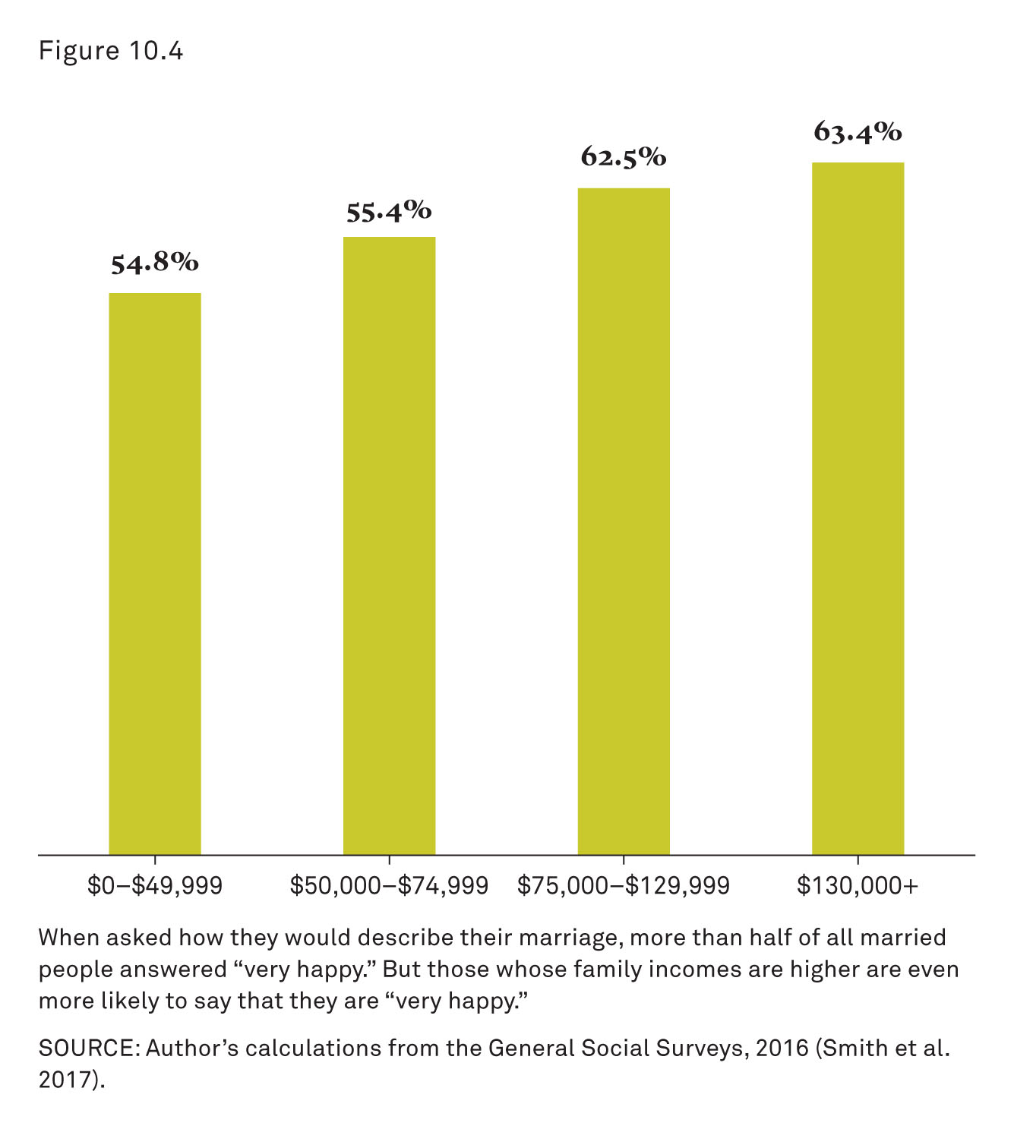
Causes of Divorce: Marital Happiness by Family Income
Notes:
When asked how they would describe their marriage, more than half of all married people answered “very happy.”
But those with higher family incomes are even more likely to answer “very happy.”
These figures can be partly explained by the independence and income effects of employment.
Source: Cohen’s calculations from the General Social Surveys, 2016 (Smith et al. 2017).

Slide 30
Consequences of Divorce
Adults’ Happiness
Notes:
Divorce is not usually an intended outcome of marriage and is generally seen as a negative event.
But divorce may be a better alternative to unhappy marriage situations, especially ones that involve violence, abuse, or neglect.
Researchers examine negative and positive outcomes and consequences of divorce.

Slide 31
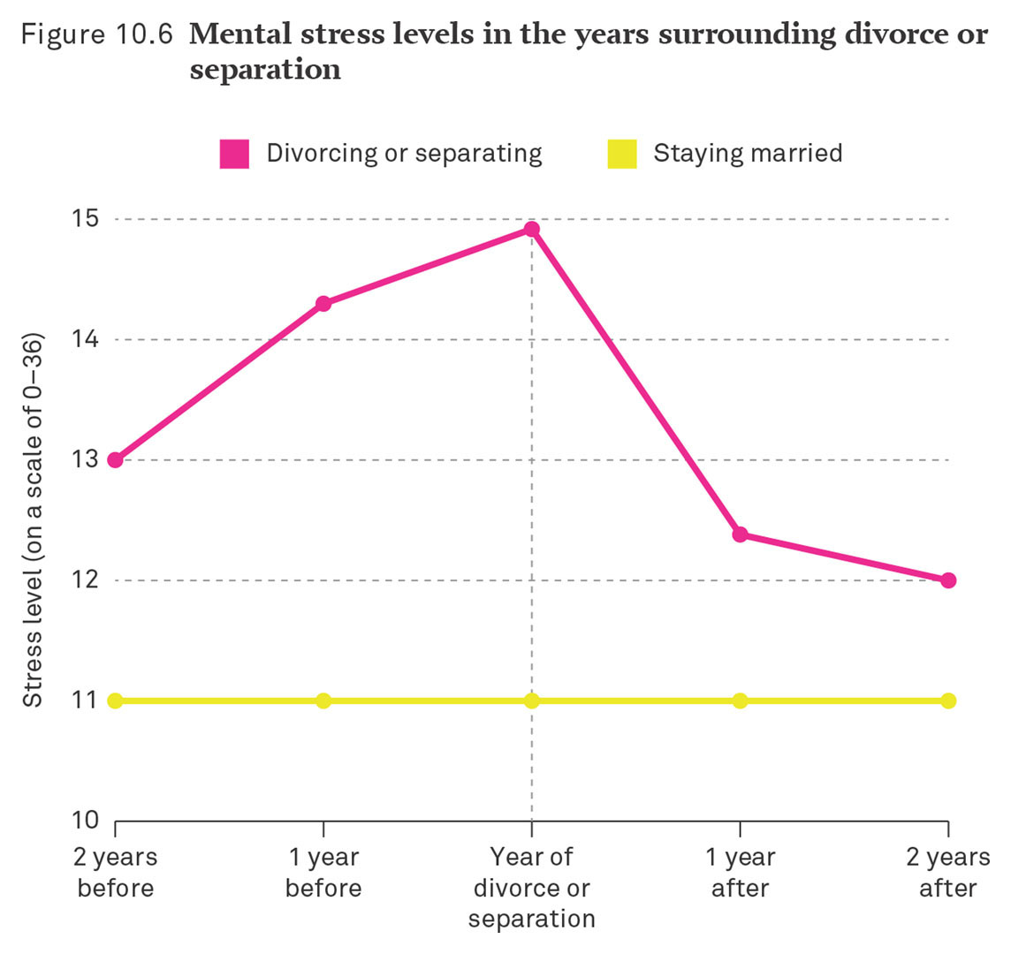
Consequences of Divorce: Mental Stress Levels in the Years Surrounding Divorce or Separation
Notes:
Source: Adapted from Gardner and Oswald (2006).
Stress levels rise and are higher before divorce or separation.
After divorce or separation, stress levels fall back to a level near that of stably married adults.

Slide 32
Consequences of Divorce: Economic Status
Adults’ Happiness
Economic Status
Notes:
Consider the divorce scenario outlined in the figure on the following slide. Even when men pay child support, divorce almost always lowers a woman’s household income.

Slide 33
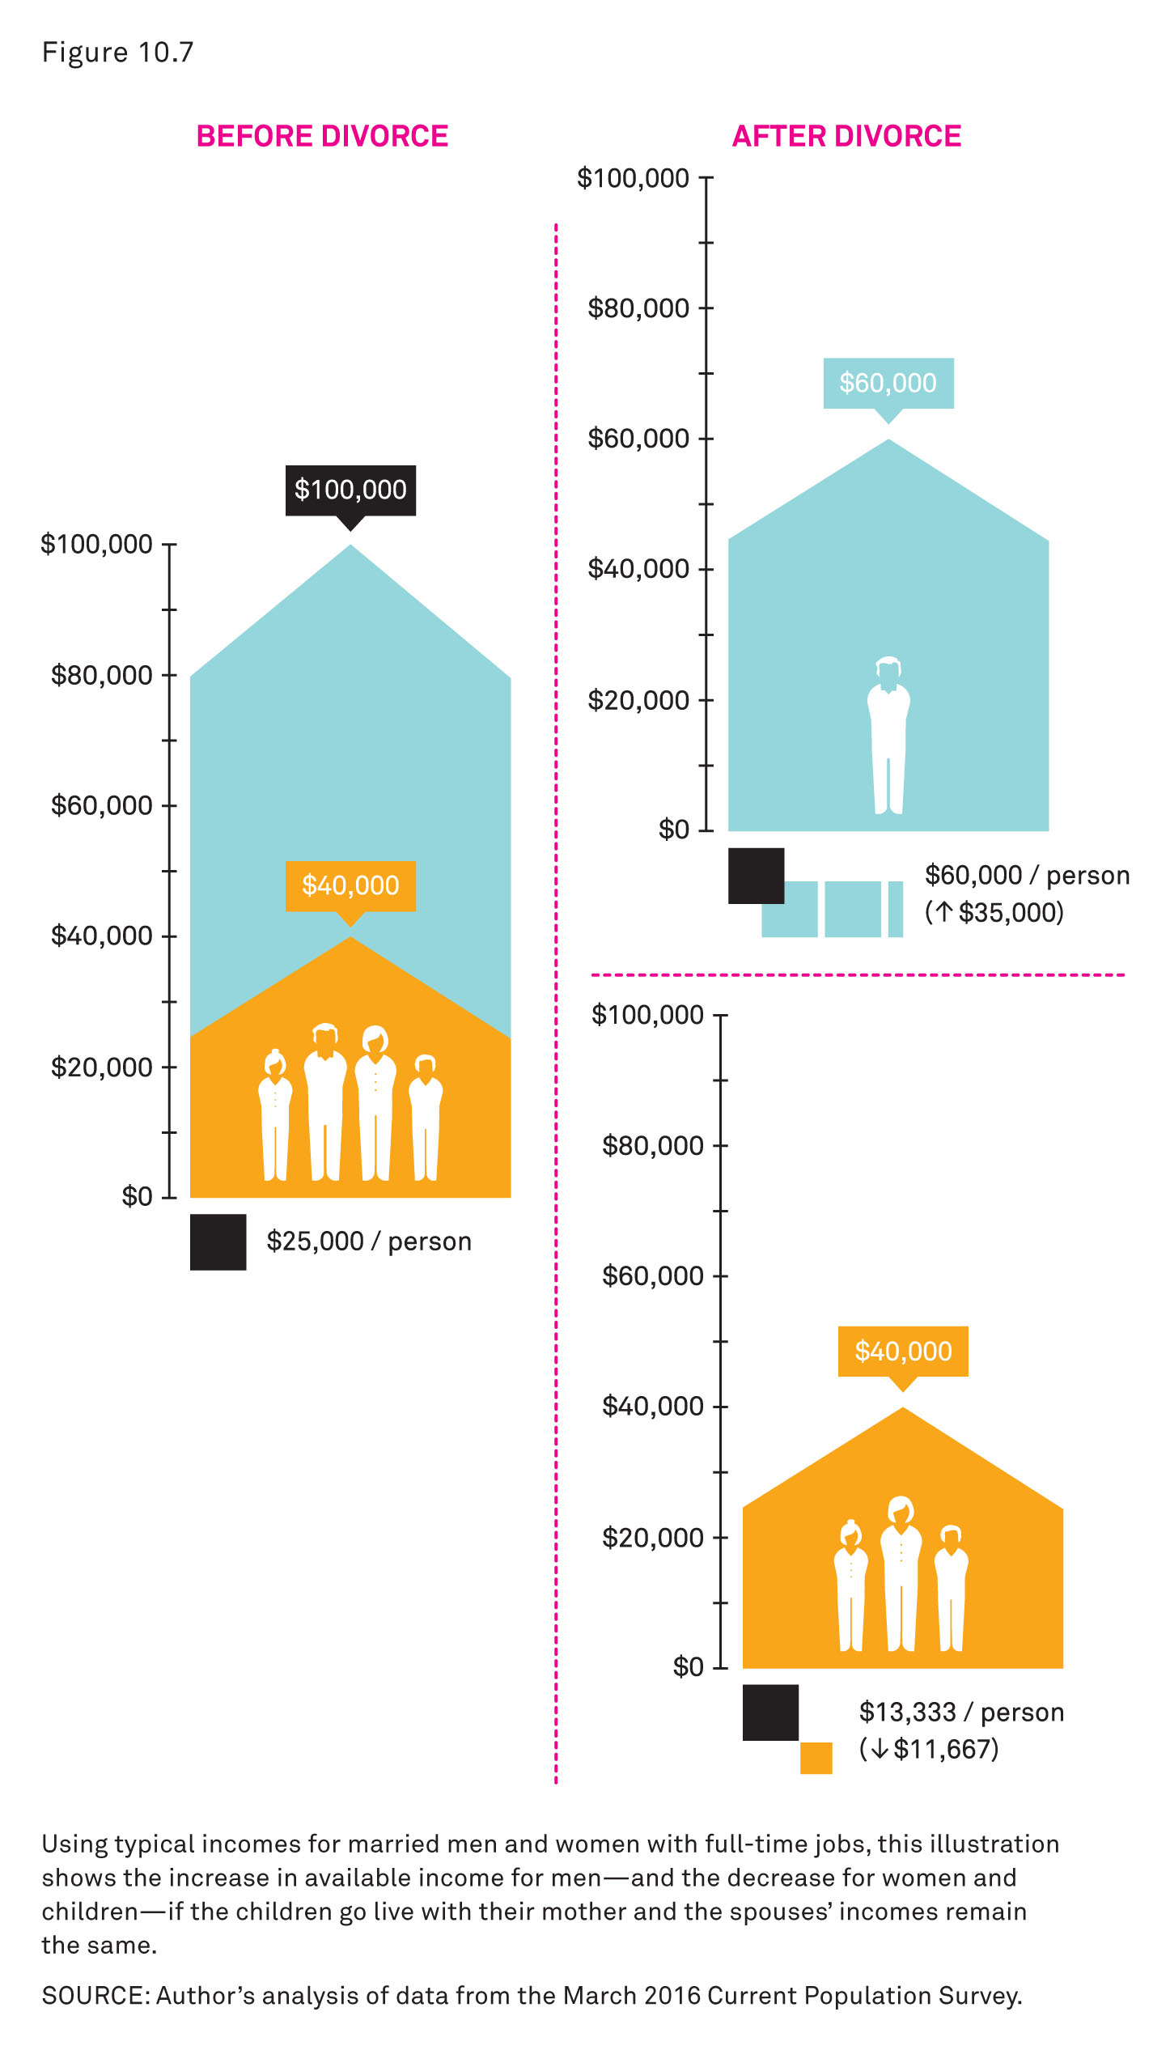
Consequences of Divorce: Breaking Up a Household
Notes:
Compares “typical” incomes for married men and women with full-time jobs before and after a divorce
This shows the increase in available income for men and the decrease in the available income for women and children if the children live with the mother and the spouses’ incomes remain the same.
Source: Cohen’s analysis of data from the March 2016 Current Population Survey.

Slide 34
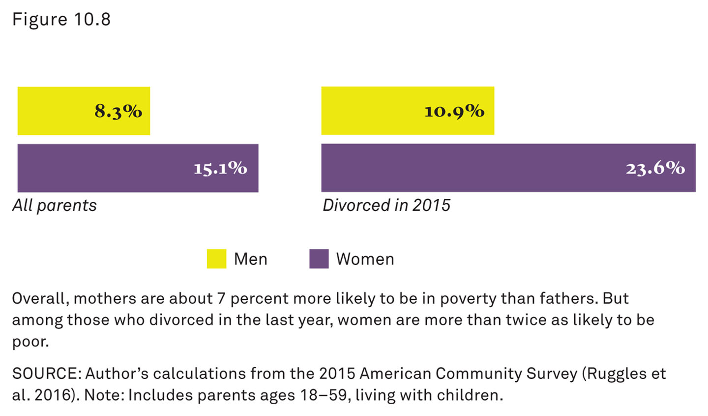
Consequences of Divorce: Poverty and Divorce
Notes:
Overall, mothers are about 7 percent more likely to be in poverty than fathers.
But among those who divorced in the last year, women are more than twice as likely to be poor.
This gender difference in poverty rates is a crucial feature of the consequences of divorce, especially for children.
Source: Author’s calculations from the 2015 American Community Survey (Ruggles et al. 2016).

Slide 35
Consequences of Divorce: Children’s Well-Being
Adults’ Happiness
Economic Status
Children’s Well-Being
Notes:
Divorce has many effects on children.
These effects can be both direct and indirect and may be both negative and positive.
There is no simple way to generalize the experiences of divorce for children because divorce is more of a process than a single event.

Slide 36
Consequences of Divorce: Moves and Hardship
Adults’ Happiness
Economic Status
Children’s Well-Being
Divorce Stressors for Children:
Less parental time and energy
Losing contact with one parent for periods of time
Witnessing or being part of conflicts
Residential moves, job and school transitions, and economic hardship
Notes:
Sociologist Paul Amato (2010) divides potential divorce stressors for children into three categories:
Stressful aspects of the divorce process
Protective factors to help prevent negative effects
Post-divorce outcomes
The following four slides outline divorce stressors for children.
Children often experience less parental time, less parental energy, and less parental patience for the normal aspects of parenting.
There is sometimes less time with parents altogether (Cooper et al. 2009).
Children may also lose contact with one parent for potentially long periods of time.
Children may also be witnesses or a part of conflicts, including arguing or shouting.
These conflicts may occur for a long time, even after the divorce.
Children may be required or forced to move homes and or schools.
They may also witness similar upheaval with adults.

Slide 37
Consequences of Divorce: Attentive Parenting
Adults’ Happiness
Economic Status
Children’s Well-Being
Protective Factors for Children
Coping skills, interpersonal skills, and self-confidence
Economic, educational, or other resources that help families buffer children
Attentive parenting, diminished conflict, and continued involvement of both parents after the divorce
Notes:
Protective factors for children

Slide 38
Consequences of Divorce: New Roles and Identities
Adults’ Happiness
Economic Status
Children’s Well-Being
Common Outcomes for Children
Short-term emotional or behavioral reactions or school problems
Permanent emotional changes
New roles and identities in the family or social environment
Notes:
Common outcomes for children

Slide 39
Remarriage and Blended Families
Defining Ambiguity
Notes:
For many U.S. individuals and families, remarriage is a part of the modern family arrangement.
Cohen has found that most people who divorce eventually remarry, and most new marriages involve at least one partner who was previously married.
Thus, the combination of children and spouses from previous marriages form a wide variety of new family types.
And there can be confusion about what to call these new family members.
Traditionally, the word step was added to a kin label to indicate that a family member was related by marriage and not by blood (i.e., genetically).
Today, the word step is also used even in relationships that do not involve formal marriage.
It can become even more complicated when the state becomes involved or unrelated family members adopt children.
Some states have even created legal definitions for new types of family members and arrangements with accompanying rights and responsibilities (Pollet 2010).
The following are definitions Cohen uses in the text.

Slide 40
Remarriage and Blended Families: Stepparent
Defining Ambiguity
Stepparent: The spouse or committed partner of one’s biological or adoptive parent
Stepchild: The child of one’s spouse or committed partner
Notes:
In terms of the new family arrangements, the words stepparent and stepchild are used for parents in relation to children.
Steprelations do not have a biological relationship but are related through marriage or a similar level of commitment.
A stepparent is the “spouse or committed partner of one’s biological or adoptive parent.”
A stepchild is “the child of one’s spouse or committed partner.”

Slide 41
Remarriage and Blended Families: Stepsibling Definition
Defining Ambiguity
Stepsibling (Stepbrother or Stepsister): The child (son or daughter) of one’s stepparent
Half-Sibling (Half-Brother or Half-Sister): The biological child of one’s parent and another person
Notes:
For the brother and sister relationships, siblings follow the same type of pattern as stepparent and stepchild.
A stepsibling is “the child (either son or daughter) of one’s stepparent who is not related biologically.”
A stepsibling is different from a half-sibling.
A half-sibling is the “biological child of one’s parent and another person.”
Half-siblings share only one biological parent.

Slide 42
Remarriage and Blended Families: Blended Family Definition
Defining Ambiguity
Blended Family: Any family that includes stepparents, stepsiblings, or half-siblings
Notes:
Cohabiting, nonmarried families add to the ambiguity.
Some families may recognize the connection between cohabitating partners and children; others may not.
This text includes cohabitating and married family arrangements for the purposes of establishing definitions.
Thus, for Cohen, a blended family is “any family that includes stepparents, stepsiblings, or half-siblings.”
The word blended indicates that a family is made up of several family types and implies that more than one family is combined (and it involves at least one “outside” member of the family who is not related to everyone).

Slide 43
Remarriage and Blended Families: Boundary Ambiguity Definition
Defining Ambiguity
Boundary Ambiguity: The situation in which family members do not know or do not agree on who is in the family and what role each person plays
Notes:
Furthermore, knowing exactly who is and is not included in one’s family is important, especially for children.
For children, the establishment of trust and boundaries is an important part of a healthy childhood development.
It is also important for everyone involved in the family to agree on these boundaries.
When these family boundaries are confused or burred, it creates a situation of boundary ambiguity.
Boundary ambiguity occurs when “family members do not know or do not agree on who is in the family and what role each person plays (Carroll, Olson, and Buckmiller 2007).
These boundaries can become increasingly more complicated with more family members and with changing family arrangements and living situations.
Boundary ambiguity can be a problem with some same-sex couples (and their blended families) who are not allowed to legally marry.
These boundary ambiguities can exist inside and outside the family.

Slide 44
Remarriage and Blended Families: Who Remarries?
Defining Ambiguity
Who Remarries?
Notes:
As noted by Cohen earlier in the chapter, most people remarry.
The United States has a high divorce rate, but it also has a high rate of remarriage.
There is also a changing pattern of remarriage as attitudes about remarriage change and demographic shifts occur.

Slide 45
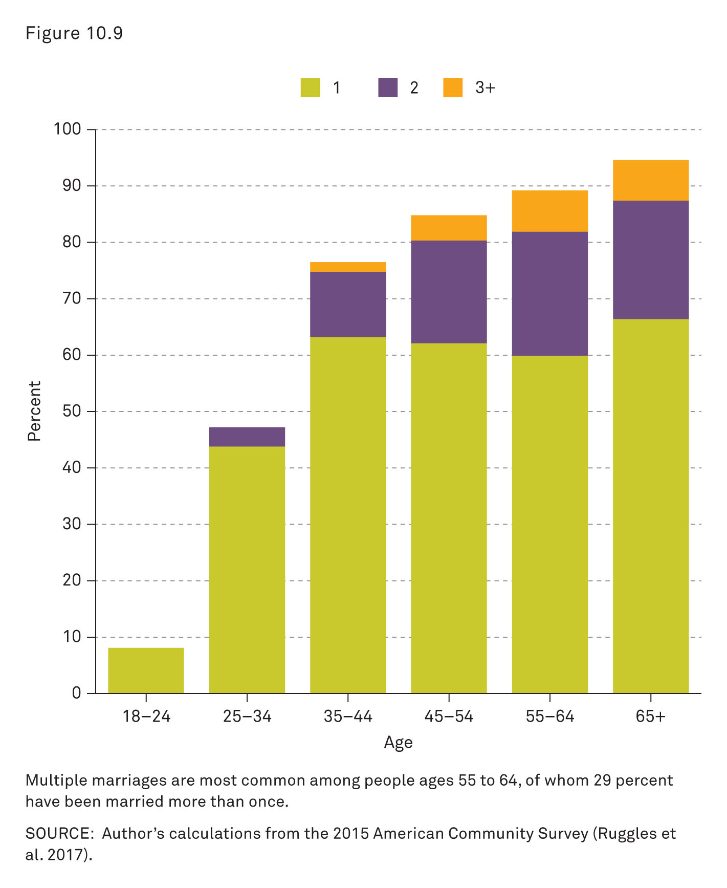
Remarriage and Blended Families: Number of Times Married
Notes:
Multiple marriages are most common for individuals ages 55 to 64 years.
Of individuals ages 55 to 65 years, one-third have been married more than once.
Most of these individuals were married for the first time in the 1970s and their marriages were the most likely to end in divorce.
In addition to having a high rate of remarriage and divorce, this generation also had the highest rate of cohabitation.
Source: Author’s calculations from the 2015 American Community Survey (Ruggles et al. 2017).

Slide 46
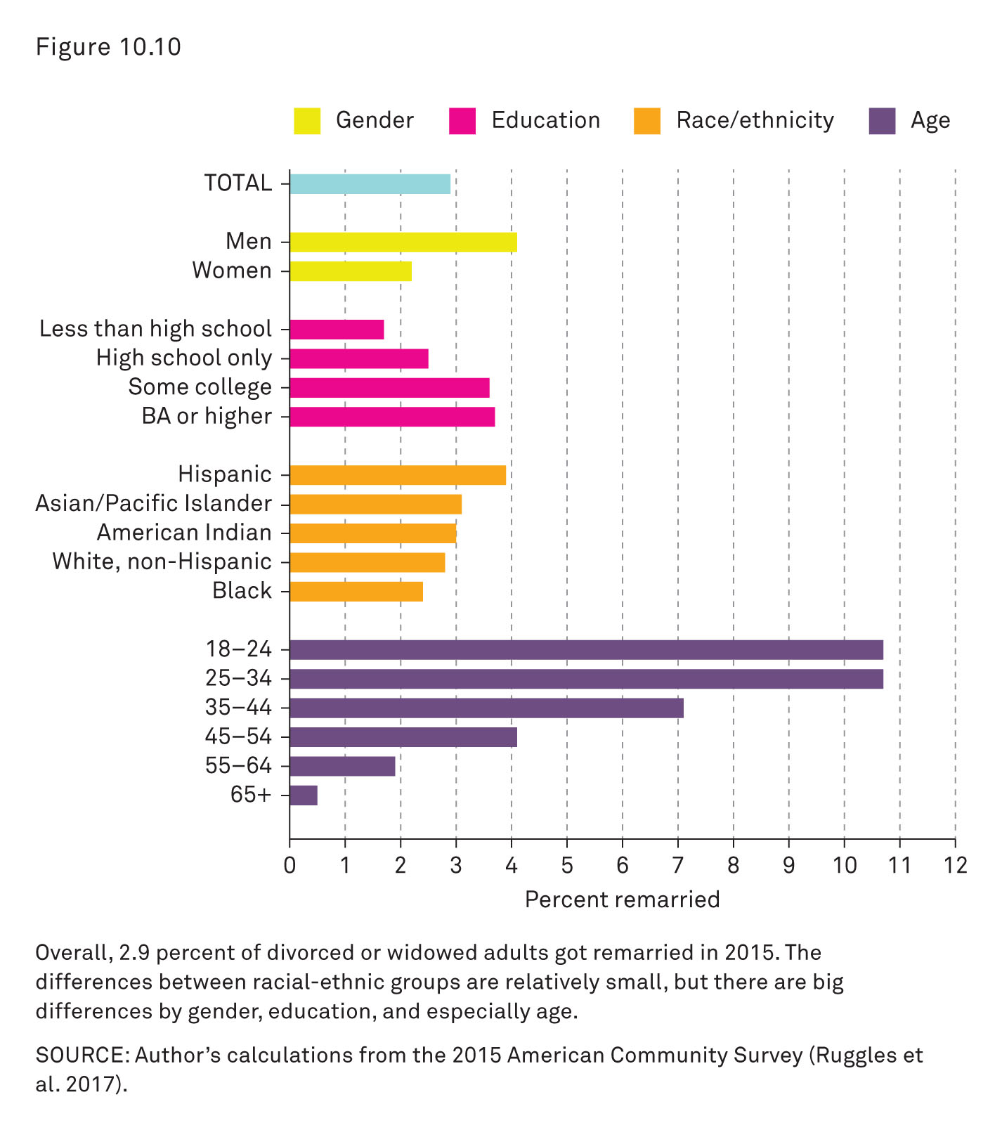
Remarriage and Blended Families: Percent Getting Remarried
Notes:
Even though divorce is often viewed as a negative event, the stigma of divorce does not seem to deter remarriage very much.
Overall, 2.9 percent of divorced or widowed adults got remarried in 2015.
The differences between racial and ethnic groups are relatively small.
However, there is a large difference by gender, education, and, especially, age.
Source: Author’s calculations from the 2015 American Community Survey (Ruggles et al. 2017).

Slide 47
Remarriage and Blended Families: Challenges
Defining Ambiguity
Who Remarries?
Challenges for Blended Families
Notes:
More children today are living in blended families than at any point in the past.
As the prevalence of blended families has increased, so have the problems of boundary ambiguity and defining the terms and roles for new family members.
Growing diversity of family forms has also created challenges of identity for individuals.
There are also benefits, including increased personal freedom for some individuals, especially women.

Slide 48
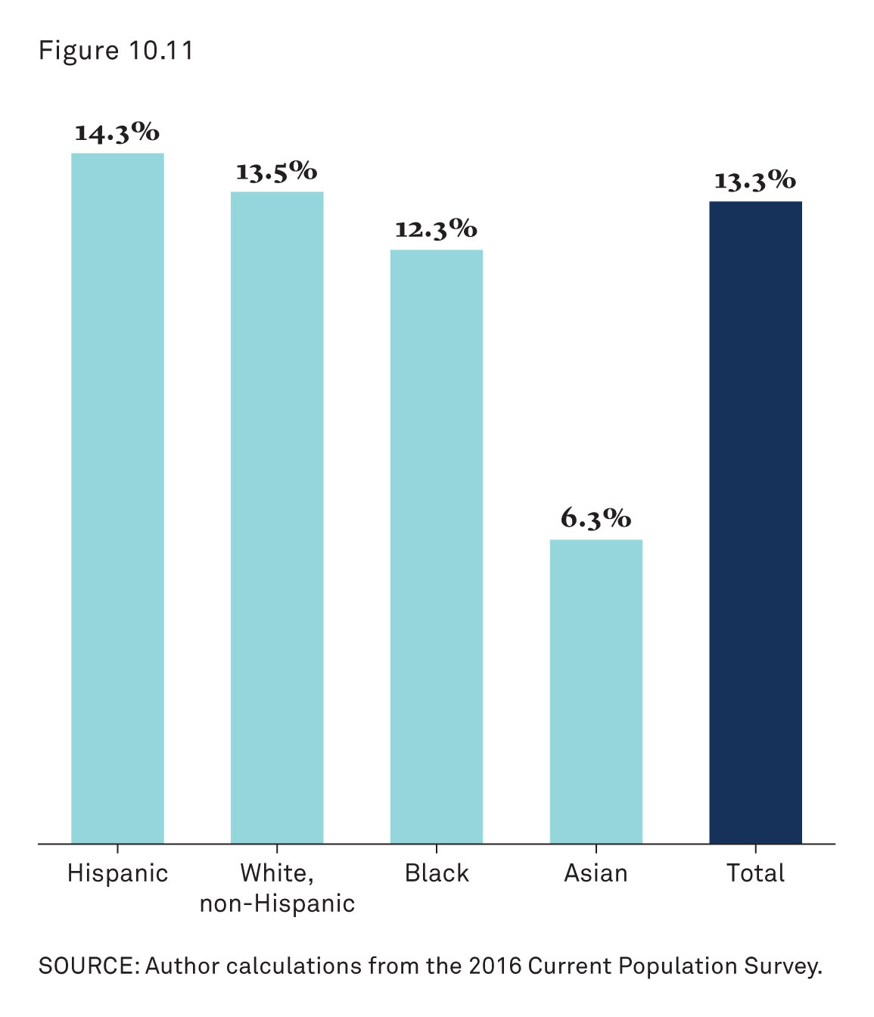
Remarriage and Blended Families: Children Living in Blended Families
Notes:
This figure shows the percentage of children living in blended families.
13 percent of children now live in blended families.
Hispanic children are more likely to experience blended families.
Source: Author calculations from the 2016 Current Population Survey.

Slide 49
Gray Divorce
Gray divorce revolution: Over the two decades leading up to 2010, the divorce rate of people older than 50 years doubled
Notes:
Today’s divorce after age 50 years is likely to be ending a second or third marriage.
Half of those older than 50 years who divorced in 2015 were married two or more times, compared with just one in four of those younger than 50 years.
The question for the future is whether this generation (i.e., baby boomers) is unique, or whether divorce at older ages will become a more permanent or even increasing feature of the family landscape.

Slide 50
Workshop: When Is Enough Enough? 1.1
1. Is divorce acceptable for couples with children?
always
sometimes
rarely
never
Notes:
In class discussion or small-group sessions, or as an individual-response exercise, have students respond to each of the following questions.
Note: there are 15 questions and one blank slide to be filled out by the instructor. Instructors may choose any number of slides for this particular workshop.
Have students use clickers or colored cards to answer the question.
Alternately, have students respond to each other in small groups and compare answers.
The questions may be used all together or individually (time permitting).
The instructor may choose to display the aggregate responses either before or after discussion.
Or the instructor may choose to just display the aggregate responses with no discussion (and leave the reflection to the students).
Other questions for the class (or individuals) to consider:
What is the range of differences within the class or group?
What do you think is the source of the differences of opinion?

Slide 51
Workshop: When Is Enough Enough? 1.2
2. Is divorce acceptable for couples without children?
always
sometimes
rarely
never
Notes:
Have students use clickers or colored cards to answer the question.
Alternately, have students respond to each other in small groups and compare answers.
The questions may be used all together or individually (time permitting).
The instructor may choose to display the aggregate responses either before or after discussion.
Or the instructor may choose to just display the aggregate responses with no discussion (and leave the reflection to the students).

Slide 52
Workshop: When Is Enough Enough? 1.3
3. Is divorce acceptable when there is unhappiness in the marriage?
always
sometimes
rarely
never
Notes:
Have students use clickers or colored cards to answer the question.
Alternately, have students respond to each other in small groups and compare answers.
The questions may be used all together or individually (time permitting).
The instructor may choose to display the aggregate responses either before or after discussion.
Or the instructor may choose to just display the aggregate responses with no discussion (and leave the reflection to the students).

Slide 53
Workshop: When Is Enough Enough? 1.4
4. Is divorce acceptable when love fades and couples grow apart?
always
sometimes
rarely
never
Notes:
Have students use clickers or colored cards to answer the question.
Alternately, have students respond to each other in small groups and compare answers.
The questions may be used all together or individually (time permitting).
The instructor may choose to display the aggregate responses either before or after discussion.
Or the instructor may choose to just display the aggregate responses with no discussion (and leave the reflection to the students).

Slide 54
Workshop: When Is Enough Enough? 1.5
5. Is divorce acceptable when a couple’s friends do not get along and their social lives are incompatible?
always
sometimes
rarely
never
Notes:
Have students use clickers or colored cards to answer the question.
Alternately, have students respond to each other in small groups and compare answers.
The questions may be used all together or individually (time permitting).
The instructor may choose to display the aggregate responses either before or after discussion.
Or the instructor may choose to just display the aggregate responses with no discussion (and leave the reflection to the students).

Slide 55
Workshop: When Is Enough Enough? 1.6
6. Is divorce acceptable when a couple has a poor sex life?
always
sometimes
rarely
never
Notes:
Have students use clickers or colored cards to answer the question.
Alternately, have students respond to each other in small groups and compare answers.
The questions may be used all together or individually (time permitting).
The instructor may choose to display the aggregate responses either before or after discussion.
Or the instructor may choose to just display the aggregate responses with no discussion (and leave the reflection to the students).

Slide 56
Workshop: When Is Enough Enough? 1.7
7. Is divorce acceptable when one spouse is disrespectful to or unable to get along with extended family?
always
sometimes
rarely
never
Notes:
Have students use clickers or colored cards to answer the question.
Alternately, have students respond to each other in small groups and compare answers.
The questions may be used all together or individually (time permitting).
The instructor may choose to display the aggregate responses either before or after discussion.
Or the instructor may choose to just display the aggregate responses with no discussion (and leave the reflection to the students).

Slide 57
Workshop: When Is Enough Enough? 1.8
8. Is divorce acceptable when one spouse is not carrying his or her own weight in the marriage?
always
sometimes
rarely
never
Notes:
Have students use clickers or colored cards to answer the question.
Alternately, have students respond to each other in small groups and compare answers.
The questions may be used all together or individually (time permitting).
The instructor may choose to display the aggregate responses either before or after discussion.
Or the instructor may choose to just display the aggregate responses with no discussion (and leave the reflection to the students).

Slide 58
Workshop: When Is Enough Enough? 1.9
9. Is divorce acceptable when there are irresolvable religious differences?
always
sometimes
rarely
never
Notes:
Have students use clickers or colored cards to answer the question.
Alternately, have students respond to each other in small groups and compare answers.
The questions may be used all together or individually (time permitting).
The instructor may choose to display the aggregate responses either before or after discussion.
Or the instructor may choose to just display the aggregate responses with no discussion (and leave the reflection to the students).

Slide 59
Workshop: When Is Enough Enough? 1.10
10. Is divorce acceptable when the career situation is impossible to solve for both spouses?
always
sometimes
rarely
never
Notes:
Have students use clickers or colored cards to answer the question.
Alternately, have students respond to each other in small groups and compare answers.
The questions may be used all together or individually (time permitting).
The instructor may choose to display the aggregate responses either before or after discussion.
Or the instructor may choose to just display the aggregate responses with no discussion (and leave the reflection to the students).

Slide 60
Workshop: When Is Enough Enough? 1.11
11. Is divorce acceptable when there is one instance of infidelity?
always
sometimes
rarely
never
Notes:
Have students use clickers or colored cards to answer the question.
Alternately, have students respond to each other in small groups and compare answers.
The questions may be used all together or individually (time permitting).
The instructor may choose to display the aggregate responses either before or after discussion.
Or the instructor may choose to just display the aggregate responses with no discussion (and leave the reflection to the students).

Slide 61
Workshop: When Is Enough Enough? 1.12
12. Is divorce acceptable when there is repeated infidelity or a long-running affair?
always
sometimes
rarely
never
Notes:
Have students use clickers or colored cards to answer the question.
Alternately, have students respond to each other in small groups and compare answers.
The questions may be used all together or individually (time permitting).
The instructor may choose to display the aggregate responses either before or after discussion.
Or the instructor may choose to just display the aggregate responses with no discussion (and leave the reflection to the students).

Slide 62
Workshop: When Is Enough Enough? 1.13
13. Is divorce acceptable when there is child neglect or when one spouse is not caring for a child properly?
always
sometimes
rarely
never
Notes:
Have students use clickers or colored cards to answer the question.
Alternately, have students respond to each other in small groups and compare answers.
The questions may be used all together or individually (time permitting).
The instructor may choose to display the aggregate responses either before or after discussion.
Or the instructor may choose to just display the aggregate responses with no discussion (and leave the reflection to the students).

Slide 63
Workshop: When Is Enough Enough? 1.14
14. Is divorce acceptable when there abuse or violence within the family?
always
sometimes
rarely
never
Notes:
Have students use clickers or colored cards to answer the question.
Alternately, have students respond to each other in small groups and compare answers.
The questions may be used all together or individually (time permitting).
The instructor may choose to display the aggregate responses either before or after discussion.
Or the instructor may choose to just display the aggregate responses with no discussion (and leave the reflection to the students).

Slide 64
Workshop: When Is Enough Enough? 1.15
15. Is divorce acceptable when ______?
always
sometimes
rarely
never
Notes:
Instructors can use this slide to insert an issue of their own choosing or to have students create examples (optional).

Slide 65
Review Question 1
1. Which term refers to the legal dissolution of marriage according to the laws of the state?
marital dissolution
divorce
relationship dissolution
separation
Notes:
Answer: B
Discussion: Divorce is the legal dissolution of marriage according to the laws of the state. Marital dissolution refers to the end of marriage through permanent separation or divorce but is not necessarily a legal dissolution of marriage. Separation refers to the formal or informal separation of married spouses into different households.

Slide 66
Review Question 2
2. Although divorce provides a legal dissolution of a marriage, an annulment of marriage is different because it
provides legal proof that a couple is separated for tax purposes.
provides a temporary divorce status that can be reversed for one year.
is considered a legal or religious determination that the marriage was never valid.
Notes:
Answer: C
Discussion: An annulment of marriage is a legal or religious determination that the marriage was never valid; afterward, the marriage is treated as though it never occurred. This is different than a divorce because a divorce acknowledges that at one point, the marriage was valid. Annulment is an important issue for some religious groups, especially Catholics, because remarriage in the Catholic Church is only permitted if the first marriage was annulled by the Church.

Slide 67
Review Question 3
3. How does cohabitation affect the likelihood that a couple will later divorce?
Cohabitation does not affect the chance of divorcing if the couple eventually marries.
Cohabitation before marriage decreases the likelihood that a couple will divorce.
Cohabitation before marriage increases the odds of a couple divorcing.
Notes:
Answer: A
Discussion: When taking into account complex factors involved with cohabitation, such as the length of the cohabitating relationship, we find that cohabitation does not create a higher probability for divorce as long as the couple eventually marries. Without taking these factors into account, the overall trends do show that cohabitating couples are more likely to see their relationship end than married couples.

Slide 68
Review Question 4
4. Mona and Jon are stepsiblings who live in a household with Jon’s mother, who is Mona’s stepmother, and Mona’s father, who is Jon’s stepfather. According to the textbook, their family can be considered
a boundary ambiguity.
a dynamic family.
a blended family.
an adoptive family.
Notes:
Answer: C
Discussion: Any family that includes stepparents, stepsibling, or half-siblings can be considered a blended family. The word blended implies that more than one family is mixed together, with at least one outside family member whose relationship is not shared with everyone.

Slide 69
Review Question 5
5. Research on the independence effect of women’s employment on the divorce rate indicates which of these conclusions?
Women’s employment is strongly associated with divorce for all types of marriage.
Women’s employment increases the likelihood of divorce, but only for women who are unhappy in their marriage.
Women’s employment has no effect.
Notes:
Answer: B
Discussion: Research on the independence effect of women’s employment that tracks couples over time has found that women’s employment does increase the likelihood of divorce, but only for women who are unhappy in their marriage. There is no evidence that employment increases the tendency of women to leave happy marriages.

Slide 70
The Story behind the Numbers 1
1. According to data on U.S. divorces in 2015, what is the relationship between education and the divorce rate?
Divorces are least common among college graduates compared with everyone else.
People who did not earn a high school diploma are the least likely to divorce.
There is no relationship between level of education and the divorce rate.
Notes:
Answer: A
Discussion: As the “Story behind the Numbers” infographic suggests, when considering the divorce rate and education, college graduates are the least likely to be divorced when compared with all other education groups. Those who have completed some college but did not graduate have the highest divorce rate.

Slide 71
The Story behind the Numbers 2
2. According to data on U.S. divorces in 2015, what is the relationship between racial and ethnic groups and the divorce rate?
Divorces are the least common for Whites compared with all other groups.
Divorces are the most common among American Indians and African Americans.
Divorces are the least common for Hispanics compared with all other racial or ethnic groups.
Notes:
Answer: B
Discussion: As the “Story behind the Numbers” infographic suggests, when considering the divorce rate and racial or ethnic groups, the Asian or Pacific Islander group has the lowest divorce rates, whereas American Indians and African Americans have the highest divorce rates. Whites and Hispanics have higher divorce rates than Asians and Pacific Islanders and lower rates than the other groups.

Slide 72
Lecture Slides
The Family: Diversity, Inequality, and Social Change, 2nd Edition
This concludes the Lecture Slide Set for Chapter 10
© 2018 W. W. Norton & Company, Inc.
Independent and Employee-Owned

