Slide 1
9
Families and Children
Slides by Joanna Pepin

Slide 2
Families and Children
Notes:
Children are an integral part of the cultural image of the family, and their presence (and absence) raises interesting questions about what society believes constitutes a real family.
Yet children are only one component of a family ideal.
The context or setting in which children are raised (e.g., by a single mother, by a same-sex couple, by grandparents) is also part of the image of the ideal family.

Slide 3
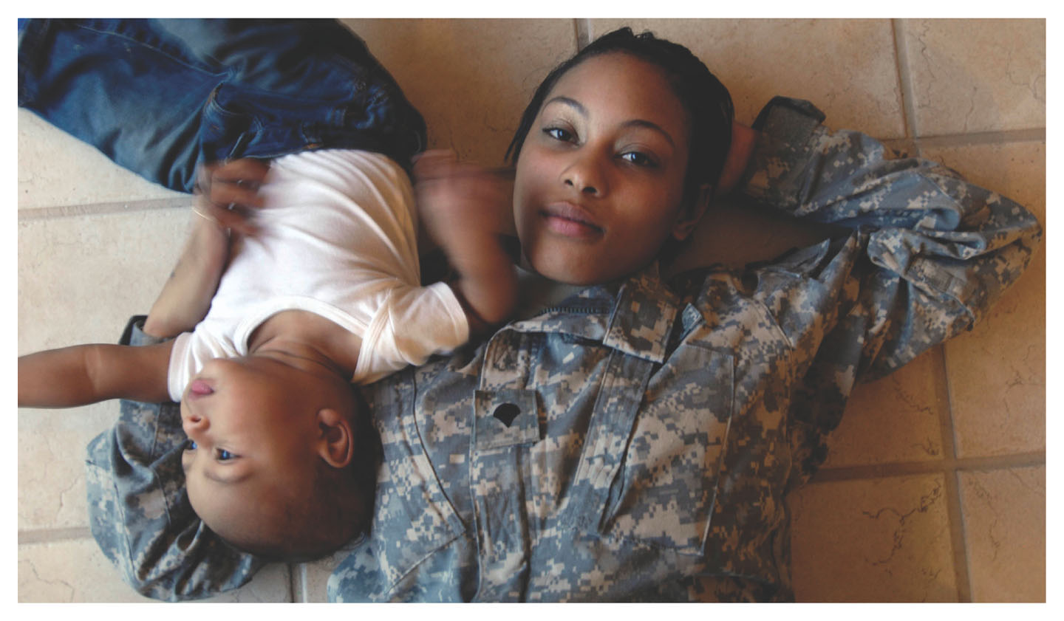
Childbearing
Notes:
Most U.S. families have one to three children; two is the average.
This is a much lower number than in the past.
Family size has been in decline for most of the twentieth century (apart from the baby boom period, 1946–1964; see Chapter 2).
But even within these simple numbers, there is a more complex story of family diversity.
In particular, the past few decades have seen several growing changes and trends.
The most important change has been the number of parents who have children outside of marriage.
There is also a trend toward single motherhood, which is generally recognized.
Other trends are not so noticeable.

Slide 4
Childbearing: Cohabitation
Childbearing Trends
About half of unmarried parents are actually living together (cohabiting) at the time of the birth.
Notes:
The organization of U.S. family life is changing dramatically, adding to its increasing diversity.
Source: U.S. Census Bureau 2015b.

Slide 5
Childbearing: More Than Two Parents
Childbearing Trends
About half of unmarried parents are actually living together (cohabiting) at the time of the birth.
Although fewer parents are married now than in the past, many children are involved with more than two parents.
Notes:
Although this may be slightly ironic, it is happening because an increasing number of families include stepparents and siblings from previous relationships.
In fact, one in five has had children with two partners or more.
Source: Monte 2017.

Slide 6
Childbearing: Women without Children
Childbearing Trends
About half of unmarried parents are actually living together (cohabiting) at the time of the birth.
Although fewer parents are married now than in the past, many children are involved with more than two parents.
The number of women reaching age 45 without having any children has doubled since the 1980s.
Notes:
More families are having their first child at older ages.
And there are more adults, singles and couples, who are spending a larger proportion of their lives without children.
Source: Abma and Martinez (2011).

Slide 7
Childbearing: Terms and Concepts
Childbearing Trends
Terms and Concepts
Notes:
These trends underscore the fact that the form and organization of U.S. family life are changing in ways that are making it increasingly diverse.
And for those families with children, the ways in which the family is structured reflect the increasing diversity of childrearing practices and family arrangements.
There also are more childless families and families with fewer children than in the past.
These highlight the decreasing role of children in family life, at least for some individuals.
The next few slides will establish some terms and concepts for the study of children in families.

Slide 8
Childbearing: Parent Definition
Terms and Concepts
Parent: An adult intimately responsible for the care and rearing of a child
Notes:
When an individual “has” a child, either biologically or by adoption, she or he becomes a parent.
In sociology and family studies, a parent is an adult intimately responsible for the care and rearing of a child.

Slide 9
Childbearing: Biological Parents
Terms and Concepts
Biological Parents: The adults whose bodies, including the father’s sperm and the mother’s egg, produce a child
Notes:
Biological parents are identified as the adults whose bodies physically produce the child (including the father’s sperm and the mother’s egg).
A woman who carries a fetus to term without providing the egg is a surrogate parent and is not considered a biological parent.

Slide 10
Childbearing: Adoptive Parents
Terms and Concepts
Adoptive Parents: People who are parents to a child they did not produce biologically
Notes:
Adoptive parents are parents to children they did not produce biologically.
U.S. adoption is usually a legal arrangement with rights, responsibilities, and obligations enforced by the government, although some stepparents or other family partner may informally take the role of an adoptive parent.
The arrangement of parents is not restricted to mother-father couples or only two parents.
There are situations where there is (sometimes legal) ambiguity.
The increase in different types of blended families can sometimes create confusion (and will be discussed more in Chapter 10).

Slide 11
Childbearing: Fertility Definition
Terms and Concepts
Fertility: The number of children born in a society or among a particular group
Notes:
When individuals are able to produce children biologically, they are often described as fertile and are compared with those who cannot have children (who are sometimes called infertile).
However, fertility means something more specific in sociology.
In sociology, fertility means “the number of children born in a society or among a particular group.”
There are many different ways to quantify the fertility rate of a society.
One of these is the total fertility rate.

Slide 12
Childbearing: Total Fertility Rate
Terms and Concepts
Total Fertility Rate: The number of children born to the average woman in her lifetime
Notes:
The total fertility rate is “the number of children born to the average woman in her lifetime.”
Fertility rates are usually measured for women because the information used for calculations is obtained from birth certificates, which do not necessarily specify the father.
The total fertility rate is useful for understanding and thinking about the overall population.
Demographers use the overall total fertility rate to estimate the replacement fertility of a country.
If a country has a total fertility rate of more than 2.1 (i.e., a rate of 2.1 children born for an average woman in her lifetime), the population will usually grow.
If the total fertility rate is lower than 2.1, the population will start to shrink.
Thus, demographers refer to a total fertility rate of 2.1 as replacement fertility.

Slide 13
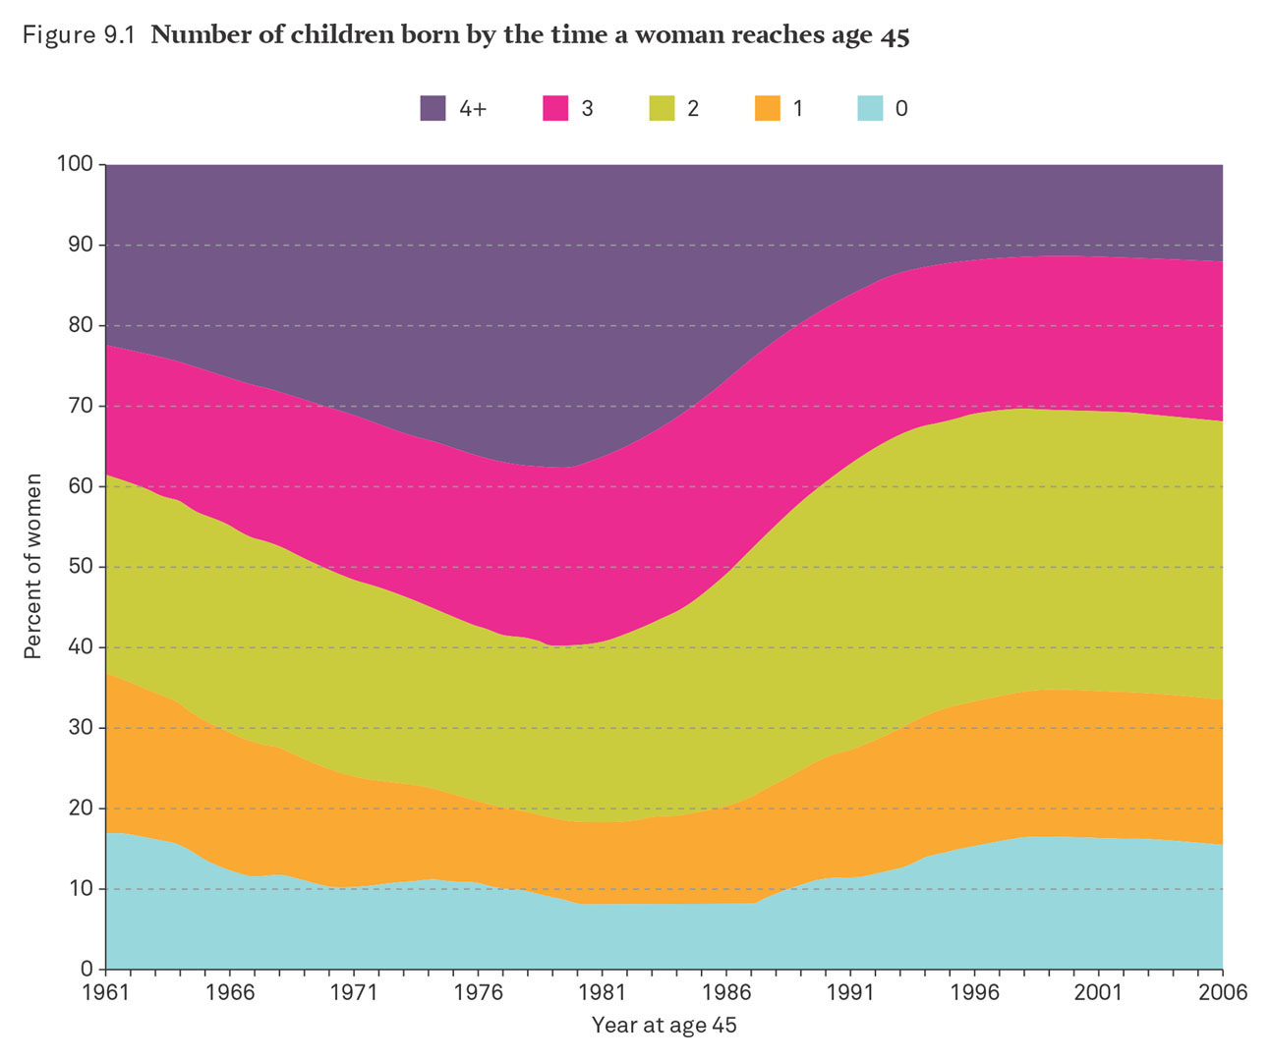
Childbearing: Number of Children Born by the Time a Woman Reaches Age 45
Notes:
This figure shows the number of children born by the time a woman reaches age 45 years.
The average number of children for the average U.S. woman is approximately two.
About one-third of women have had two children by the age of 45 years.
One-third of women have had three or more children by the age of 45 years.
One-third of women have had no children by the age of 45 years.
There are more complex patterns of childbearing related to marital status, race and ethnicity, and education.
Source: National Center for Health Statistics (2013).

Slide 14
Childbearing: Unmarried Parents
Unmarried Parents
Notes:
The increase in the number of unmarried parents is closely related to the decline of marriage (discussed in Chapter 8).
Since the 1980s, marriage rates have declined more than childbearing rates.
This has caused an increase in the number of unmarried parents.

Slide 15
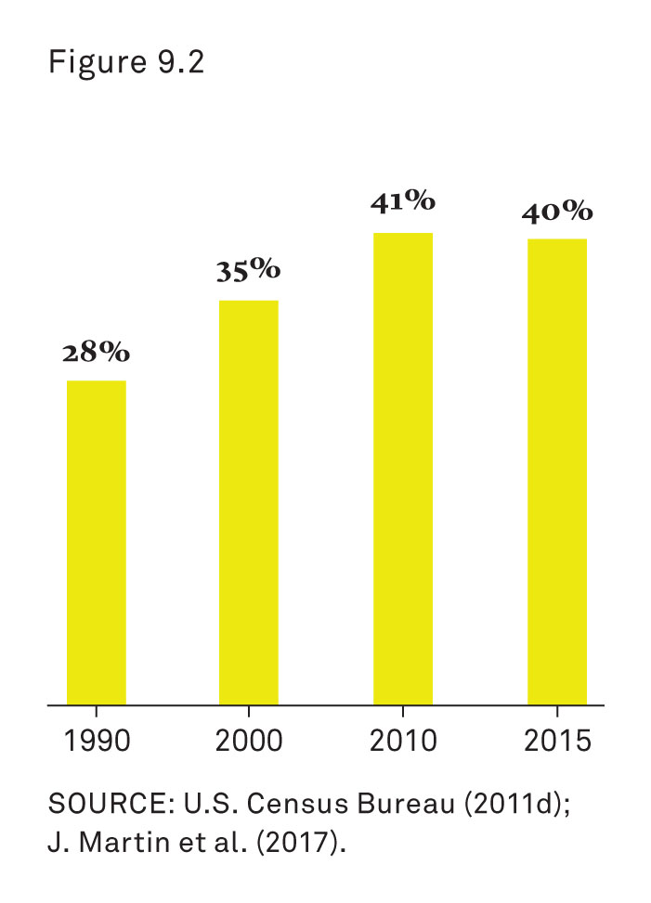
Childbearing: Percentage of Births to Unmarried Women
Notes:
This figure shows the percentage of births to unmarried women.
40 percent of all children born in the United States are born to parents who aren’t married, up from 28 percent in 1990.
However, individuals become single parents in a variety of ways.
Source: U.S. Census Bureau (2011d); Martin et al. (2017).

Slide 16
Childbearing: Young Adults
Unmarried Parents
Young adults who are not ready or willing to marry and who have children
Notes:
Young adults, with or without children, may not be ready, willing, or feel able to marry because of real or unrealistic expectations.
These individuals are more likely to be economically disadvantaged (McKeever and Wolfinger 2011).

Slide 17
Childbearing: Single Older Women
Unmarried Parents
Young adults who are not ready or willing to marry and who have children
Single older women who decide to have children
Notes:
Older women may be single either by life circumstances or choice.
Some women decide to have a child or children with or without a partner because they do not want to wait to get married or do not want to get married at all.
Although they may prefer to be married, they decide to adopt, use a sperm donor, or get pregnant using alternative arrangements.
The families in these circumstances are less likely to be poor (Hertz 2006).

Slide 18
Childbearing: Divorced Adults
Unmarried Parents
Young adults who are not ready or willing to marry and who have children
Single older women who decide to have children
Divorced adults with children
Notes:
There are individuals who are divorced who have children.
They may be in a serious relationship but are not remarried.
They may or may not get remarried, either by choice or because the complications of remarriage create obstacles for them (Brown 2000).

Slide 19
Childbearing: Race and Ethnicity
Unmarried Parents
Race and Ethnicity
Notes:
The second fertility pattern involves race and ethnicity.
Single parenthood is much more common is some racial and ethnic groups than in others.
American Indian, African-American, and Puerto Rican families are more likely to include single-parent households.
There also differences in total fertility rates among racial and ethnic groups.

Slide 20
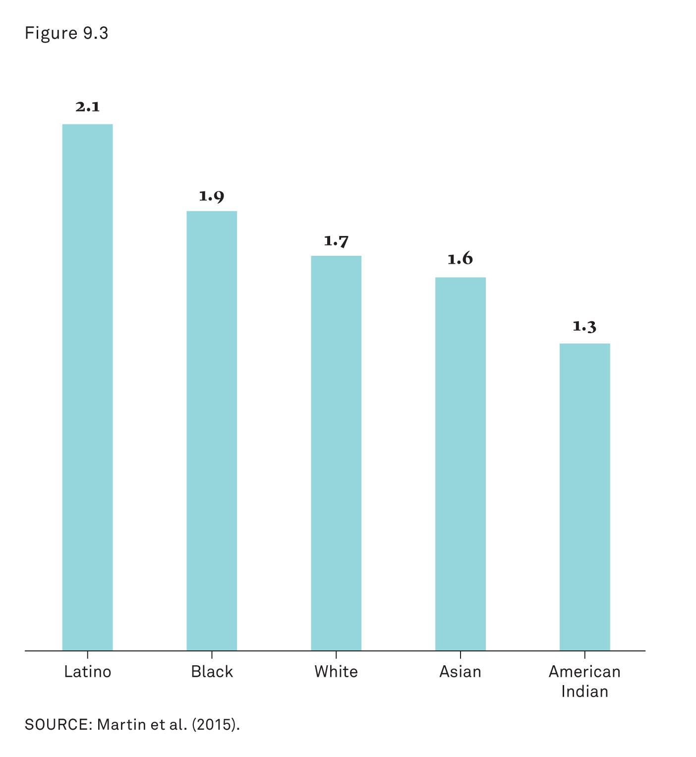
Childbearing: Total Fertility Rates
Notes:
This figure shows the total fertility rates by race and ethnicity and the expected births per women in 2010.
The total fertility rates indicate that Latina women, on average, have 2.1 children, African Americans have 1.9, and Whites, Asians, and American Indians have the fewest.
Latinas have high total fertility rates because of several factors, including immigration, demographics, and religion (explained in Chapter 3).
Source: Martin et al. (2015).

Slide 21
Childbearing: Education
Unmarried Parents
Race and Ethnicity
Education
Notes:
The third fertility pattern involves education.
Women with lower levels of education have more children (Kravdal and Rindfuss 2008).
This is true globally.

Slide 22
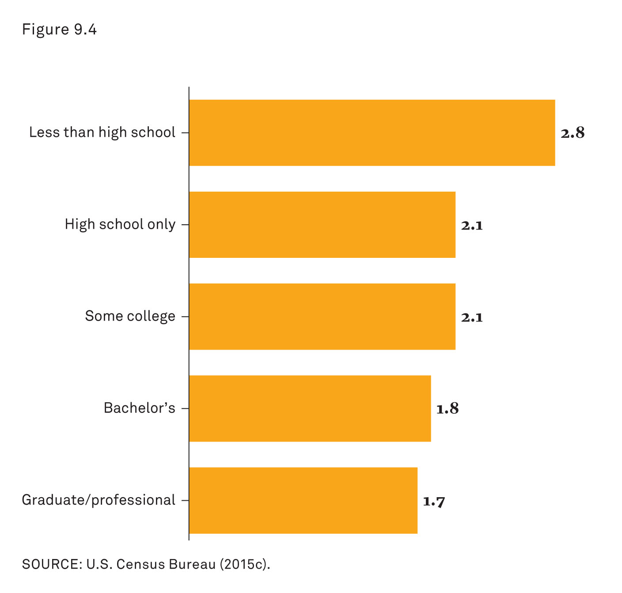
Childbearing: Average Number of Children Ever Born to Women Ages 40 to 44
Notes:
This figure shows the average number of children ever born to women ages 40 to 44 years and the mothers’ levels of education in 2014.
Women who did not finish high school have an average of 2.8 children, compared with 1.8 or fewer among those with bachelor’s degrees.
This can be partially explained by the fact that some women do not go back to school after they have children.
Some women postpone having children until after they have finished school.
As a result, those women with less education start having children earlier and end up having more children overall.
Source: U.S. Census Bureau (2015c).

Slide 23
Childbearing: Opportunity Cost Definition
Unmarried Parents
Race and Ethnicity
Education
Opportunity Cost: The price one pays for choosing the less lucrative of available options
Notes:
Also, women who have higher levels of education end up thinking about the opportunity cost of having children.
Many women in the workforce must face the choice between choosing to have children (and losing or earning a lower income) and having a career and higher income.
Deciding to have children is considered the less lucrative option and is viewed by social scientists as an opportunity cost.
The opportunity cost is greater for women with higher levels of education (and therefore, higher levels of income and occupation) than it is for women with less education.
This way of thinking implies that women (and men) carefully consider all economic options before deciding whether to have children.
And some research has shown that half of all pregnancies are considered “unintended,” meaning the woman was not trying to get pregnant (Finer and Zolna 2016).
A larger proportion of unintended births occurs among those with less education (and thus lower incomes), partly because of inadequate health care, contraception, and health education.

Slide 24
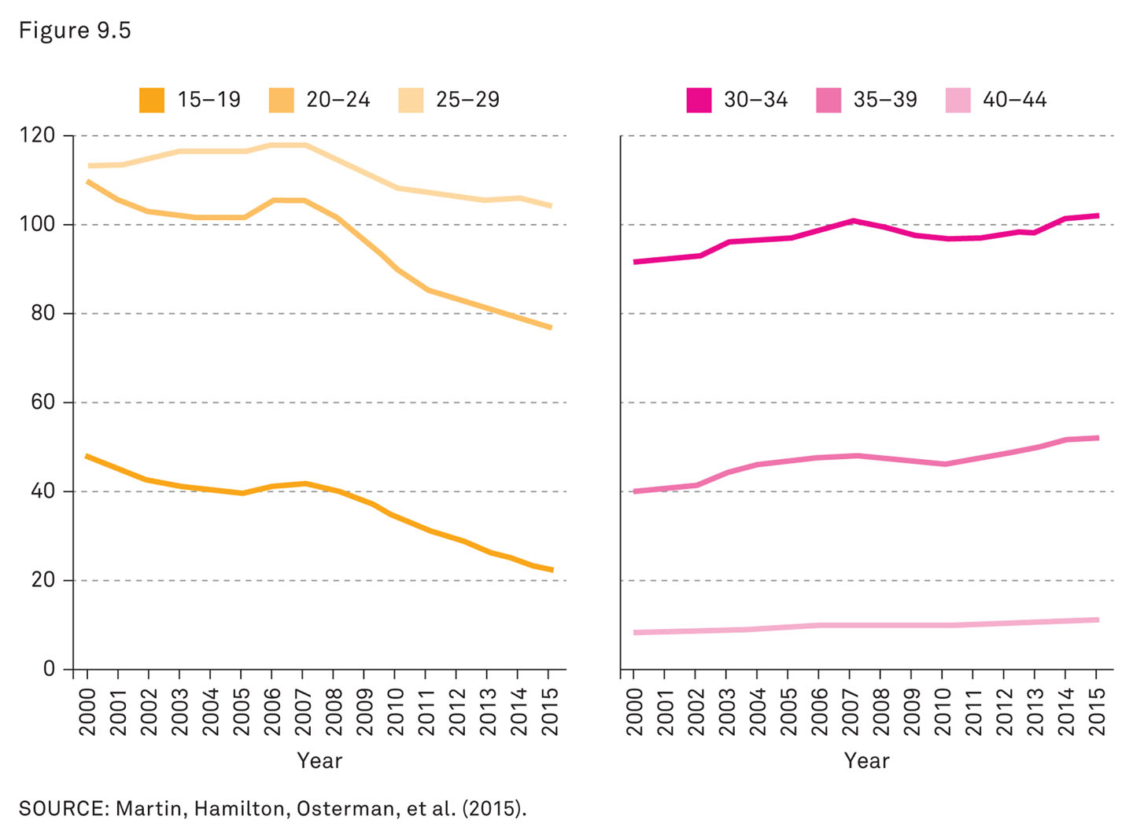
Childbearing: Economic Trends:
Notes:
When we look at larger trends, we can see that childbearing patterns do show people responding to their economic condition.
Clear evidence of conscious birth planning emerged during the recession of the late 2000s, when birth rates fell sharply for women younger than age 30 years but rose for those who were older.
The trend toward having children at older ages was already underway in 2007, when the Great Recession began, but the economic shock accelerated the trend.
It appears that many younger people deliberately postponed having children.
On the other hand, women who were nearing the end of their childbearing years had no such luxury, deciding to have children even though it might mean difficult economic sacrifices.
The decision to put off having children, or having more children, will probably lead to fewer children eventually being born as a result of the recession, as some people lose the opportunity or end up permanently changing their plans.
Source: Martin, Hamilton, Osterman, et al. (2015).

Slide 25
Adoption
Notes:
Adoption was, and still remains, an option for parents who are unable or unwilling to raise their own biological children.
Adoption used to be more common and more secretive before the 1960s.
Adoption became less common after the 1930s because of the decline of the stigma of unwed motherhood, the growing availability of birth control, and the legality of abortion.
Women who were not willing or able to become parents were less likely to have children as a result.
Only approximately 2.1 percent of all U.S. children are adopted today.
Furthermore, adoptions are much less secretive and almost all adopted children know that they are adopted (Vandivere, Malm, and Radel 2009).
Today, adopted children can be divided into three categories:
37 percent are adopted through the foster care system;
38 percent are U.S. born and adopted through private services;
25 percent are born in other countries and adopted by U.S. parents.

Slide 26
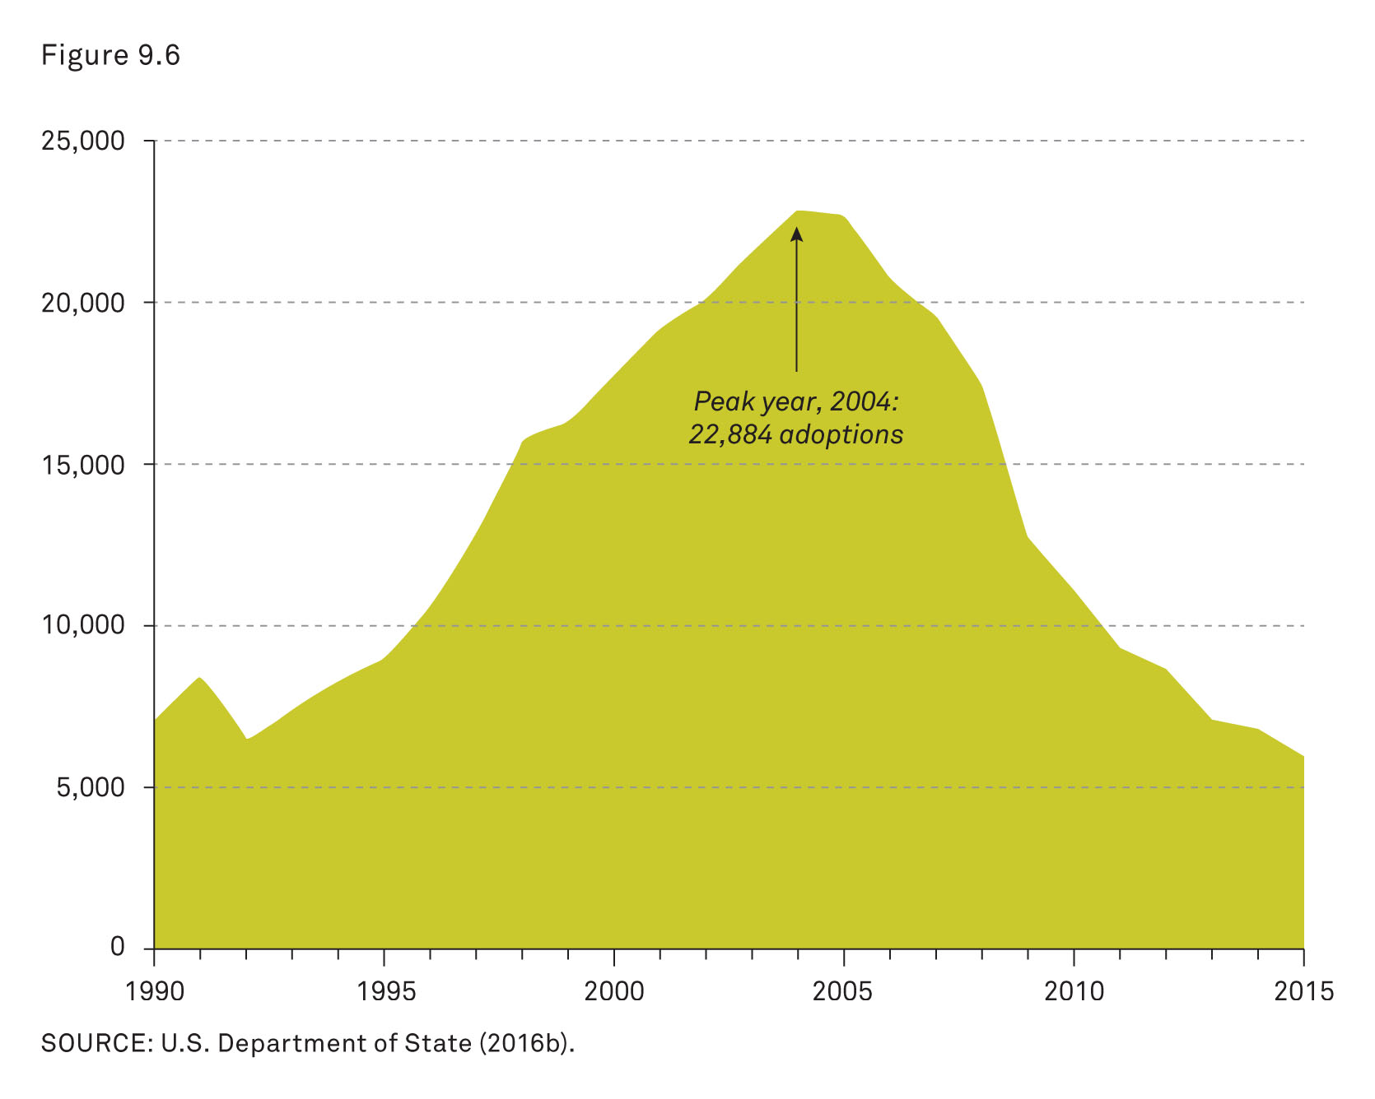
Adoption: Children Adopted into the United States from Other Countries
Notes:
This figure shows the number of children adopted into the United States from other countries from 1990 through 2013 (U.S. Department of State 2016b).
International adoption can be complicated and controversial.
There are many legal and cultural difficulties and considerations, which are not always taken into consideration by all parties involved in the adoption process.
The Hague Adoption Convention is an international agreement that seeks to facilitate adoptions in the interests of these children.
Among other things, the convention attempts to protect children against economic and cultural exploitation.

Slide 27
Why (Not) Have Children?
Notes:
The reasons individuals decide to have or to not have children are many and varied.
They may include conscious and unconscious factors.
In preindustrial families, many couples had many children, partly because of the labor they could provide.
And before government programs such as Social Security existed, children were often expected to take care of parents in their later years.
In modern society, children are a large expense (even considered an investment) and are considered valuable more for symbolic and emotional reasons than for economic ones (Schoen et al. 1997).
Parents expect children to be a source of pride, achievement, accomplishment, and love.
Yet there are also reasons why individuals in modern society do not have children.
For some individuals or couples, this is a deliberate choice; for others, it may be a matter of circumstances or biology.

Slide 28
Why (Not) Have Children? Abortion
Abortion
Notes:
The reasons for terminating a pregnancy are varied and may be complicated.
Sometimes the termination of a pregnancy may be because of medical reasons, but surveys have found that the most common reasons include decisions based on economics, education, or other family concerns (Finer et al. 2005).
Women who are most likely to have abortions are those who are most likely to have unintended pregnancies (Jones, Finer, and Singh 2010).

Slide 29
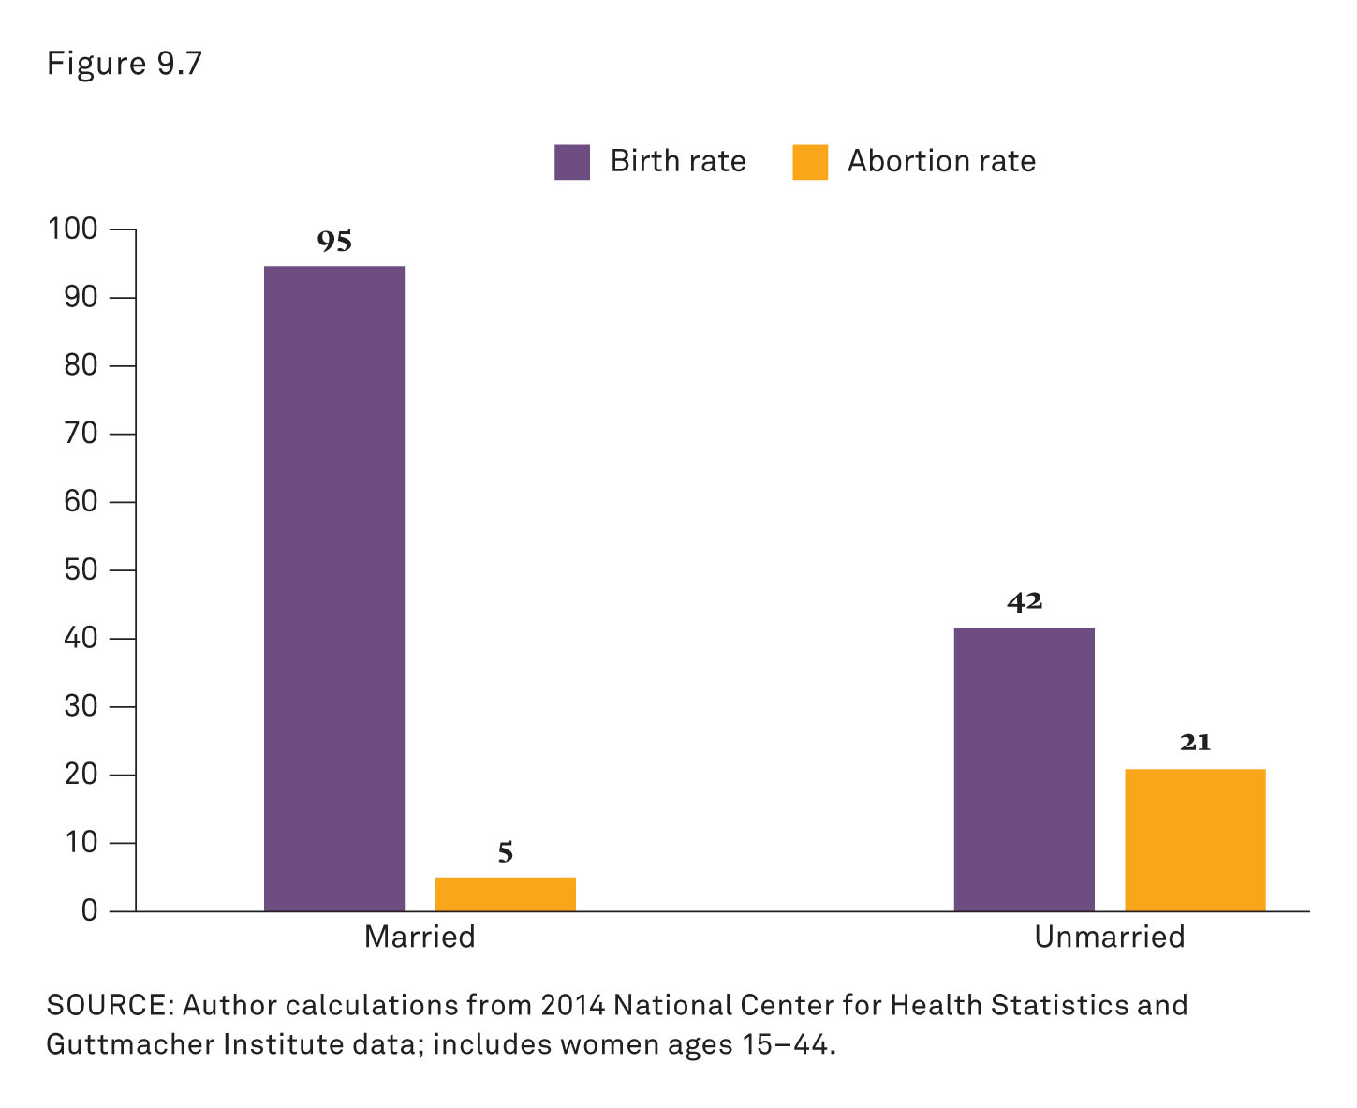
Birth and Abortion Rate
Notes:
Not surprisingly, the groups of women more likely to have unintended pregnancies—single (or cohabiting) women, those with low incomes or education, and Black women—are also more likely to have abortions (Jerman, Jones, and Onda 2016).
The breakdown of birth and abortion rates by marital status clearly shows the difference in abortions.
Among women ages 15–44 years in 2014, those who weren’t married were less than half as likely to have a birth as married women, but about four times as likely to have an abortion.
Source: Author calculations from 2014 National Center for Health Statistics and Guttmacher Institute data; includes women ages 15–44 years.

Slide 30
Why (Not) Have Children? Infertility Definition
Abortion
Infertility: The failure of a couple to have a successful pregnancy despite deliberately having sex without contraception
Notes:
In addition to unintended pregnancies, there are also unsuccessful pregnancies and the experience of infertility.
This is the usual definition of infertility; it is used as general description without having to obtain a specific cause or medical diagnosis.
Demographers use an arbitrary time period of 12 months of sex without contraception as part of the definition.
Given this general definition, approximately 9 percent of couples experience infertility around the world; the United States has a slightly lower rate of 7 percent per couple (Boivin et al. 2007).
There are many causes of infertility, including, but not limited to, advanced age, poor health, smoking, and obesity.
Although infertility is a natural part of the sexual experience, there is also a pattern of infertility linked to inequality.
Social conditions contribute to the problem of infertility.
Higher rates of infertility can be attributed to lower education and poorer overall health.

Slide 31
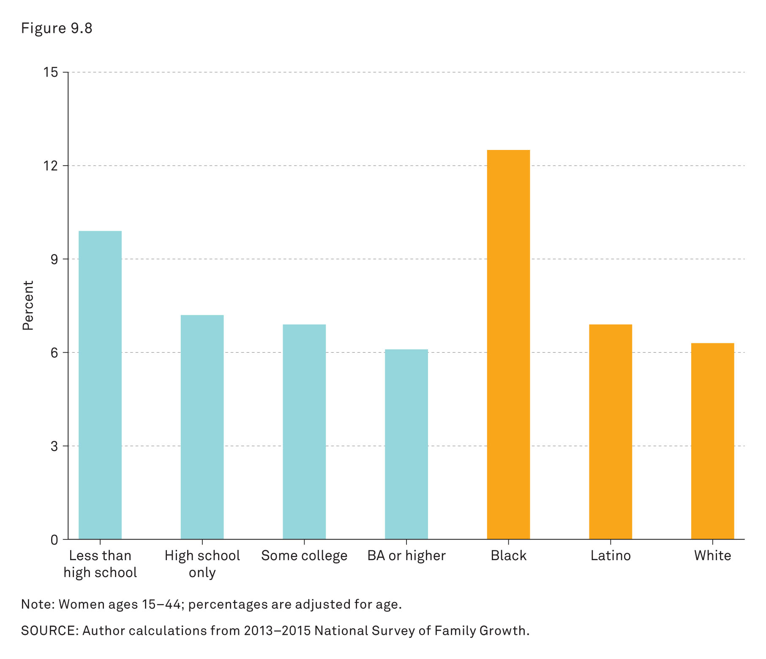
Why (Not) Have Children? Infertility for 12 Months
Notes:
White women are the least likely to experience infertility.
Women with higher levels of education have lower rates of infertility.
In the past, women tended to be blamed for infertility more than men.
However, male and female medical conditions are equally likely to be the cause of infertility for a couple.
Infertility is now considered to be a treatable problem, because of medical research and a shift in cultural attitudes.
This has increased the options for families, but certain couples are unable to take advantage of medical advancement and treatments.
Source: Author calculations from 2013–2015 National Survey of Family Growth.

Slide 32
Why (Not) Have Children? Childfree Living
Abortion
Infertility
Living without Children
Childfree Living
Notes:
As opposed to couples and individuals who desire to have children but cannot, because of infertility, many people choose to avoid or postpone having children.
Those who experience infertility are childless; those who choose not to have children are childfree.
Families without children (by choice) is just another type of family arrangement in modern society.
Part of this phenomenon has been attributed to a backlash against the culture of intensive parenting and the rise of modern individualism.
Although the choice not to have children is becoming increasingly more acceptable, people who decide not to have children are in the minority.
And even though it is becoming more socially acceptable, making this particular choice often requires reasoning and justification to oneself and others.

Slide 33
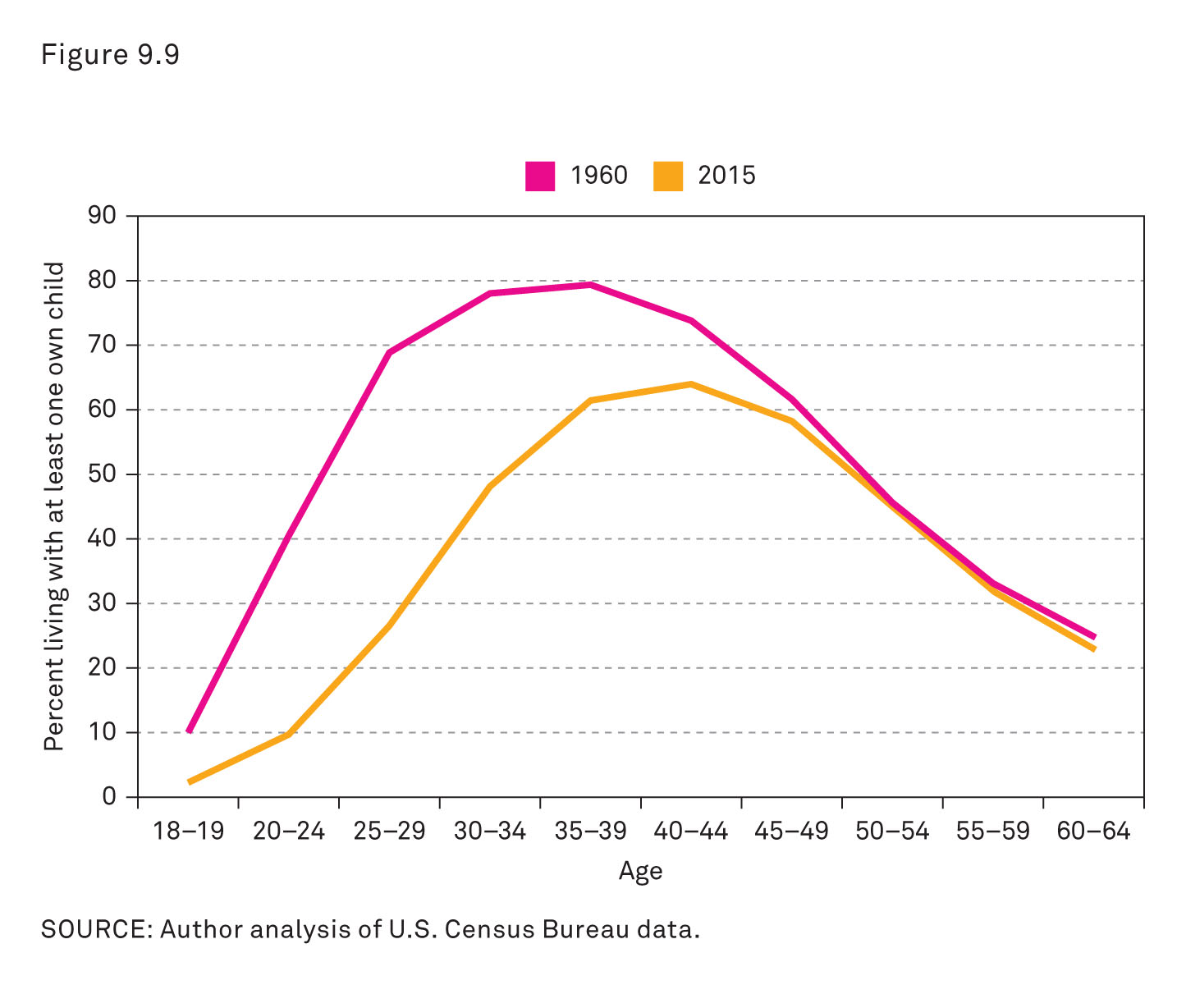
Why (Not) Have Children? Living without Children
Notes:
There has been a sharp drop in the proportion of adults living with children in the last half century, especially below age 40 years.
In 1960, 70 percent of people in their late 20s were living with one of their own children.
By 2015, that had fallen to 27 percent.
This has introduced a new era in which living with children is less the universal arrangement for American adults and looks more like one among a variety of lifestyles.
Source: Author analysis of U.S. Census Bureau data.

Slide 34
Children’s Living Arrangements
Notes:
As marriage rates have declined and divorce rates have increased, family arrangements have grown more diverse.
The social, economic, and cultural choices of adults greatly impact the lives of children.
The study of childrearing often begins with the study of children’s living arrangements.

Slide 35
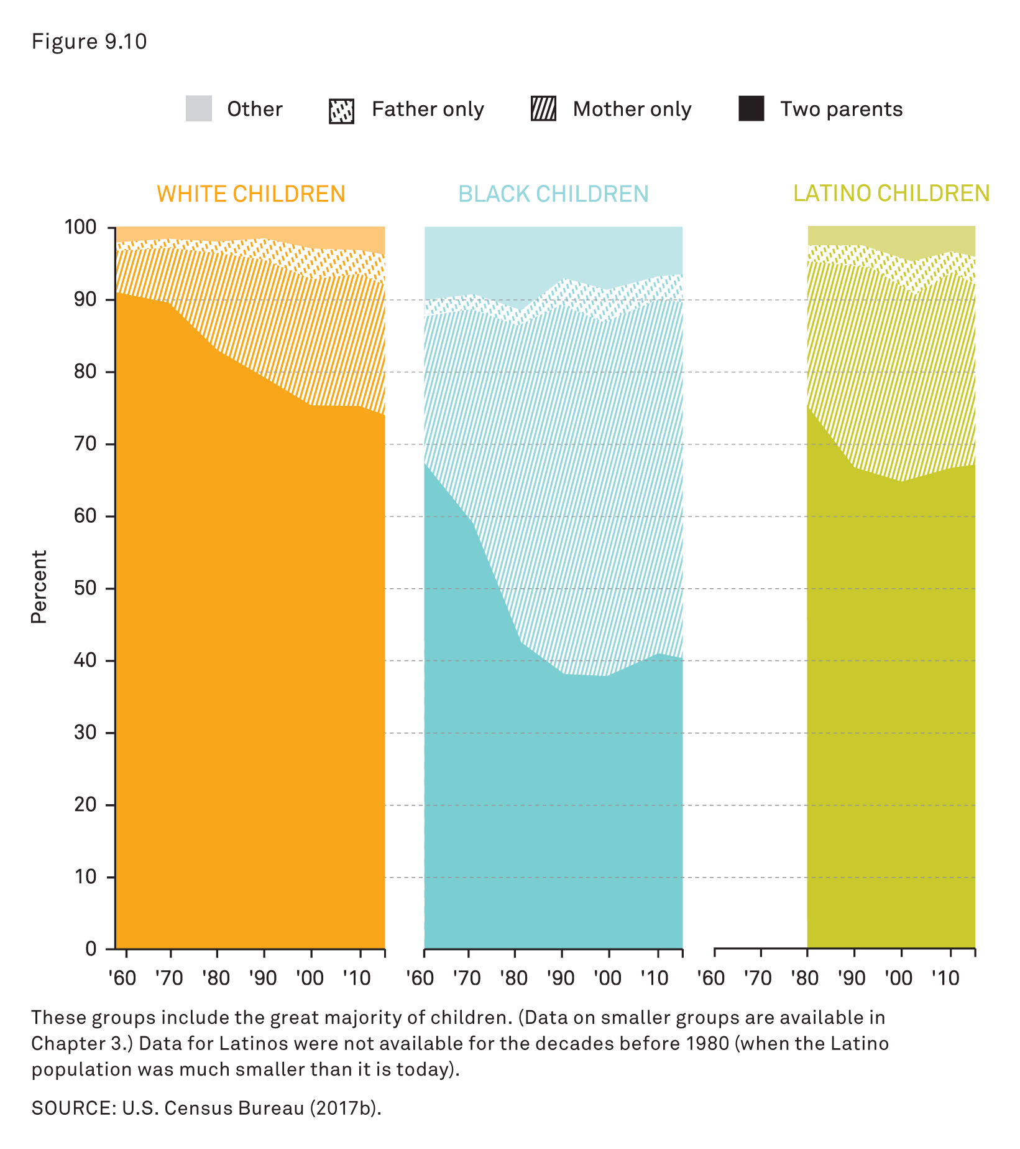
Children’s Living Arrangements
Notes:
This figure shows the living arrangements of children by race and ethnicity from 1960 to 2010 (Source: U.S. Census Bureau 2017b).
These groups include most children in the United States.
Data on smaller groups are included in Chapter 3.
Data for Latinos were not available for the decades before 1980.
The percentages shown in this figure highlight the themes of this text (next three slides): diversity, inequality, and social change.

Slide 36
Children’s Living Arrangements: Diversity
Diversity
Notes:
Fifty years ago, the dominant household arrangement for children used to be a household with two married parents.
There are now many more diverse arrangements, and no one type of structure is dominant.
These variations now include extended families, same-sex parents, blended families, and cohabiting parents, among others.

Slide 37
Children’s Living Arrangements: Inequality
Diversity
Inequality
Notes:
The rate and scale of transformation from married two-parent households vary according to group.
African-American children are experiencing a much more rapid shift toward single-mother families than are children in other racial or ethnic groups.
Single-mother families have fewer resources and lower incomes; these factors contribute to growing inequality among family types.
Also, children in single-parent homes are much more likely to experience disruption in family living arrangements (McLanahan and Percheski 2008).

Slide 38
Children’s Living Arrangements: Social Change
Diversity
Inequality
Social Change
Notes:
Diversity and increased inequality are symptomatic of broader social change.

Slide 39
Children’s Living Arrangements: Transitions
Diversity
Inequality
Social Change
Transitions
Notes:
Transitions within society are often experienced as transitions within the family.
Transitions, for better or for worse, can have long-lasting effects on children.
Children who live with a cohabitating parent may experience multiple transitions in family composition (Kennedy and Bumpass 2008).
This may include parental relationships with multiple adults and a variety of arrangements of other (related or not) children (Cherlin 2009).
Family transitions always have an economic component (e.g., a parent may lose a job, unemployment may break up a marriage) and can add stress to every member of the family, especially children (Brown 2006).
There is an increase in multigenerational households because of shifting economic conditions.
In the past, older adults who were parents depended on the economic security of their children.
Because of the transitions to a postindustrial service economy, it is more common for adult children to depend on the economic security of their parents.
Research findings suggest that when children live with grandparents, it is often reflective of economic hardship; this is a common arrangement among poor and immigrant families during hard times (Landale, Thomas, and Van Hook 2011).

Slide 40
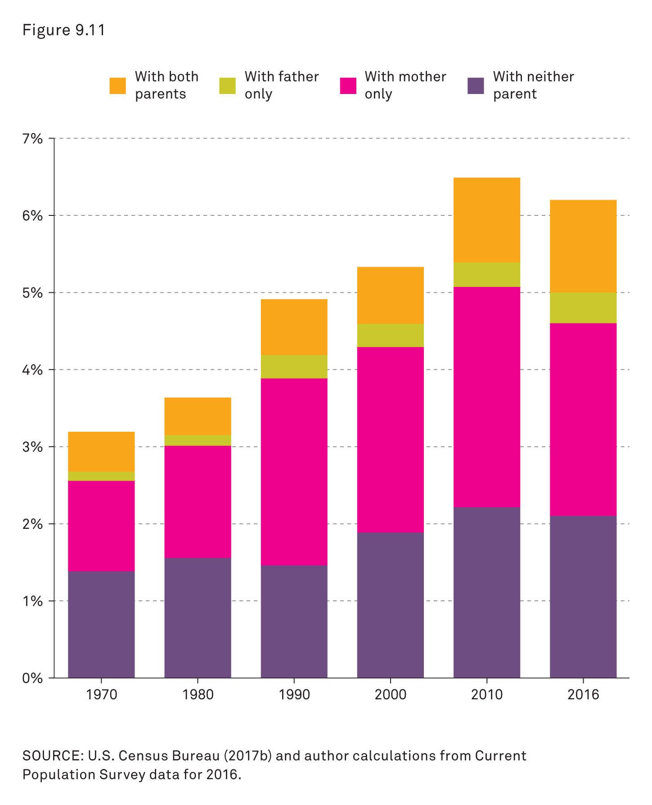
Children’s Living Arrangements: Percentage of All Children Living in Home of a Grandparent
Notes:
This figure shows the percentage of all children living in the home of a grandparent from 1970 to 2016.
This has become an increasing trend, reflecting economic hardship for many families.
Green: percentage of children living with father only
Pink: percentage of children living with mother only
Orange: percentage of children living with both parents
Purple: percentage of children living with neither parent
Source: U.S. Census Bureau (2017b) and author calculations from Current Population Survey data for 2016.

Slide 41
Parenting
Parenting: The activity of raising a child
Notes:
Parenting is the activity of raising a child.
The word parenting (in English) is less than 100 years old, but the concept of caring for children is not new.
The term parenting became much more popular and used frequently in the 1970s (Cohen 2018).
Thus, parenting is made up of many different components and many different types of relationships.
And parenting occurs in a wide variety of social environments that vary from place to place.
According to Cohen, parenting (at least in terms of parental behavior) includes three broad categories (next three slides): socialization, social bonds, and social networks.
These components are in addition to money and other financial resources.

Slide 42
Parenting: Socialization
Socialization
Notes:
Through socialization, individuals internalize elements of society and social structure (from Chapter 5).
For sociologists, individual personality is developed through social processes.
Parents are one of the primary agents of socialization for children.
Successful socialization prepares children for future social situations as adults.

Slide 43
Parenting: Social Bonds
Socialization
Social Bonds
Notes:
As discussed in Chapter 2, children build stable bonds with parents to create a needed foundation for learning and development.
Without these bonds, as they grow and mature, children may have difficulty forming relationships with others.

Slide 44
Parenting: Social Networks
Socialization
Social Bonds
Social Networks
Notes:
Parents establish social networks with and for their children.
Parental networking begins early and can be extensive and subtle.
Parents create deliberate (and sometimes unintentional) networks of friends, relatives, mentors, and others, which have a profound effect on the development of their children.
These networks greatly influence the social environment.

Slide 45
Parenting: Meaning of Childhood
The Meaning of Childhood
Notes:
The number of children surviving childhood and becoming adults increased dramatically in the nineteenth century and into the twentieth century.
As a result of this and other factors, parents started having fewer children.
The usefulness of child labor also started to decrease at the same time that child workplace safety concerns were being raised.
The shift away from child labor combined with fewer children per family had several implications for how individuals thought of children and the meaning of childhood.
Children were becoming more precious to their parents and were beginning to be valued more for their emotional worth than their economic worth (Zelizer 1985).

Slide 46
Parenting: Competition and Insecurity
The Meaning of Childhood
Competition and Insecurity
Notes:
Modern parenting in the United States increasingly reflects competition and insecurity.
Because modern parents have fewer children, they invest more per child than in the past.
Children are increasingly becoming prized for their emotional value and less for their economic value.
Parents have increasing anxiety about the job they are doing and the quality of their parenting.
This anxiety is exacerbated by the growing perception of economic insecurity and the increased necessity of higher education (Waldfogel 2006).

Slide 47
Parenting: Intensive Motherhood Definition
The Meaning of Childhood
Competition and Insecurity
Intensive Motherhood: Cultural pressure on women to devote more time, energy, and money to raising their children
Notes:
Sociologist Sharon Hays (1996) identifies an ideology she terms intensive motherhood.
She explains it in her book The Cultural Contradictions of Motherhood.
For Hays, there is a cultural pressure on women to devote more resources (i.e., time, energy, and money) to raising children.
Hays also points out that this cultural pressure increased as the employment rates for women increased.
Hays is primarily concerned with the effects that this pressure has on women and how this affects gender inequality.
But the term intensive parenting is now being used to refer to pressure on parents in general (Cha 2010).
Many women’s priorities have changed in response to this pressure and the time spent with their children actually did increase (Bianchi et al 2004).
There are now changes in parental expectations to go along with the changes in attitudes toward parenting.
Not all parents are able to live up to these cultural expectations.

Slide 48
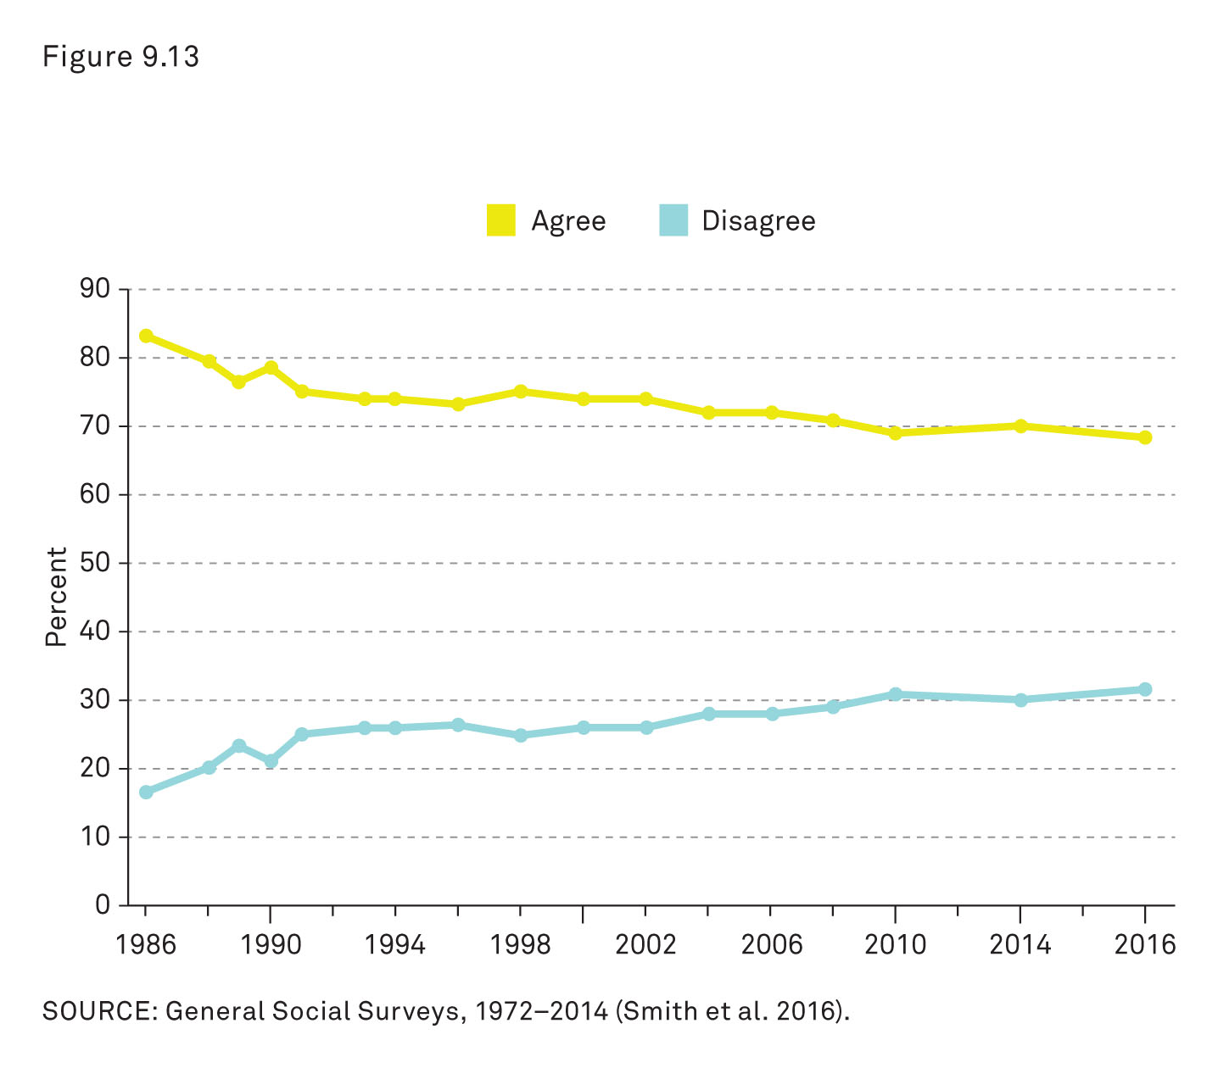
Parenting: Spanking
Notes:
This figure shows the percentage of adults who agree or disagree with the statement, “It is sometimes necessary to discipline a child with a good, hard spanking.”
Source: General Social Surveys, 1972–2014 (Smith et al. 2016).

Slide 49
Class Activity
1. “It is sometimes necessary to discipline a child with a good, hard spanking.”
agree completely
agree somewhat
neutral/unsure
disagree somewhat
disagree completely
Notes:
This workshop can be done as a peer-instruction exercise or without preparation.
Have students use clickers or colored cards to answer the question on the slide.
Display aggregate results to the class.
Students may break into pairs or small groups to discuss their answer with each other (preferably with those who had different answers) or the instructor may assign groups.
The topic may then be shared or discussed as a class.
The instructor may choose to ask this question again, after there has been group or class discussion (optional).

Slide 50
Parenting: Gay and Lesbian Parents
The Meaning of Childhood
Competition and Insecurity
Gay and Lesbian Parents
Notes:
Few children (less than 1 percent) are actually a part of same-sex couple families (Payne 2014).
Even though this percentage is small, it has actually increased rapidly in the past few years.
This can be attributed partly to changes in laws and attitudes toward same-sex partnerships, which, in turn, increase family and child-rearing options for same-sex couples.
Same-sex couples are increasingly pursuing adoption, fostering, assisted reproduction, and so on.
There is limited research covering the practices of child rearing for same-sex couples.

Slide 51
Parenting: Fatherhood
The Meaning of Childhood
Competition and Insecurity
Gay and Lesbian Parents
Fatherhood
Notes:
With parenting research mostly focused on mothers, research on fathers and fatherhood has been limited. It has increased only in the last few decades (Marsiglio and Roy 2012).
Sociologists now acknowledge that fathers have an important influence on the lives of their children, and the research is beginning to reflect this.
The study of fatherhood has shown that there has been a major shift in the attitudes of what individuals feel makes a “good father.”
This attitude has shifted from the ideal of the father as a male provider to the ideal of the father as an involved father.

Slide 52
Parenting: Male Provider Ideal Definition
The Meaning of Childhood
Competition and Insecurity
Gay and Lesbian Parents
Fatherhood
Male Provider Ideal: The father as an economic provider and authority figure for his children
Notes:
The male provider ideal began with the period of separate spheres and dominated social attitudes until the 1960s.
Although vestiges of this attitude still exist, it is not as predominant as it used to be.
The male provider ideal posits the father as the economic provider and the authority figure for his children.
This ideal is based on the assumption that the father is successfully employed and is able to take care of his family (i.e., wife and children) economically.
The career of the father is the priority in the family, and it is the success of his career that makes him a good father.
Several historical changes contributed to this shift from this ideal to the involved father ideal.
First, the increase in women’s paid employment outside of the home undermined the importance of the male as sole breadwinner and provider.
The family role differences between men and women were starting to blur and become challenged.
Second, as more families strayed from the model of the male breadwinner and stay-at-home wife and mother, the idea of that type of family as normal and natural began to decline.
Third, the emotional development of children was becoming more important and the roles of both parents were beginning to reflect this.
Mothers, and fathers, were becoming to be seen as increasingly necessary to the socialization and development of their children.

Slide 53
Parenting: Involved Father Ideal Definition
The Meaning of Childhood
Competition and Insecurity
Gay and Lesbian Parents
Fatherhood
Involved Father Ideal: The father as an emotional, nurturing companion who bonds with his children as well as provides for them
Notes:
All these factors gradually led to the development of the involved father ideal.
The involved father ideal viewed the father as an emotional nurturing companion as opposed to just an authority figure who solely provided economic support for the family.
This ideal is now almost universally accepted, with most (modern) fathers embracing this new role of the father and rejecting the previous male provider ideal (Lewis 2012).
Research has also shown that wealthy fathers and poor fathers value this new ideal (Edin and Nelson 2013).

Slide 54
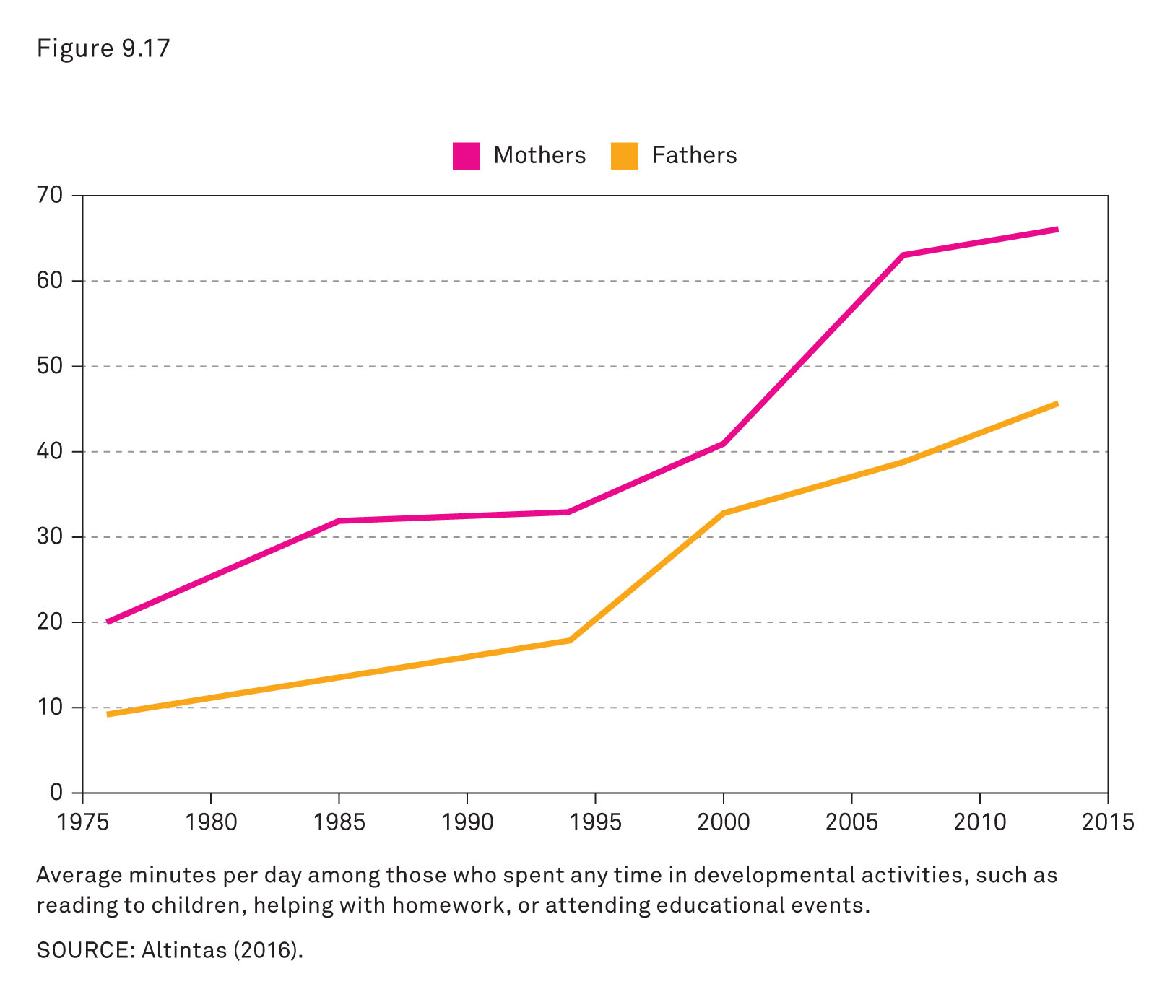
Fatherhood
Notes:
These shifting attitudes seem to have contributed to measureable changes in parenting behavior.
Fathers (at least those who live with their children) have increased their daily time spent in developmental activities, such as reading to children, helping with homework, or attending educational events, from about 10 minutes per day to 45 minutes per day.
And research confirms the positive effects of father involvement with their children (Carlson 2006).
Mothers still do more of the care for and rearing of their children than fathers do, but parenting is not as one sided as it was a few decades ago.
Source: Altintas (2016).

Slide 55
Trend to Watch: Assisted Reproductive Technology
ART refers to fertility treatments in which eggs or embryos are handled outside the mother’s body
Older parents
Diverse family arrangements
New parenting opportunities
Genetic selection
Notes:
The biological feat of human reproduction has been subject to the influence of rapidly advancing technology.
Assisted reproductive technology (ART) may have had the greatest impact.
ART usually means adding sperm to eggs that have been surgically removed from a woman’s ovaries, and then transferring the embryos to a woman to start a pregnancy.
ART has made it more possible for older people to achieve their goal of having a baby, provided they are medically and financially eligible to take advantage of this technology.
ART has facilitated more diverse family arrangements, including same-sex couple parenting, surrogate parenting (in which one woman carries a pregnancy for another woman and her family), and sperm-donor embryos.
ART has enabled people to have children who might otherwise not have been able to for health reasons. In addition to the many causes of infertility, there are also times when, for example, a man in the military or a man preparing to undergo sperm-damaging medical treatments arranges for sperm to be available for his partner if he dies or his sperm become unviable.
Finally, ART allows for possible genetic selection or manipulation of sperm, eggs, or embryos to produce a child with traits the parents choose.
As this technology advances, the consequences of these choices for parents and their families—and the new kinds of family relationships they create—
remain to be seen.

Slide 56
The Story behind the Numbers
1. How much does it cost for a low-income family (<$59,000/yr) and a high-income family (>$108,000/yr) to raise a child through age 17 years?
$135,000; $295,000
$175,000; $370,000
$210,000; $425,000
$300,000; $560,000
Notes:
Have students use clickers or colored cards to answer the question.
Display aggregate results to the class and discuss the answer to the question using the next five slides.
Answer: B
Discussion: Rich parents spend more (on clothing, houses, yards, food, health care, child care, and education) than parents who are less well off. This means children in wealth families are more expensive and also benefit in many ways from their parents’ income.
The following five “Story behind the Numbers” slides may be used at the discretion of the instructor to elucidate the differences in raising children between low- and high-income families.

Slide 57
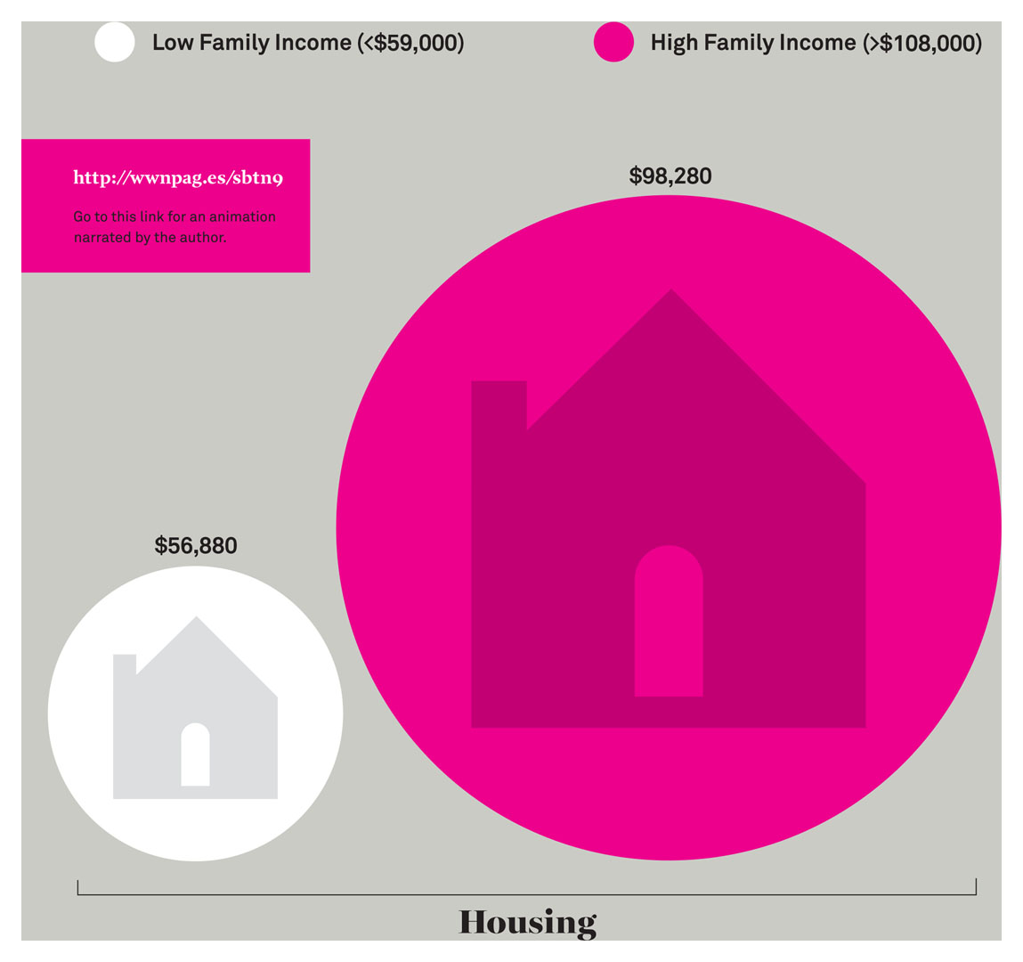
The High, and Highly Unequal, Cost of Raising Children: Housing
Notes:
This figure shows the difference between what a family with high income (>$108,000/yr) spends on housing and what a family with low income (<$59,000/yr) spends on housing.
Source: Lino et al. (2017).

Slide 58
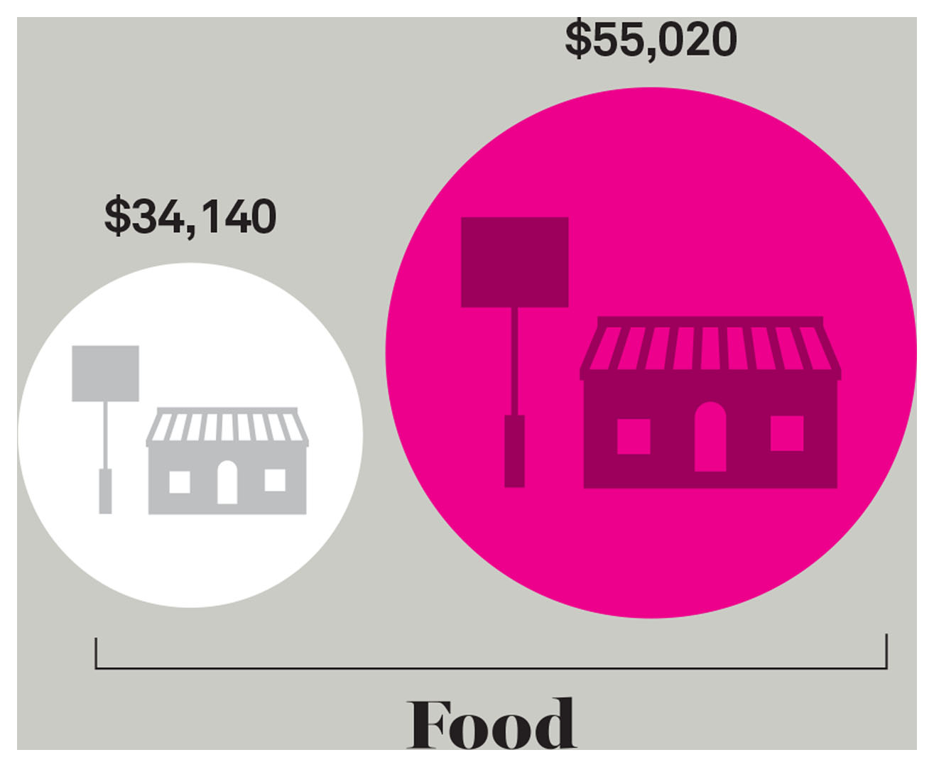
The High, and Highly Unequal, Cost of Raising Children: Food
Notes:
This figure shows the difference between what a family with high income (>$108,000/yr) spends on food and what a family with low income (<$59,000/yr) spends on food.
Source: Lino et al. (2017).

Slide 59
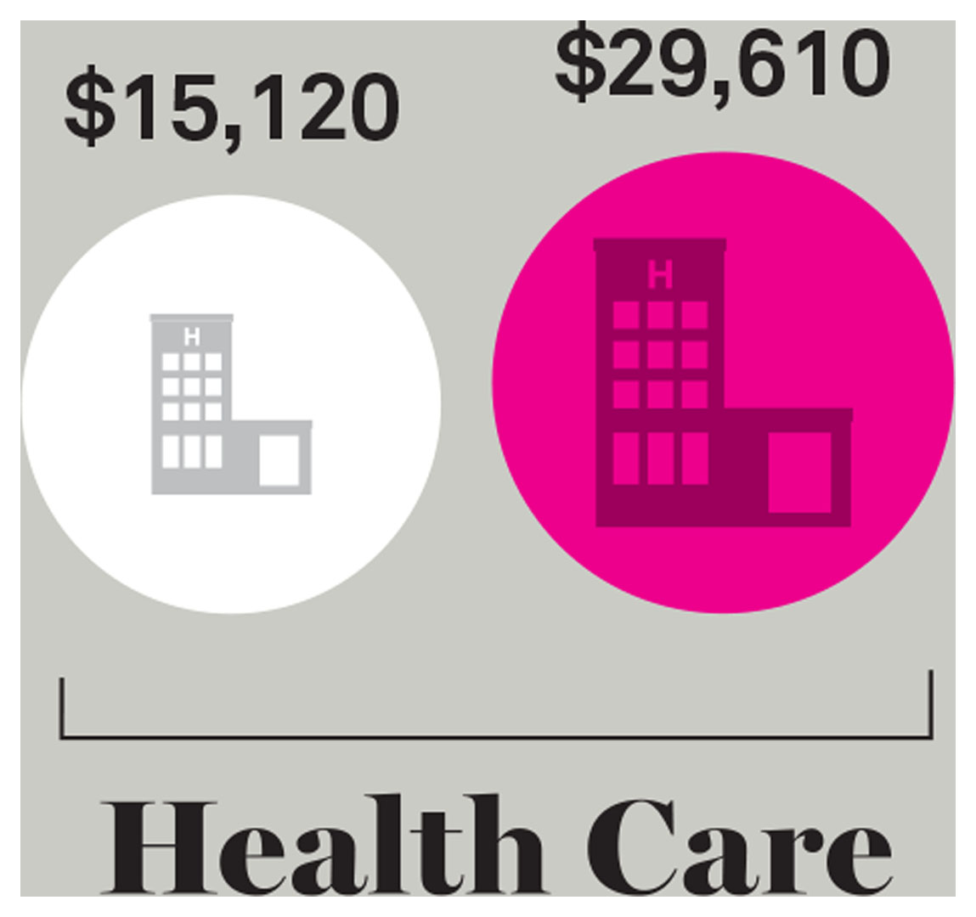
The High, and Highly Unequal, Cost of Raising Children: Health Care
Notes:
This figure shows the difference between what a family with high income (>$108,000/yr) spends on health care and what a family with low income (<$59,000/yr) spends on health care.
Source: Lino et al. (2017).

Slide 60
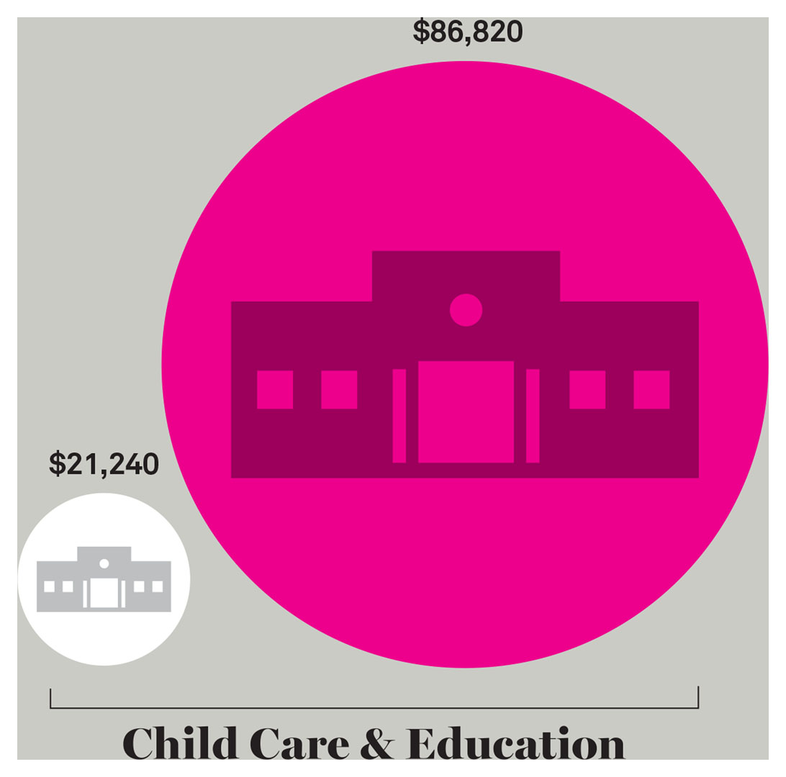
The High, and Highly Unequal, Cost of Raising Children: Child Care and Education
Notes:
This figure shows the difference between what a family with high income (>$108,000/yr) spends on child care and education and what a family with low income (<$59,000/yr) spends on child care and education.
Source: Lino et al. (2017).

Slide 61
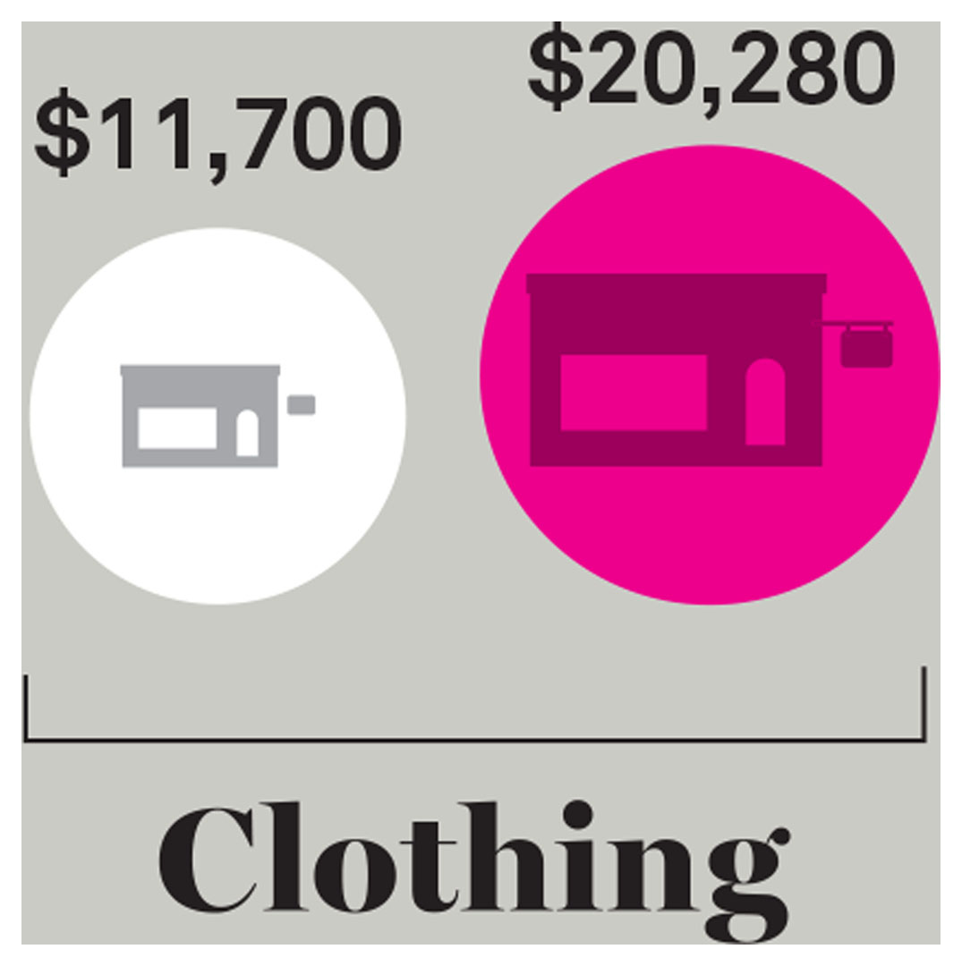
The High, and Highly Unequal, Cost of Raising Children: Clothing
Notes:
This figure shows the difference between what a family with high income (>$108,000/yr) spends on clothing and what a family with low income (<$59,000/yr) spends on clothing.
Source: Lino et al. (2017).

Slide 62
Review Question 1
1. One skill or resource that parents provide (or try to provide) for their children is ______, which helps prepare them for future social situations so they will feel less confusion and stress.
the social bond
socialization
intensive motherhood
social networking
Notes:
Answer: B
Discussion: Socialization is a type of resource that parents provide for their children that allows them to internalize elements of the social structure into their own personality. This then helps children prepare for future social situations so they will feel less stress and confusion.

Slide 63
Review Question 2
2. The increase in women’s employment and the increased diversity of family structure changed the cultural view of fathers from the ______ to the ______ ideal, which emphasizes providing both material support and emotional bonding.
male provider; involved father
working father; intensive fatherhood
absent father; involved father
single father; involved father
Notes:
Answer: A
Discussion: The dominance of the male provider view, which was characterized by the father as an economic provider and authority figure for children, started shifting in the 1960s, when several historical events began to undermine this ideal, such as the increase of women’s employment and the increased diversity of family structures. The new ideal, the involved father, characterizes fathers as emotional and nurturing to their children.

Slide 64
Review Question 3
3. Public opinion regarding spanking children can be understood as being shaped by traditional beliefs and by ______, which are influenced by the advice of experts such as doctors, teachers, and social scientists.
opportunity costs
contemporary attitudes
religious beliefs
stigmas
Notes:
Answer: B
Discussion: Changes in public opinion on issues like spanking can be understood as a reflection of traditional beliefs as well as changes in contemporary attitudes. These contemporary attitudes are partly influenced by the advice and information provided by experts such as doctors, teachers, social workers, and social scientists.

Slide 65
Review Question 4
4. Kayla decides to leave her lucrative job as a financial analyst to have and raise a second child. The income she will be giving up to raise her child can be referred to as
the motherhood penalty.
an opportunity cost.
the parenting cost.
the fertility cost.
Notes:
Answer: B
Discussion: An opportunity cost is the price a person pays for choosing the less lucrative of available options. In this example, Kayla pays an opportunity cost by leaving behind the more lucrative option of continuing work and choosing to stay home to raise her second child.

Slide 66
Review Question 5
5. If a country has a total fertility rate of more than 2.1, the population will usually ______ , but if the total fertility rate is lower than 2.1, the population will instead ______.
shrink; grow
grow; stay the same
grow; shrink
stay the same; shrink
Notes:
Answer: C
Discussion: The total fertility rate refers to the number of children born to the average woman in her lifetime. If a country has a total fertility rate of less than 2.1, the population will eventually start to shrink. This is because not everyone survives to have a child or wants to have a child, so an average rate of at least 2.1 is needed to replace each woman and her partner. The 2.1 fertility rate is also referred to as replacement fertility.

Slide 67
Review Question 6
6. As described by sociologist Viviana Zelizer, the transformation of American childhood during modern times can be understood as children losing their ______ value and instead achieving a newfound ______ value.
material; labor
emotional; economic
labor; material
economic; emotional
Notes:
Answer: D
Discussion: The new industrial workplace and child labor laws resulted in the meaning of American childhood going through a transformation. Children no longer worked for their keep; therefore, they lost their economic value, instead achieving a newfound emotional value that was considered priceless.

Slide 68
Review Question 7
7. Reed and May are young children who live with their mother. Recently, due to the financial strain of single parenthood, all three of them moved in with a grandparent. This change is referred to as
a family transition.
a social change.
intensive motherhood.
an opportunity cost.
Notes:
Answer: A
Discussion: When children experience the social changes of our era inside their own families, these are referred to as family transitions. Some of these, as in the example, involve a change from a worse condition to a better one, such as moving in with a grandparent to help alleviate financial stress. Most transitions, though, still cause stress for developing children and can have long-lasting effects.

Slide 69
Lecture Slides
The Family: Diversity, Inequality, and Social Change, 2nd Edition
This concludes the Lecture Slide Set for Chapter 9
© 2018 W. W. Norton & Company, Inc.
Independent and Employee-Owned

