Slide 1
5
Gender
Slides by Joanna Pepin

Slide 2
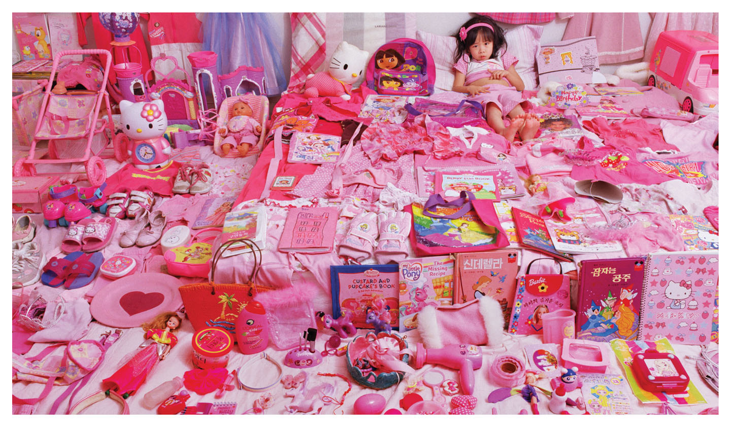
Sex and Gender
Notes:
Sex and gender are both socially constructed categories.
They both have origins in biology, but they are both social constructs.
Both are interpreted and inscribed with meaning through complex social interaction between people and sociohistorical forces and institutions.
Sex and gender are often (and sometimes mistakenly) used to explain the same set of phenomena, but there are crucial distinctions and implications.
The socially constructed nature of sex and gender is especially important for family studies and the sociology of the family.
There are many different terms sociologists use to distinguish between sex and gender to differentiate experiences and stages of development.
There is a minority of people for whom sexual and gender identity do not correspond, and it is important to understand the difference between the two so we can understand their experiences.

Slide 3
Sex and Gender: Sex Definition
Sex: One’s biological category, male or female, based on anatomy and physiology
Notes:
Sociologists commonly distinguish between sex and gender.
In sociology, sex refers to the biological categorizing of, and between, male and female.
This is based on anatomy and physiology.
Categories are assigned at birth and remain influential throughout life.
They are essential in their influence on identity, behavior, and the types of families we create.

Slide 4
Sex and Gender: Sexual Identity Definition
Sexual Identity: The recognition, or internalization, of a biological sex category
Notes:
It is important to make the distinction between sex and sexual identity.
An individual’s sexual identity usually matches his or her sex category, but not always.
Most people identify, and are identified by others, as either male or female.
But this is not always the case.
The occurrence of this discrepancy (when sexual identity does not match with one’s assigned sex) underscores the importance of recognizing sex as a socially constructed category.
This aspect of sexual identity and sexual expression will also be explored more in Chapter 6.

Slide 5
Sex and Gender: Gender Definition
Gender: The social realization of biological sex
Notes:
Most sociologists refer to sex as the “biological” category and gender as the “social” category—at least initially—even though the situation is actually more complicated than that.
Gender can then be defined as the social realization of biological sex.
Gender itself can be broken into two parts: gender identity and gender expression.

Slide 6
Sex and Gender: Gender Identity
Gender
Gender Identity: The identification with the social category boy/man or girl/woman
Notes:
This identification is internal to the individual.
It is developed through interactions with others, primarily family members .
It begins at a very young age.
It is a lifelong development, although most individuals do not change gender identity during their life.
Gender identity requires learning the behavior expected of a biological sex.
Expressing gender (identity) through individual behavior and action is the second part of gender: gender expression.

Slide 7
Sex and Gender: Gender Expression
Gender
Gender Expression: One’s pattern of outward behavior in relation to common standards of a gender category
Notes:
Gender expression is usually expressed through outward behaviors and appearance.
In heteronormative cultures, males are expected to express “masculinity” and females are expected to express “femininity.”
Examples of gender expression include clothing and the use of names associated with one gender or the other.
However, what is expressed as masculinity and femininity differs between cultural settings and times.
The roles of boys and girls are not unchanging or fixed by biology.
Also, not all people express their gender according to the rules of society.
Some people may act out of the desire to avoid conforming to the roles they are assigned.
Fashion is one way individuals turn biological sexual identity into social gender identity and expression (Paoletti 2012).

Slide 8
Sex and Gender: Differences
How Different Are We?
Notes:
Biological differences between the sexes develop meanings that are socially constructed.
In the past, biology and sociology used to be pitted against one another in a “nature” versus “nurture” debate.
Academics sometimes still debate the question of whether behavior is biological or social in origin.
The conclusion of most sociologists has been that it is both biological and social.
No matter how biological or natural something may seem, society always affects how things are interpreted and treated.
Sex differences are the basis for observable and average physical differences between girls and boys and between men and women.
The origin of sex categories focused on anatomy and hormonal patterns.
Among humans, there are two chromosomes that determine sex (the X and Y chromosomes).
But between males and females, there is much more similarity than difference.
Girls and boys or women and men are not “opposite” sexes.

Slide 9
Sex and Gender: Sexual Dimorphism
How Different Are We?
Sex Differences Made Social
Sexual Dimorphism: Physical differences between the sexes
Notes:
Compared with many other species, male and female humans are very similar.
Humans exhibit a low level of sexual dimorphism (i.e., physical difference between the sexes).
Men and women’s bodies differ, but in relatively subtle ways.
Social practices enhance these differences.

Slide 10
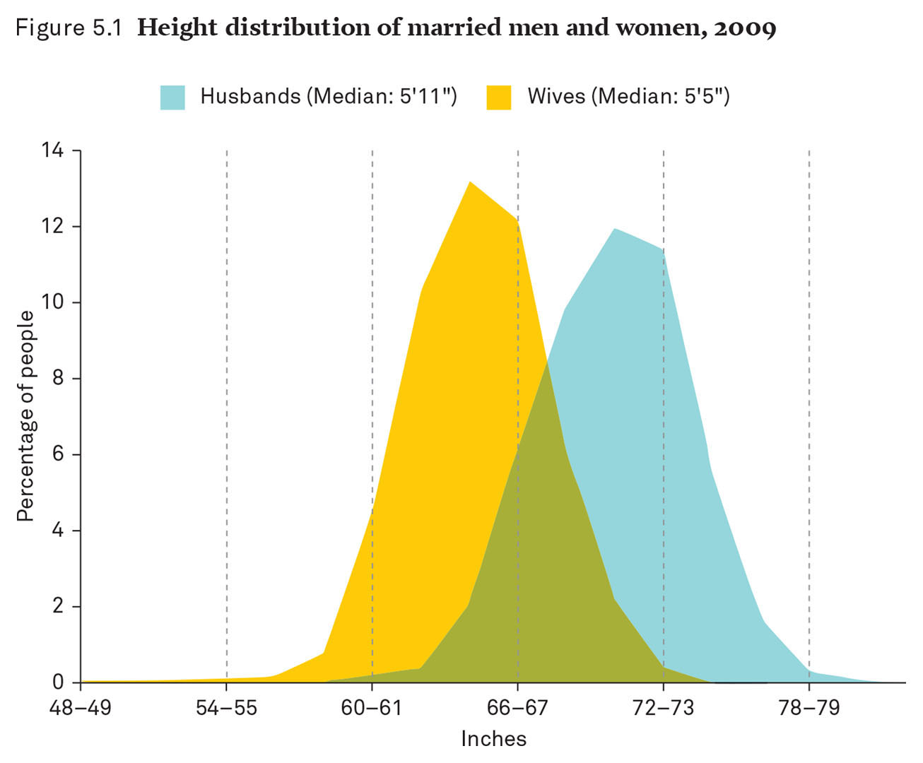
Height Distribution of Married Men and Women, 2009
Notes:
This figure shows the height distribution between married men and women in 2009.
Source: Cohen’s analysis of data from the Panel Study of Income Dynamics (2009).
Height is one easily observed difference between the sexes.
There is a substantial difference between the average height of men and the average height of women.
The average American male in his 20s is approximately 6 inches taller than a female of the same age (McDowell et al. 2008).
But there are overlaps in height between men and women.
Social behavior enhances, rather than minimizes, these differences.

Slide 11
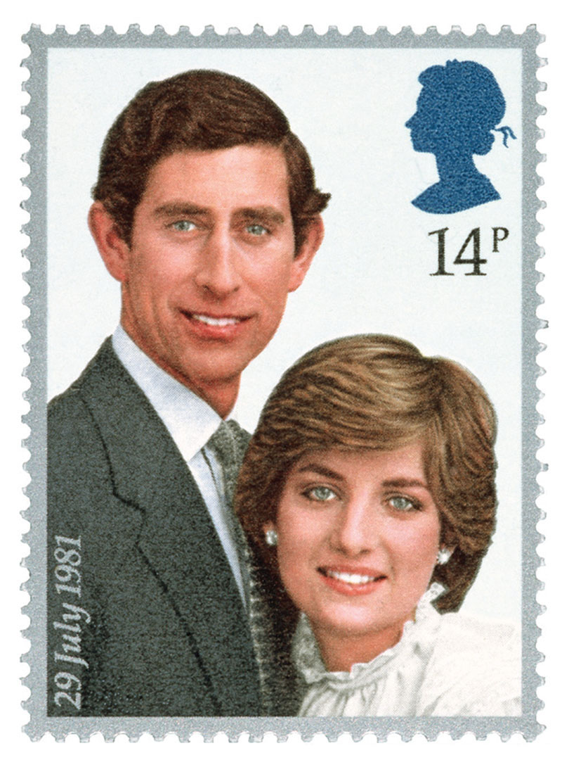
Sex and Gender: Height
Notes:
The Western cultural expectation is that men should be taller than women.
It is also (culturally) expected that men should pair up with shorter women (Fink et al. 2007).
For example, Prince Charles was only 1 inch taller than Princess Diana but was often pictured and portrayed as much taller.
This reinforces the cultural expectation of the husband as taller, protective, and more dominant and the wife as nurturing and supportive.

Slide 12
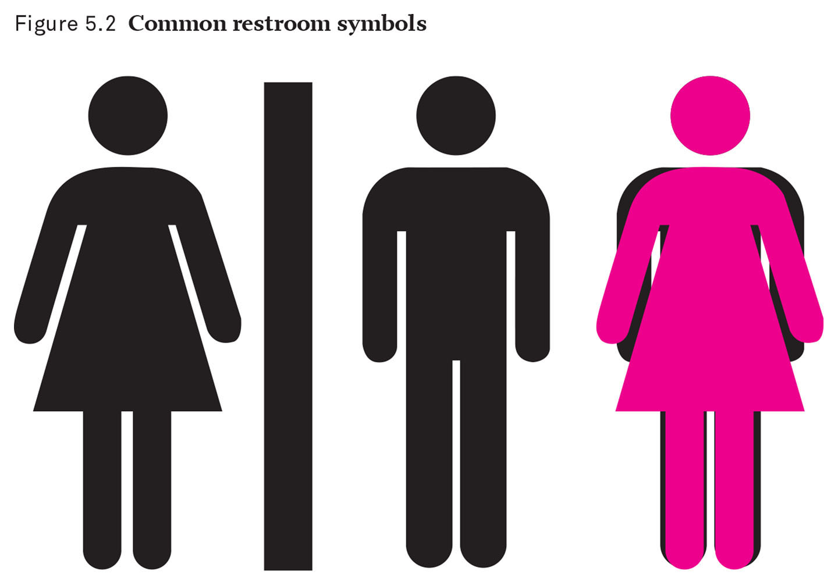
Common Restroom Symbols
Notes:
The idea of women as the “weaker sex” is also reinforced throughout culture.
Icons used to denote male and female bathrooms exemplify this theme.
The female icon is wearing a dress, her shoulders are narrower, and so on.
The two figures are the same height, but there are subtle differences.
The differences accentuate the differences between men and women, rather than minimize them.
Biology is more complicated than the restroom symbols imply.
Furthermore, women are not the “weaker” sex if variables like life expectancy are used as a measure.
Women live longer than men (on average) in 99 percent of all countries (United Nations Statistics Division 2012).
All these factors create sexes that appear to be opposites rather than a continuum of the human animal.

Slide 13
Sex and Gender: Sexual Diversity
Sexual Diversity
Notes:
We try to define the two sexes objectively by identifying them as one of two roles in sexual reproduction.
Even so, there is still great physical variety among people.

Slide 14
Sex and Gender: Intersex Definition
Sexual Diversity
Intersex: A condition in which a person’s chromosomal composition does not correspond with his or her sexual anatomy at birth, or the anatomy is not clearly male or female
Notes:
Sexual identity is assigned to all children at birth by parents or medical workers.
The assignment of gender is not controversial for the vast majority of individuals.
There are rare instances when the anatomy does not match sexual identity.
Intersex conditions are reported by doctors in approximately 18 of 100,000 births.
Intersex is a broad set of conditions and is categorized as “disorders of sexual development.”
There is a growing intersex movement, and the ways in which intersex “conditions” are explained are highly sensitive and controversial.
Some of these intersex “disorders” include medical conditions such as congenital adrenal hyperplasia and androgen insensitivity.

Slide 15
Sex and Gender: Transgender Identity
Sexual Diversity
Transgender: A term to describe individuals whose gender identity does not match their assigned sex
Notes:
How we behave is constructed around our sexual identity.
How we relate to others is also constructed around our sexual identity.
Transgender people do not follow the gender norms that match their assigned sex or what is expected of them based on their physical body.
Gender expression may take the form of clothing, mannerisms, and so on, but does not necessarily indicate an attraction to people of the same sex.
Transsexual people are a smaller group of transgender people.
Transsexual people have a sexual identity (as opposed to strictly gender identity) that does not match their assigned sex.
Transsexual people may use medical procedures, surgery, hormones, for example, in an attempt to match their body with their sexual identity.
Transgender identities present a problem for the United States because we have such a rigid two-gender system.
There are other cultural arrangements in other societies that allow for alternatives to the two-gender system.
Some countries have called for the legal recognition of an “other” gender or for gender diversity (Godwin 2010).

Slide 16
Sex and Gender: Transgender Identity
Sexual Diversity
Transgender
Gender Dysphoria: Psychiatric disorder that occurs when transgender identity causes distress in a person’s life
Notes:
Transgender identity used to be considered a psychiatric disorder. Experts in the United States now consider it problematic only when it causes distress in a person’s life, in which case it is known as gender dysphoria.
Despite a shift toward accepting sexual diversity, however, transgender identities still present a problem for our strictly two-gender system.
The issue has exploded into the debate over public bathrooms. Although some schools and local governments have embraced a new approach that permits people to use the bathroom that matches their gender identity, a backlash among conservatives has demanded that people be required to use the bathroom of the gender on their birth certificate.
An example of incremental change in the United States: A judge in Oregon broke new ground in 2016, allowing a 52-year-old Army veteran named Jamie Shupe, who was born male and transitioned to female, to identify legally as “nonbinary”—neither male nor female.

Slide 17
Raising Androgyny: Androgynous Definition
Androgynous: Neither exclusively masculine nor exclusively feminine
Notes:
Gender identification is important in culture.
Many parents want their “boys to be boys” and their “girls to be girls” according to the standards of their community or culture.
For example, the use of the color blue for boys and the use of the color pink for girls
Some parents strictly enforce gender roles.
Some parents criticize strict or polarizing gender identification.
An androgynous gender approach is one that is neither exclusively masculine nor exclusively feminine.
The issue of gender identity in childhood is still highly contested.

Slide 18
Perspectives on Gender
Notes:
The next section is an overview of the most common perspectives on gender for sociologists: biological, feminism, masculinity, and symbolic interaction.
Review some of the general theories from Chapter 1 as they apply to gender.

Slide 19
Perspectives on Gender: Biological
Biological Perspective
Notes:
Biological explanations for family behavior are often inspired by a structural functionalist view of society.
Biological evolution provides a useful framework for this perspective.
These explanations tend to emphasize the complementary and natural roles of men and women that serve the greater social good.
This view focuses on stability and those aspects of family behavior that may or may not have an evolutionary basis.
Does not really take into account processes of social change and variation

Slide 20
Perspectives on Gender: Feminism
Biological Perspective
Feminism
Notes:
Feminist explanations for family behavior are influenced by feminist theory.
As opposed to biological explanations, which generally argue that gender differences are natural, feminist explanations emphasize that gender identity and gender inequality is central to the social order and family life.
Some feminists have argued that because men have more influence over social rules, they set gender standards to serve their own interests.
There is a system of rigid gender categories and roles that serve a male-dominated society.
That is why gender stratification and hierarchy continue to exist.
The interactions between men and women in society reflect men’s dominant position over women and reinforce these differences.

Slide 21
Perspectives on Gender: Masculinity
Biological Perspective
Feminism
Masculinity
Notes:
A focus on masculinity in gender studies emerged to provide an examination of the “dominant” gender group.
Much of the early research on gender was focused primarily on women.
Rigid gender roles and expectations hurt women, but they also hurt men and male identity.
Masculinity has its own history and development, and is socially constructed.
In fact, researchers are finding multiple masculinities based on different social constructions of what it means to be a boy or a man.
These areas of interest are important for family studies because they involve the topics of fatherhood, parenting, and relationships with women (Doucet 2006).

Slide 22
Perspectives on Gender: Symbolic Interaction
Biological Perspective
Feminism
Masculinity
Symbolic Interaction
Notes:
Symbolic interaction explanations for family behavior are often inspired by a symbolic interactionism view of society.
Symbolic interaction asks the question, “How is the social construction of gender achieved?”
The theory of symbolic interactionism argues that complex social systems are maintained through elaborate interpersonal interaction.
Individuals must enact their social roles and receive feedback from others to build and maintain their identities.
Individuals must enact their own sex categories into accomplishments of gender identity in a process called doing gender (West & Zimmerman 1987).
Individuals can enhance (or suppress) aspects of their gender identity to conform to the norms of masculinity and femininity.
The performance of gender requires an audience, and the most important members of an individuals audience are family members.
Lifelong patterns of (gender) interaction are reproduced within the family and within the family arena.

Slide 23
Gender Socialization: Socialization Definition
Socialization: The process by which individuals internalize elements of the social structure, making those elements part of their own personality
Notes:
Learning the norms, rules, and beliefs of the culture is an important process.
Gender socialization is a complex process.
It is not just things that are taught to people, but things that people do to themselves.
These things include learning the norms, rules, and beliefs of the culture as well as ways to adapt behavior to get along with others in that environment.
An individual must also know the rules by which gender is organized and have the capacity to act and react to others.
It is a lifelong process by which people learn to think and act in consideration of what others do and expect.
Gender socialization consists of countless interactions with several different agents of socialization.
The earliest agent for most children is the parent, who is usually the dominant influence over this process.
As children age, other agents of socialization become increasingly important (e.g., interactions with siblings, peers, schools, and the wider culture).
Adult gender socialization also occurs more often in other institutional arenas, especially the market.

Slide 24
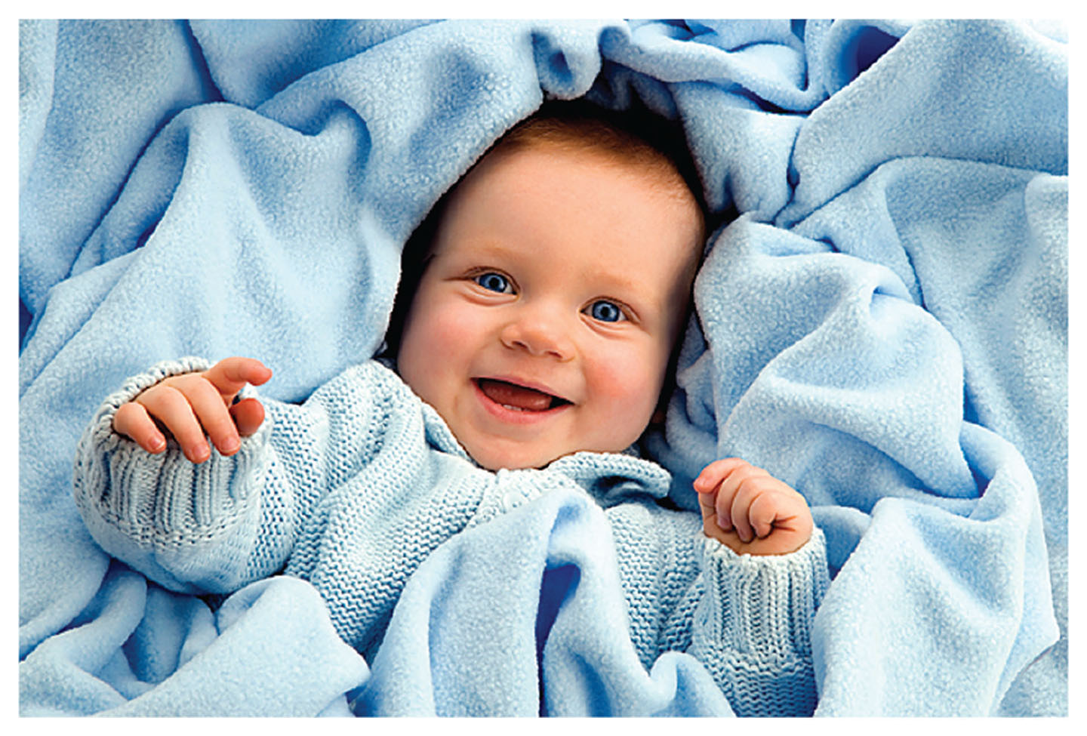
Gender: Male
Notes:
How does the color of a baby’s outfit affect your perception of his or her gender?

Slide 25
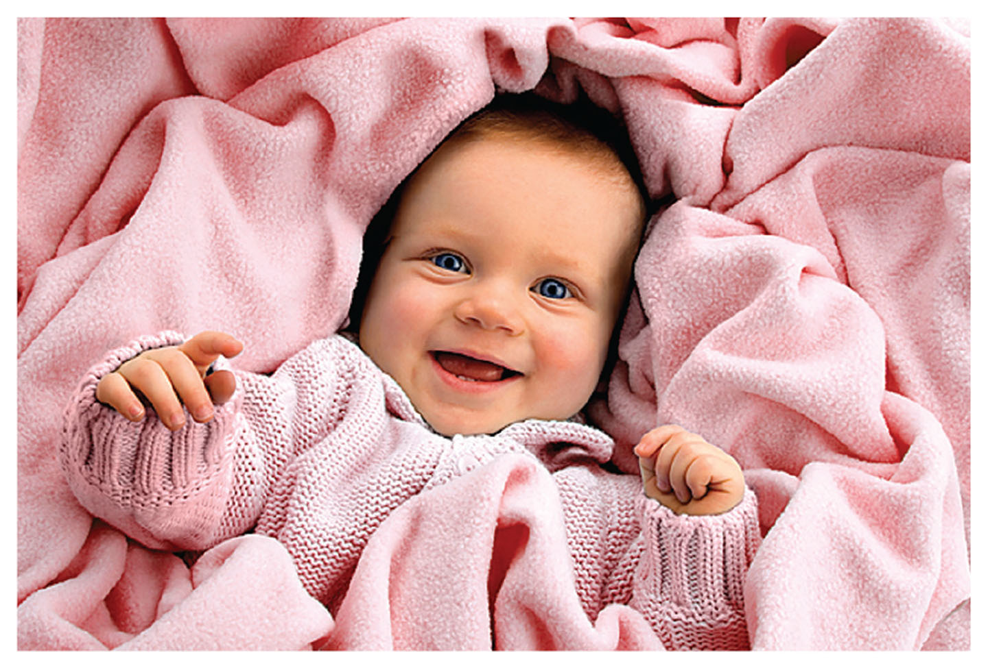
Gender: Female
Notes:
How does the color of a baby’s outfit affect your perception of his or her gender?

Slide 26
Gender Socialization: Parents
Parents
Notes:
Although every parent is different, there are clear patterns (albeit sometimes subtle) in how parents treat boys and girls differently (Raley and Bianchi 2006).
One of the most important outcomes of parenting is the establishment and reproduction of gender difference and the gender binary.
How we are different is sometimes less important to some people than the fact that we are different, especially when it comes to sex and gender.
Parent gender socialization begins at birth (and often earlier) and is very effective and influential.
By the age 3 years, there are clear differences in toy preferences between boys and girls.
Girls tend to prefer toys that involve nurturing and caring for others (especially dolls) and boys tend to prefer power tools, weapons, cars, and so on.
These early gender differences translate into later gendered family roles and assignments.
This sets a precedent for future patterns inside and outside the family.
For example, men and women tend to do different types of work in the workplace (Chapter 11).

Slide 27
Gender Socialization: Siblings
Parents
Siblings
Notes:
Siblings also exert influence on gender socialization.
Siblings help reinforce difference.
But siblings can also make gender socialization more complicated, depending on how many siblings one has, birth order in the family, and so on.

Slide 28
Gender Socialization: Interactive Circles
Parents
Siblings
Interactive Circles of Socialization
Notes:
People internalize aspects of gender through all their interactions, not just within the walls of the family home.
Families do not exist in isolation, and interaction occurs within a broader social and cultural context.
Also, the upbringing that the parents experienced may influence how they raise their own children.
Parents may use their own upbringing as a frame of reference.

Slide 29
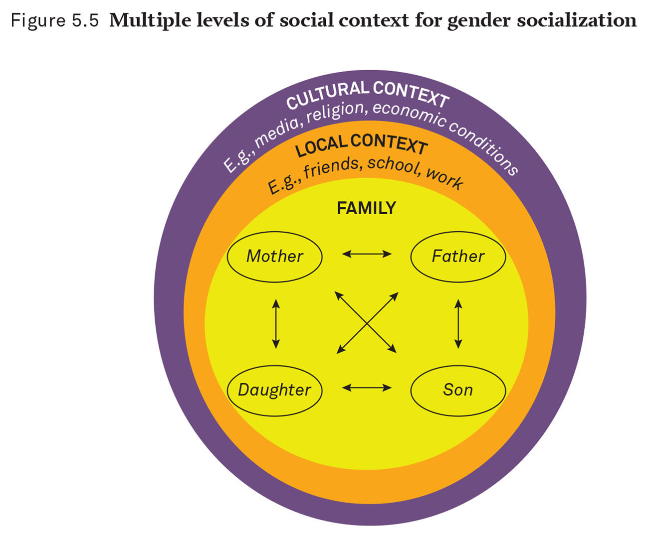
Interactive Circles of Gender Socialization
Notes:
Individual interactions within families are influenced by the local context (local and family interactions) as well as by the larger culture around them.
In reality, each family is unique.
The world around individuals and their families could be represented by any number of circles and layers.

Slide 30
Gender Socialization: School
Parents
Siblings
Interactive Circles of Socialization
School
Notes:
For children, the primary location for nonfamily social interaction is school.
In school, children are exposed to formal content (i.e., lessons, school instructions) and informal content (e.g., teacher expectations, peer pressure).
In the early years, emphasis is on boy-versus-girl identification.
Clothing differences can be important markers of gender difference.
As students become older, gender differences can influence other important life choices, such as choice of study subjects and career or occupation.

Slide 31
Gender Socialization: Peers Definition
Parents
Siblings
Interactive Circles of Socialization
School
Peers: People in a similar social situation and of similar social status with whom an individual interacts
Notes:
In and around school and the neighborhood, peer culture interactions have a critical influence.
Peers are people in similar social situations and of similar social status with whom an individual interacts.
For children, peers are usually the same age.
Peers may come from the same neighborhood or classroom—anywhere children interact and are together socially.
Despite the strong influence of immediate family members, peers are often the ones whose opinions matter the most, especially during adolescence (Adler, Kless, and Adler 1992).

Slide 32
Gender Socialization: Activities
Parents
Siblings
Interactive Circles of Socialization
School
Peers
Activities
Notes:
For children, choosing friends and choosing activities are interrelated.
Children develop gender identities through the activities in which they participate, partly because of their peers.

Slide 33
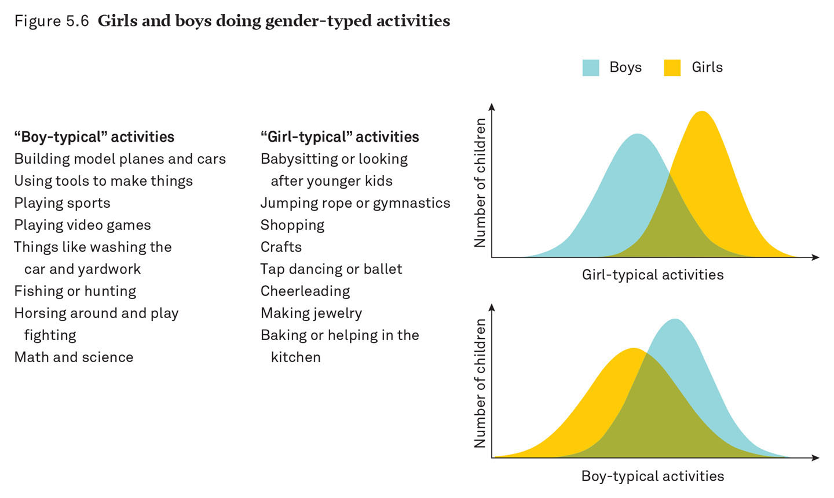
Gender-Typed Activities
Notes:
Source: This graph is from Cohen’s calculations taken from Egan and Perry (2001).
“Boy-typical” activities were counted as, and include, building model planes and cars; using tools to make things; playing sports; playing video games; things like washing the car and yardwork; fishing and hunting; horsing around and play fighting; math and science.
“Girl-typical” activities were counted as, and include, babysitting or looking after younger kids; jumping rope or gymnastics; shopping; crafts; tap dancing or ballet; cheerleading; making jewelry; baking or helping in the kitchen.
Boys and girls have different patterns of identifying with the two group activities.
More girls are higher on the “girl-typical” scale (yellow); more boys are higher on the “boy-typical” scale (blue).
There is a marked difference between the sexes but there is also considerable overlap (represented in green).
In this instance, gender conformity in a peer-group context may tell us more about conforming and fitting in than it tells us about innate (or even social) gender differences.

Slide 34
Gender Socialization: Neighborhoods
Parents
Siblings
Interactive Circles of Socialization
School
Peers
Activities
Neighborhoods
Notes:
Neighborhoods are also a social setting and a source of peer influence (Rankin and Quane 2002).

Slide 35
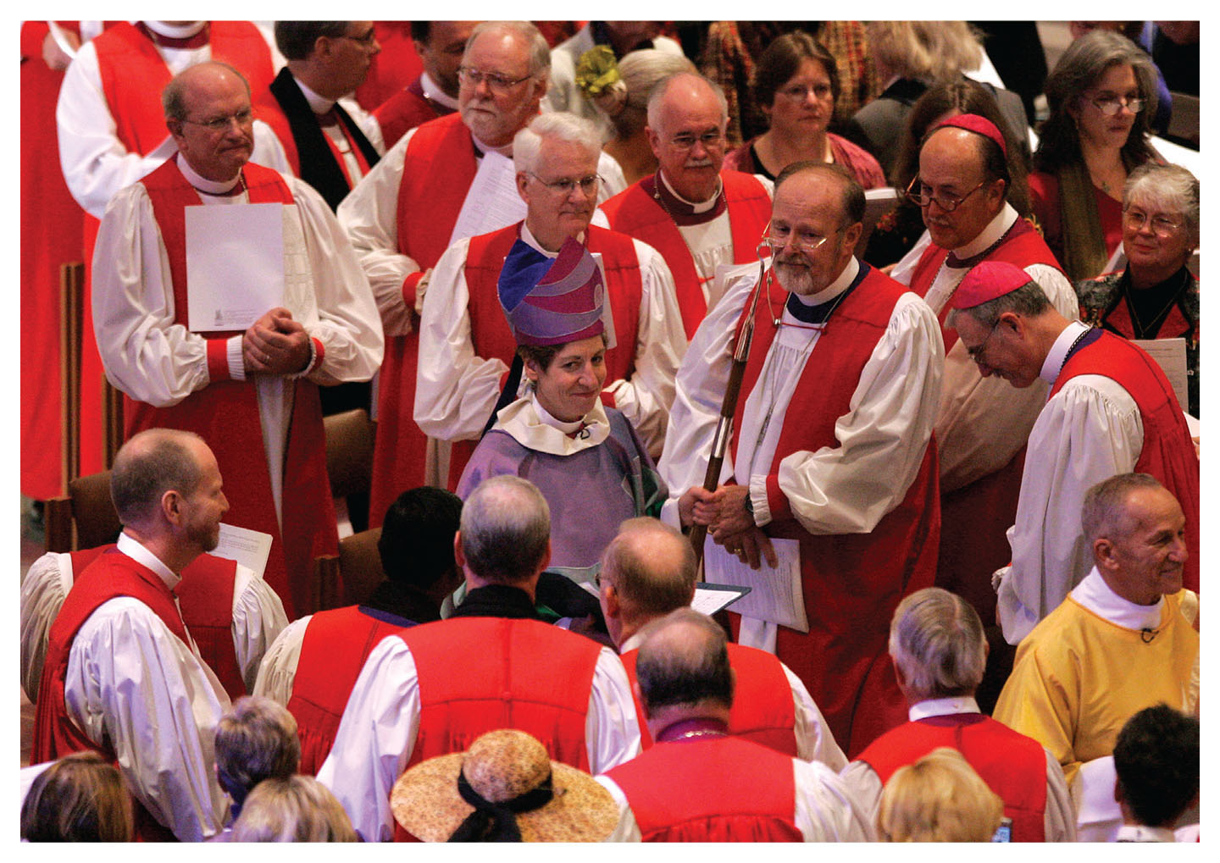
Gender and Religion
Notes:
Religious institutions continue to exert an inordinate amount of influence on gender and families for many individuals.
Many individuals turn to religion for guidance on parenting and attempt to pass on their way of life to their children.
Usually the influence of religion is conservative.
Those who practice religion express more conservative attitudes toward gender and family life (Pearce and Thornton 2007).
But the relationship among religion, gender, and family is complicated.
Attitudes expressed by individuals do not always correspond with behavior.
And there are significant feminist trends within religious communities that have influenced the family and traditional gender roles.

Slide 36
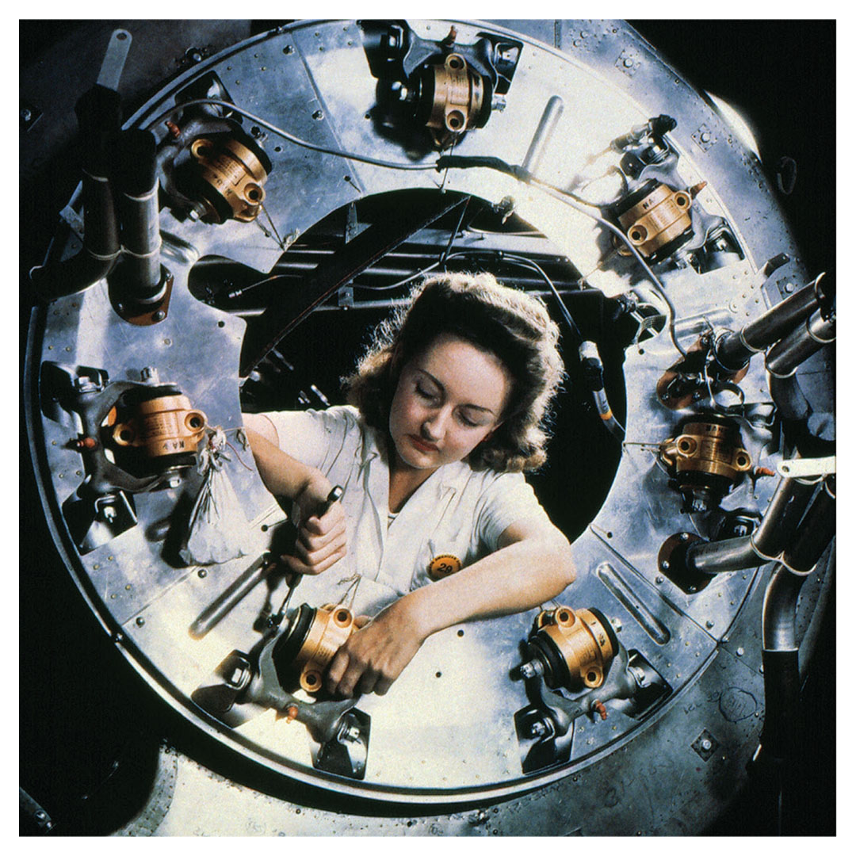
Gender at Work
Notes:
One of the greatest barriers to equality between men and women is the divide between paid and unpaid work (Cohen 2004).
When married women entered the workforce in greater numbers in the 1960s, this started to break down some of the barriers.
Woman working in the public sphere went from being seen as improbable to being considered more normal.
In the process, women’s independence increased somewhat (especially for White women).
But there is still a division of labor between men and women in the workforce.

Slide 37
Gender at Work: Segregation
Educational and Occupational Segregation
Notes:
In the decades after World War II, much more work became acceptable for both men and women: It became gender integrated.
This was especially true in middle-class occupations.
The system of college education was increasingly open to women.
But occupational gender segregation still persists (persistent occupational gender segregation will be addressed more in Chapter 11).
Two sources of continued segregation
First, women are more likely to be employed in occupations that are closely associated with (unpaid) domestic work and the occupations that men dominate are not associated with work done at home (Cohen 2013).
Second, and more important, there are differences in what men and women study in college and graduate school.
The division into separate spheres remains pronounced.

Slide 38
Gender at Work: Gender, Status, and Pay
Educational and Occupational Segregation
Gender, Status, and Pay
Notes:
Who earns more: men or women?
Among full-time workers in all occupations in 2015, women’s median earnings were just 81 percent of men’s.

Slide 39
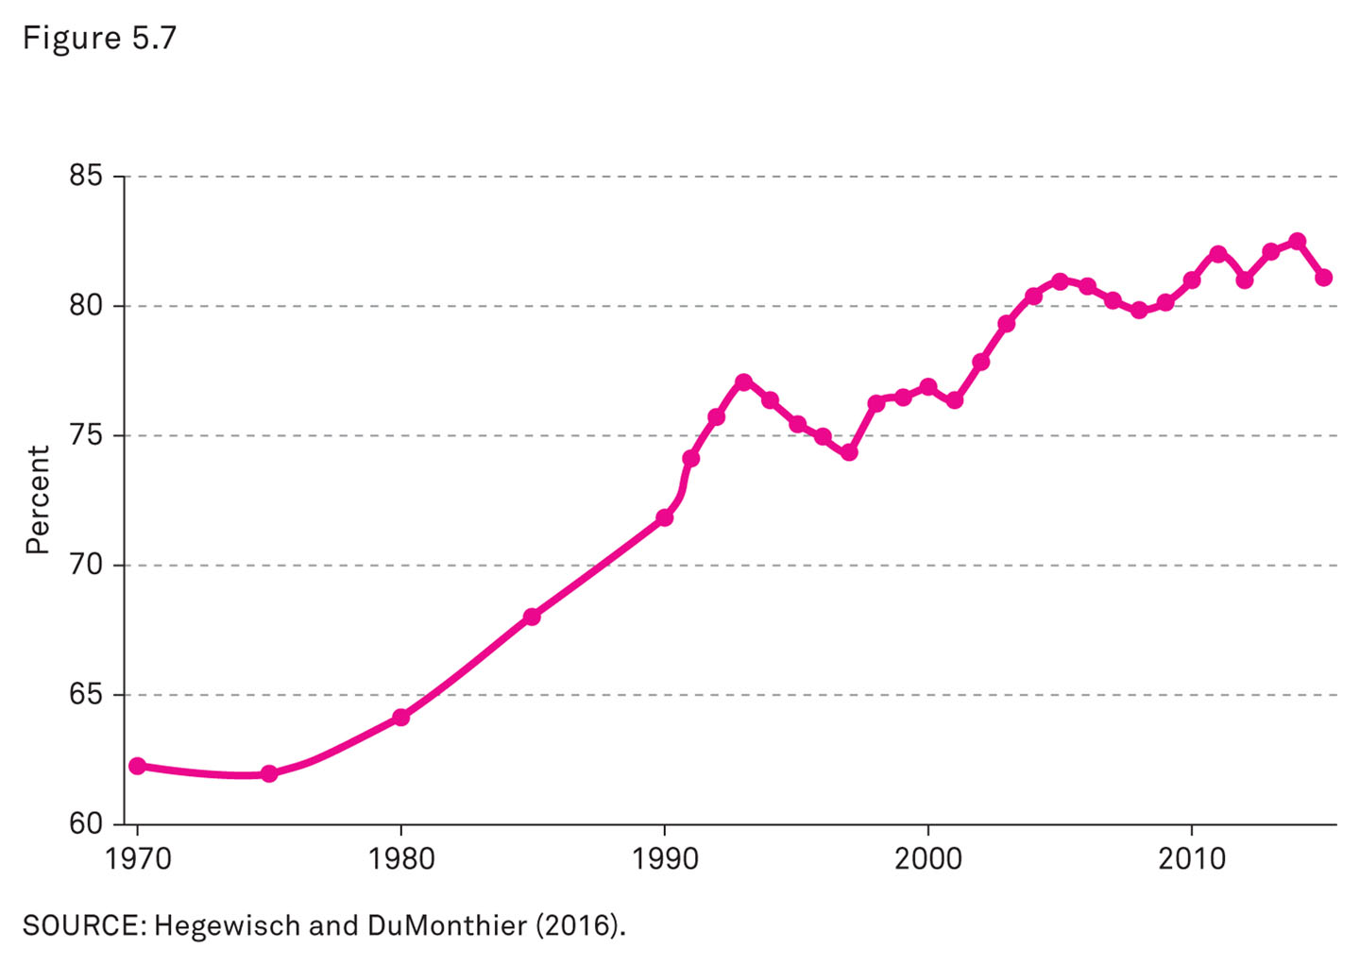
The Gender Pay Gap
Notes:
Men’s jobs generally pay more than women’s.
The biggest reason for the pay gap is that women and men work in different jobs.
Within the same job at the same workplace, there is much less gender inequality (although it is illegal, it still persists for a variety of reasons).
Laws requiring equal pay for equal work have been difficult to enforce.
Even in 2014, U.S. Congress failed to pass the Paycheck Fairness Act.
Women tend to enter occupations traditionally dominated by men in much greater numbers than men enter occupations traditionally held by women.

Slide 40
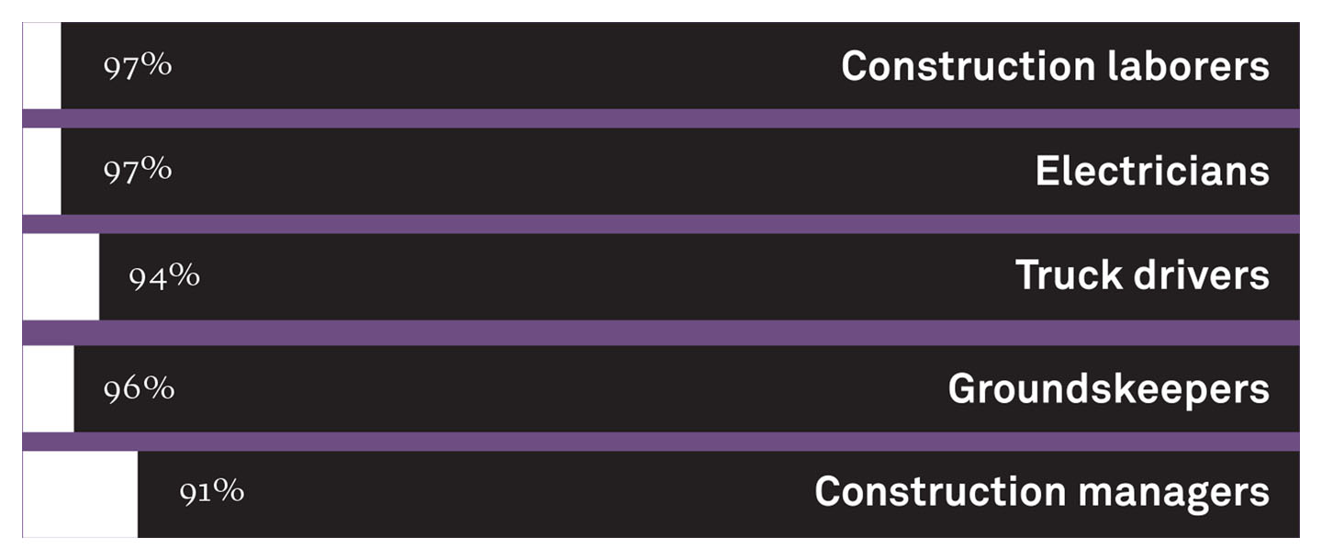
The Story behind the Numbers: Male-Dominated Fields
Notes:
Some of the most common jobs in the United States are the most gender segregated (e.g., trucking, construction, nursing).
Source: Author analysis of 2016 Current Population Survey data via IPUMS (Ruggles et al 2016)

Slide 41
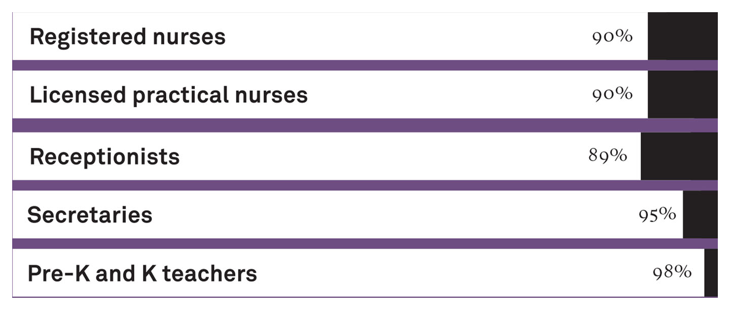
The Story behind the Numbers: Female-Dominated Fields
Notes:
One explanation for this gender segregation is that women often occupy professions that replicate the kind of labor they typically performed without pay in the domestic sphere (e.g., caring for children and elders, cooking, nursing).
Alternately, men do not typically work these jobs (i.e., jobs associated with domestic labor), so they remain occupations predominantly occupied by women.
Some gender segregation is the result of personal choices that individuals make (although sociologists note that “choice” and free will are often a matter of what is made available through social structures and institutions).
But there are also conscious, discriminatory actions taken by employers, and sometimes by male workers, to keep women away from certain job duties or high-paying occupations.
Because of this, occupational gender segregation is an important aspect of gender inequality in society.
Source: Author analysis of 2016 Current Population Survey data via IPUMS (Ruggles et al 2016)

Slide 42
Women’s Educational Advantage
Women surpassed men’s rate of college graduation in about 1996
But where will it lead?
Notes:
In one key respect, women have actually pulled ahead of men: completing college.
The movement toward greater educational achievement for women in the last few decades goes against the entire history of education, in which men dominated schooling at all levels.
It remains to be seen whether women’s advantage will continue to grow in the face of continued sexism, and whether it will expand into areas where they are still behind men, such as corporate management, engineering, and political power.

Slide 43
Workshop: Boys’ and Girls’ Activities
1. How often did you participated in “boy-typical” activities as a child?
most of the time or always
often
My time was evenly distributed between “boy-typical” and “girl-typical” activities.
sometimes
rarely or never
Notes:
This workshop should be done as a peer-instruction exercise.
The instructor should generate a customized list of common “boys’” and “girls’” activities or students may be assigned the list of activities included in Figure 5.6 on p. 184.
Alternately, students may be assigned to small groups to generate lists among themselves.
Students may break into pairs to discuss their findings with each other.
Then results may be shared or discussed with the entire class.

Slide 44
Review Question 1
1. Shawn was born with ambiguous genitalia and XX chromosomes. This is a condition known as ______, and Shawn’s parents decided to label her female and raise her as a girl.
sexual identity disorder
homosexuality
transgender
intersex
Notes:
Answer: D
Discussion: We tend to assume a newborn infant’s genitalia will be clearly female or male and will “match” their chromosomes (XX for female and XY for male). When an infant’s genitalia are not clearly female or male, physicians may do a chromosomal test. This is one example of a range of conditions called intersex.

Slide 45
Review Question 2
2. Max and Claire have a son and daughter. Their son is expected to mow the lawn and wash the cars. Their daughter is expected to cook the meals and vacuum. This is an example of
equality.
gender socialization.
sex dimorphism.
androgyny.
Notes:
Answer: B
Discussion: Gender socialization is a complex process that includes learning to adapt to the way that gender is organized in a particular culture. This is not as simple as learning a particular “gender role” but rather requires developing the capacity to act and react to the actions and expectations of others.

Slide 46
Review Question 3
3. Which pair of terms refers to social gender?
man and male
woman and female
woman and man
male and female
Notes:
Answer: C
Discussion: Women and men are the terms we use to refer to gender, whereas female and male are the terms we use for sex.

Slide 47
Review Question 4
4. Transgender people are people whose
sexual orientation does not match their sex.
gender identity does not match their assigned sex.
sexual identity does not match their sexual orientation.
gender identity matches their assigned sex.
Notes:
Answer: B
Discussion: U.S. society assumes that an individual’s gender identity (woman or man) corresponds to their assigned sex (female or male). When this is not the case (e.g., a male-bodied person identifies as a woman), the person may behave in a way that reflects his or her gender identity.

Slide 48
Review Question 5
5. When individuals internalize elements of the social structure and make those elements part of their personalities, they have experienced the results of
integration.
segregation.
discrimination.
socialization.
Notes:
Answer: D
Discussion: When people learn the norms and expectations of a particular society and then make decisions and act based on them, they have been socialized into the culture. People may not always follow the “rules,” but they tend to know what the rules are. This learning happens through ongoing social interaction, first with family and then with schools, peers, media, religion, and the wider culture.

Slide 49
Review Question 6
6. For as long as she can remember, Nilay has liked to play with dolls, whereas her brother prefers trucks and tools. These were the toys given to them by their parents. This is an example of
gender orientation.
gender socialization.
biological imperative.
androgyny.
Notes:
Answer: B
Discussion: When we encourage girls and boys to play with toys we deem “appropriate” for their gender, we teach them what it means to be girls and boys (and women and men) in our society. This is reinforced in books, by peers, in the media, and in the broader culture.

Slide 50
Review Question 7
7. The association of the color pink with girls and blue with boys
has existed for at least 200 years.
is rarely used to differentiate babies by gender.
is a relatively new gender “rule.”
is based in biology.
Notes:
Answer: C
Discussion: We use color to differentiate girl babies and boy babies because gender distinction is very important in our society. Historically, pink was viewed as a stronger color and thus appropriate for boys. Blue was viewed as daintier and thus appropriate for girls. The change is relatively recent and has more to do with marketing than with any real gender difference.

Slide 51
Lecture Slides
The Family: Diversity, Inequality, and Social Change, 2nd Edition
This concludes the Lecture Slide Set for Chapter 5
© 2018 W. W. Norton & Company, Inc.
Independent and Employee-Owned

