Slide 1
4
Families and Social Class
Joanna Pepin

Slide 2
Families and Social Class
Notes:
Class is more complicated than how much money an individual has or earns.
Class and family issues are even more complicated.
Who controls the money in a family? Who inherits it when someone dies?
Who “belongs” to a family is not always clear.
Fundamental questions posed by the text:
Is social class experienced as a gradation from poor to rich or is class a hierarchy of discrete categories?
Does social class refer to individuals or groups?

Slide 3
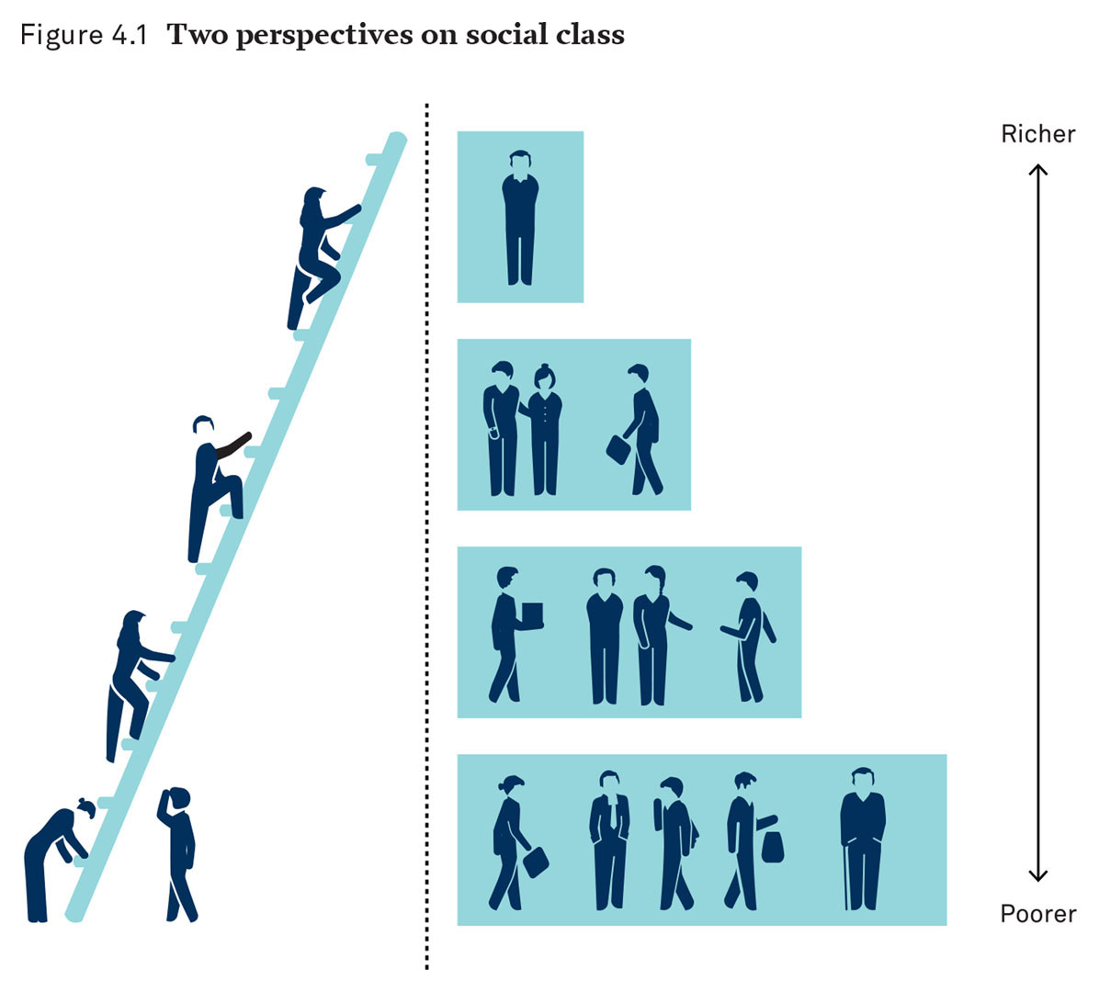
Two Perspectives on Social Class
Notes:
There are two broad perspectives on social class:
Class status as having access to a continuum of resources, with richer people above poorer people on the socioeconomic ladder (on the left)
Class as a set of discrete groups, with smaller, higher classes stacked on top of larger, lower classes (on the right)

Slide 4
Families and Social Class: Theories
Theories of Social Class
Notes:
The two broad class perspectives can be matched with consensus and conflict theory.
The assumptions of these perspectives lead to very different interpretations of class and inequality.
These differences regarding class are best understood through the issue of the division of labor.
This has been a central concern of sociology from the beginning (Durkheim 1893/1997).

Slide 5
Families and Social Class: Division of Labor
Theories of Social Class
Division of Labor
The social process of determining who does what work and for what rewards
Notes:
Consensus theorists and functionalists start with the assumption that social inequality is a necessary part of society and serves an essential function.
Davis and Moore’s (1945) statement of this position asserts that some jobs are more important or difficult than others.
A system of unequal rewards serves as an incentive to attract the most talented people to perform these tasks.
Unequal rewards are necessary to motivate individuals to strive to do the best job they can.
In this view, social class is a continuum from lower to higher rungs on the economic ladder.
Different levels of reward are not only beneficial but also necessary to the functioning of society.

Slide 6
Families and Social Class: Exploitation
Theories of Social Class
Exploitation
Notes:
The conflict perspective also uses the division of labor to explain the class system, but it comes to a different conclusion.
This perspective draws from the work of Karl Marx in the nineteenth century.
Inequality is neither beneficial nor necessary.
Inequality is a result of economic exploitation.

Slide 7
Families and Social Class: Exploitation Definition
Theories of Social Class
Exploitation
The process by which the labor of some people produces wealth that is controlled by others
Notes:
In a capitalist society, class division is not determined by skill or talent.
Class inequality is created by ownership (and a lack of ownership) of capital.
People who own and control property have resources and power over those who do not.
Individuals who do not own capital must exchange their labor in the market, and this exchange is often exploited by those with ownership.
The owners are not necessarily more skilled or more qualified; they merely have ownership.
Classes and class difference exist only in relationship to one another and do not form a continuum.
Since Marx’s time, this situation has become more complicated with the development and growth of the middle class.

Slide 8
Families and Social Class: Life Chances
Theories of Social Class
Life Chances
Notes:
Max Weber (1864–1920) used neither the consensus perspective nor the conflict perspective.
Weber explained class inequality through opportunities available to individuals.
The sociological concept of life chances posited that the opportunity to succeed is crucial to the definition of class.

Slide 9
Families and Social Class: Life Chances Definition
Theories of Social Class
Life Chances
The practical opportunity to achieve desired material conditions and personal experiences
Notes:
From this perspective, an individual with few material resources or skills does not have high life chances.
To succeed in a capitalist economy, an individual must have a practical chance, not just an abstract one.
Life chances help explain how social class works within families.
The job, income, or resources of a parent will affect the life chances of the spouse and children.
Income and other resources of family members are connected to life chances and the class position of those in the rest of the family.

Slide 10
Families and Social Class: Social Capital
Theories of Social Class
Social Capital
Notes:
French sociologist Pierre Bourdieu (1930–2002) developed the idea of social capital.
Social capital is a resource an individual has by virtue of relationships and networks and can improve that individual’s life chances.

Slide 11
Families and Social Class: Social Capital Definition
Theories of Social Class
Social Capital
The access to resources people have by virtue of relationships and connections within a social network
Notes:
Families are only one of the networks that connects us with social capital, but they might be the most important.
Different classes have different amounts of social capital.
Social capital is an added element that contributes to class stratification.

Slide 12
Theories of Social Class: Families
Families in Their Social Classes
Notes:
Two extended families will be compared:
The first is a wealthy family.
The second is a working-class family.

Slide 13
Theories of Social Class: Generations of Wealth and Privilege
Families in Their Social Classes
Generations of Wealth and Privilege
Notes:
The Winston family is an example of a family with a network of people with similar class backgrounds (upper-class) and economic circumstances.
They represent a small slice of the American upper class.

Slide 14
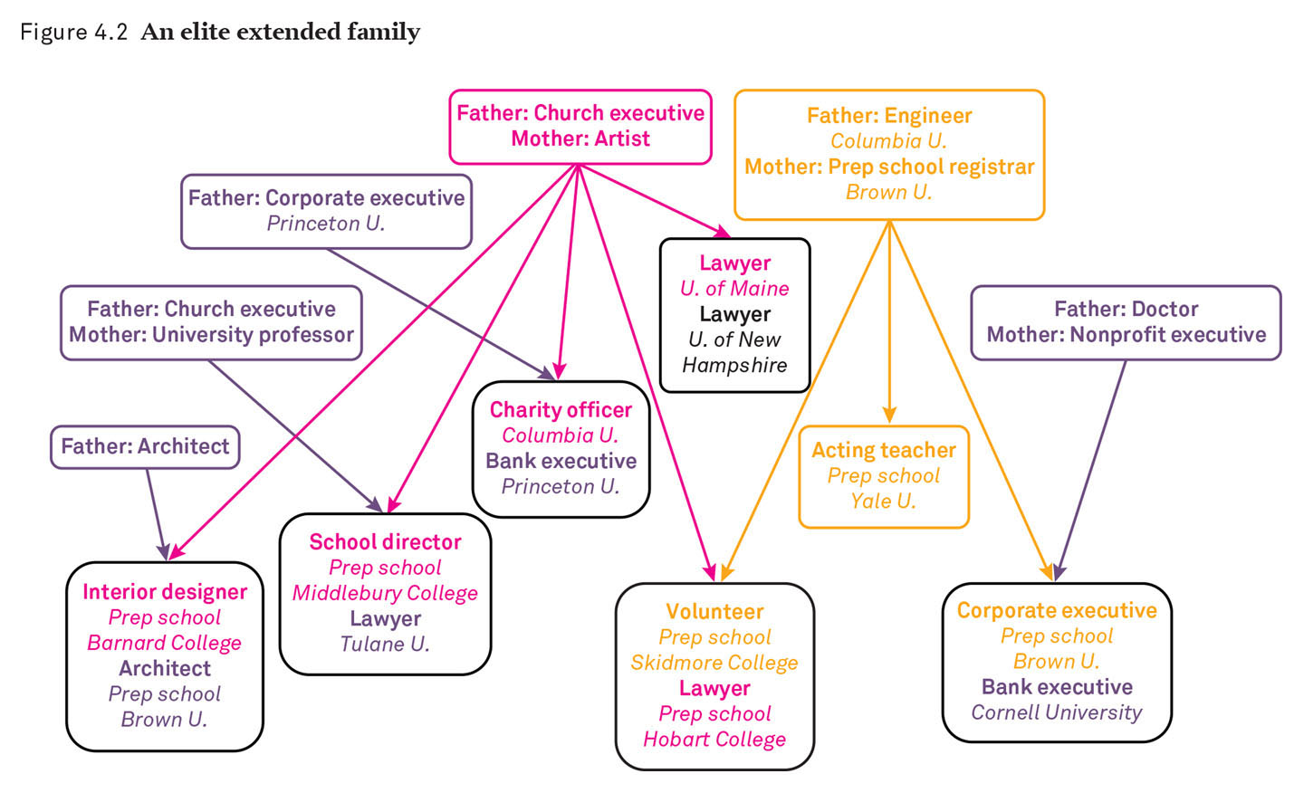
An Elite Extended Family
Notes:
This diagram shows the interconnections and networks of the Winston family and demonstrates that class is not only people but also groups of connections and family networks.
Class membership is not only a matter of inherited wealth but also of social capital and the life chances created by wealth and social capital.

Slide 15
Theories of Social Class: Generations of Working Poverty
Families in Their Social Classes
Generations of Wealth and Privilege
Generations of Working Poverty
Notes:
Families who are working poor have networks, but they do not create the same life chances as upper-class networks, which have higher social capital.

Slide 16
Theories of Social Class: Family Networks
Families in Their Social Classes
Generations of Wealth and Privilege
Generations of Working Poverty
Family Networks
Notes:
Social class networks are crucial to understanding class stratification and inequality.

Slide 17
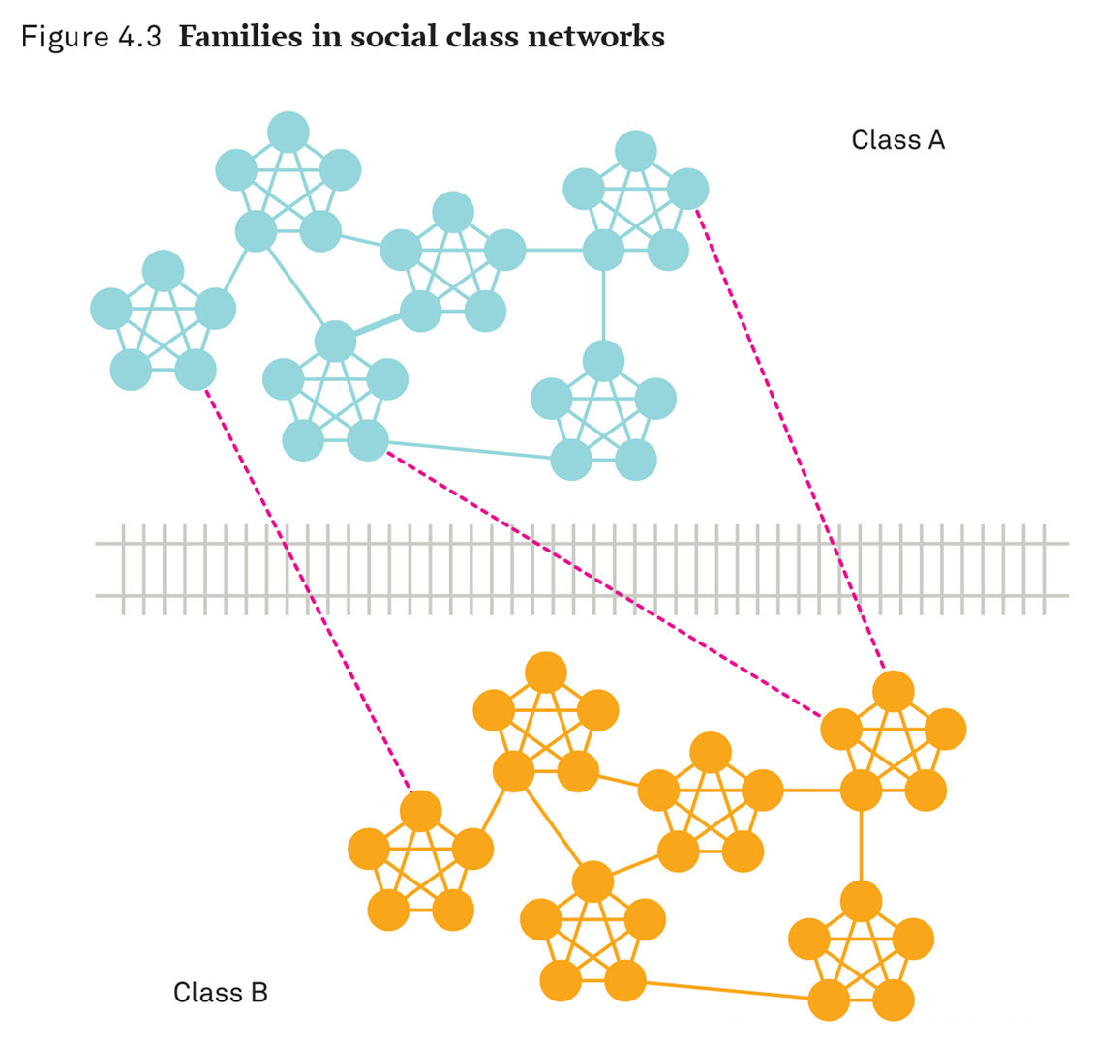
Families in Social Class Networks
Notes:
This diagram represents individuals (circles) and families (clusters of circles).
The different colors represent different social classes.
Notice that there are many more connections within each social class than between social classes.
Most families have connections only to those within the same class.
The class groups are not just at different levels; they also occupy distinct social spaces.
The barriers in between are sharply defined and are often insurmountable.
Marriage across class lines (exogamy) is uncommon.
Families are often grouped according to class divisions.

Slide 18
Theories of Social Class: Class Identity
Families in Their Social Classes
Generations of Wealth and Privilege
Generations of Working Poverty
Family Networks
Class identity
Notes:
Family networks help us understand class identity.

Slide 19
Theories of Social Class: Class Identity Definition
Families in Their Social Classes
Generations of Wealth and Privilege
Generations of Working Poverty
Family Networks
Class identity: the awareness of, and sense of belonging to, a specific social class
Notes:
Without class identity, class distinctions would be strictly economic distinctions.
But social class also incorporates distinctive ways of life, patterns of interaction, and shared patterns of thinking and acting.
Class identity also helps us figure out who belongs in which social class even when individuals have fluctuating incomes.
People are raised and socialized according to their family’s class perspectives.
Barriers between classes are strong.
Class identity is also strong and tends to be reinforced through close contact with others in the same social class.

Slide 20
The American Class Structure
Social Class Categories
Notes:
Sociologists have developed an imprecise, but working, description of the contemporary structure of social classes (Wright and Rogers 2011).
Although not exact, these categories are useful to provide a framework for learning about social class.

Slide 21
The American Class Structure: Capitalist and Corporate Managerial
Social Class Categories
Capitalist and Corporate Managerial Class
Notes:
This is what has been referred to as “the 1 percent.”
This is a very small group, but the actual number is not known.
This group is sometimes called “the upper class.”
The percentage of American adults who identify as upper class is 2.7.
This class has an extremely high standard of living.
This class has a disproportionate amount of economic and political influence.

Slide 22
The American Class Structure: Middle Class
Social Class Categories
Capitalist and Corporate Managerial Class
Middle Class
Notes:
The middle class is a much larger group than the upper class.
Historically, middle-class occupations have been relatively stable, but this is beginning to change.
The middle class usually has jobs based on higher education, technical skills, or credentials.
Members of the middle class are usually able to meet all their basic needs, including health care and education.
The middle class generally has a high rate of home ownership.
In the U.S. adult population, 42.4 percent identifies with this category.

Slide 23
The American Class Structure: Working Class
Social Class Categories
Capitalist and Corporate Managerial Class
Middle Class
Working Class
Notes:
The working class has as a standard of living comparable to the middle class but with much less stability.
Working-class jobs are based in industries, require less education and training, and are less secure.
In the U.S. adult population, 47 percent identifies with this category.

Slide 24
The American Class Structure: Lower Class
Social Class Categories
Capitalist and Corporate Managerial Class
Middle Class
Working Class
Lower Class
Notes:
Most people in the lower class do not have higher education or skilled jobs.
They tend to have low income and high economic insecurity.
They may experience periods of poverty.
They often lack adequate medical care and housing.
This group also includes the very poor, who depend on government assistance.
Only about 8 percent of the population identifies with this group, but most sociologists believe it is larger.

Slide 25
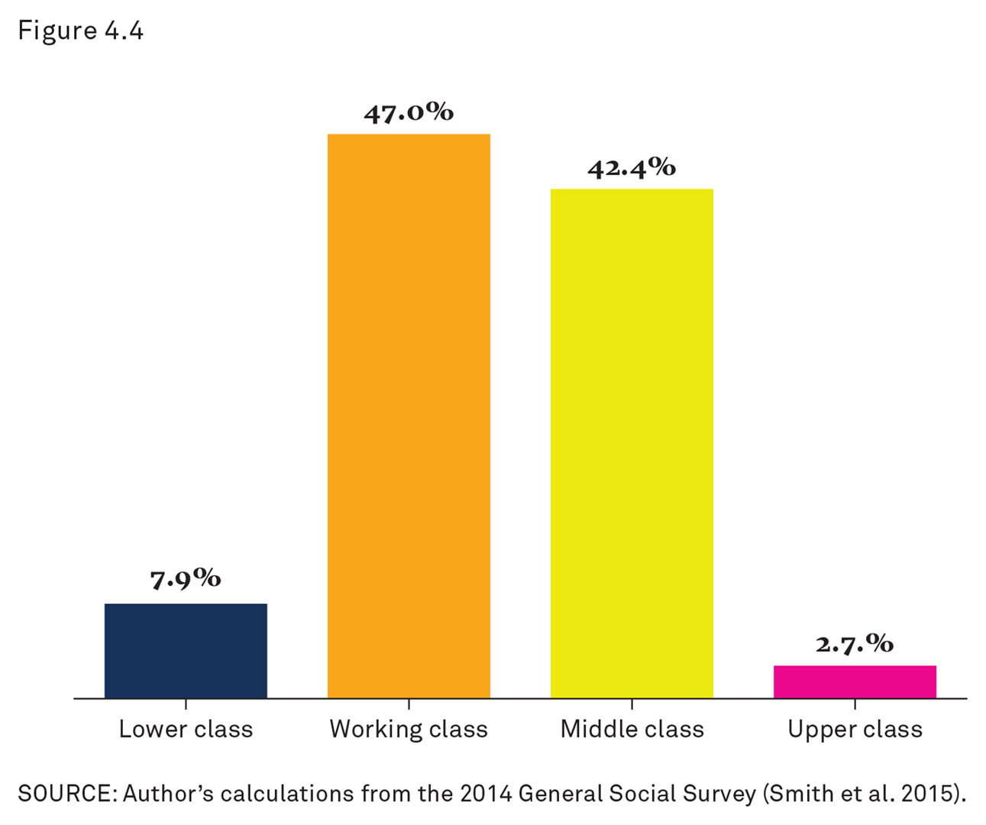
American Class Identification
Notes:
This is graph shows the author’s calculated results from the 2014 General Social Survey.
This is a general idea of how individuals perceive class identity.
Cohen notes that while only 8 percent of Americans identify with the lower class, the official poverty rate was 13.5 percent in 2015.

Slide 26
The American Class Structure: Inequality
Increasing Inequality
Notes:
Social class categories and identity are important aspects of family life.
This includes social class inequality.
An important growing trend in U.S. history for the last 50 years has been the increasing growth of inequality.

Slide 27
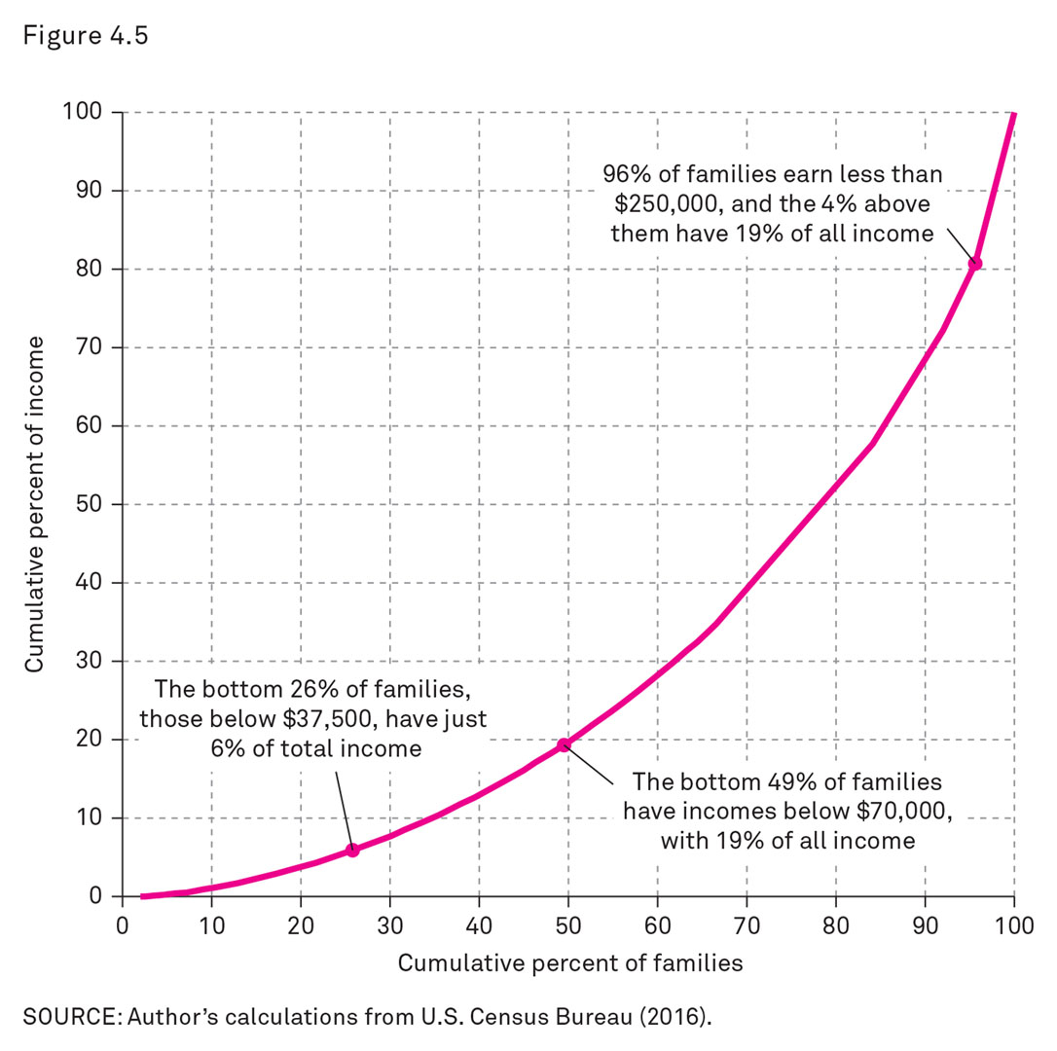
U.S. Family Income Distribution, 2011
Notes:
This graph shows the author’s calculations from U.S. Census Bureau sources.
Ninety-six percent of families earn less than $250,000, and the 4 percent above them have 19 percent of all income.
The bottom 49 percent of families have incomes below $70,000, with 19 percent of all income.
Americans’ perceptions of class in relation to actual resources, as well as increasing inequality in American society, need further investigation.

Slide 28
The American Class Structure: Gini Index
Increasing Inequality
Gini index
Notes:
The Gini index is a good tool to use to compare rates of income inequality and stratification over time.

Slide 29
The American Class Structure: Gini Index Definition
Increasing Inequality
Gini index
A measure of inequality in which 0 represents complete equality and 1 represents complete inequality
Notes:
The Gini index is a measure of inequality.
A score of 0 represents complete equality (all families have the same income).
A score of 1 represents complete inequality (one family has all the income).
Income distributions can show increases and decreases in the level of inequality.

Slide 30
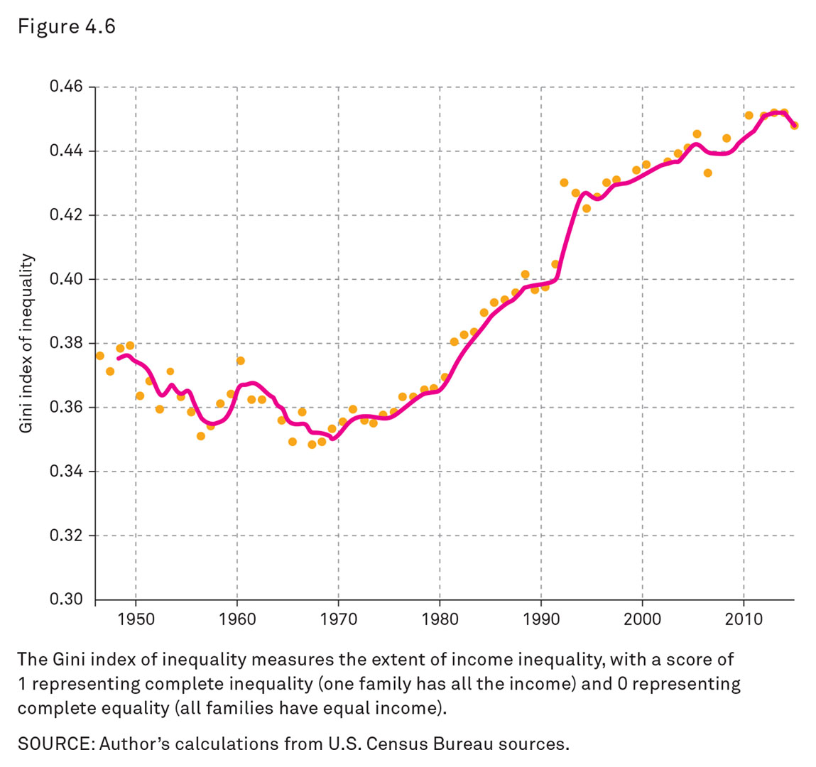
Family Income Inequality, 1947–2015
Notes:
This graph charts the author’s calculations from U.S. Census Bureau sources.
It demonstrates the dramatic increase in inequality in the United States since the end of the 1960s.

Slide 31
The American Class Structure: At the Bottom
Increasing Inequality
At the Bottom: Keeping the Poor from Improving Their Lot
Notes:
Why has inequality increased so drastically?
There are institutional factors at each level of the economic ladder that must be considered.
For the lowest earners, changes in public policy and family structure have kept incomes from rising.
Example of public policy (state and market): the legal minimum wage has been allowed to fall, especially after being adjusted for inflation and real buying power.
Example of family structure: there is a growing number of single-parent families.

Slide 32
The American Class Structure: In the Middle
Increasing Inequality
At the Bottom: Keeping the Poor from Improving Their Lot
In the Middle: Divergent Fortunes
Notes:
In the middle ranges, some families have been pulled down while others have been pushed up.
Because of global competition, there has been a decline in middle-income jobs that did not require higher education.
However, middle-income jobs with higher education are doing much better.
The education gap contributes to increased inequality.
People also tend to marry at their own education level, which further contributes to dividing the middle class.

Slide 33
The American Class Structure: At the Top
Increasing Inequality
At the Bottom: Keeping the Poor from Improving Their Lot
In the Middle: Divergent Fortunes
At the Top: The New Superrich
Notes:
A new pattern of very high income has emerged, due to government policies that include deregulation of the finance industry, reduced taxes for the very rich, and relaxed restrictions on corporate lobbying (Stiglitz 2013).
The richest 1 percent of individuals more than doubled its share of the total national income in the last four decades (Piketty and Saez 2007).

Slide 34
The American Class Structure: Poverty and Policy
Increasing Inequality
Poverty and Policy
Notes:
As the gap between rich and poor increases, it causes insecurity and instability for many families.
Social class is important for government policy, especially tax and welfare policy.
The government redistributes income through taxes to assist the poor.
Various laws establish dividing lines between rich and poor and set tax rates.
Progressive taxation taxes richer families at higher rates than poorer families.

Slide 35
The American Class Structure: Poverty Line
Increasing Inequality
Poverty and Policy
Poverty Line
Notes:
The government defines poverty and uses this definition to determine who is eligible for government benefits.

Slide 36
The American Class Structure: Poverty Line Definition
Increasing Inequality
Poverty and Policy
Poverty Line
The level of income below which the federal government defines a family or individual as poor
Notes:
This definition was created in the 1960s based on a formula that multiplied a family “economy food plan” times three.
It was assumed that food accounted for one-third of a family’s expenses.
The poverty line is adjusted annually to account for inflation.
This measure brings up political and moral questions, and implications.

Slide 37
The American Class Structure: Poverty in the United States
Poverty and Policy
Poverty in the United States
Notes:
The following are key facts organized by Cohen about poverty in the United States.

Slide 38
The American Class Structure: Poverty Increase
Poverty and Policy
Poverty in the United States
Poverty increased dramatically during the 2000s.
Notes:
In 2012, the official poverty rate in the United States was 15 percent (the highest ever recorded).
Approximately 46.5 million people were living below the federal poverty line.
By 2015, the poverty rate fell slightly, to 13.5 percent, as the economy slowly recovered from the crisis, but it is still worse than at the beginning of the 2000s.

Slide 39
The American Class Structure: Poverty Concentration
Poverty and Policy
Poverty in the U.S.:
Poverty increased dramatically during the 2000s.
Poverty is concentrated by race/ethnicity.
Notes:
Indigenous Americans, Latinos, and African Americans are about three times more likely to be poor than Whites.
This disparity is growing because of recent trends (Edin and Kissane 2010).

Slide 40
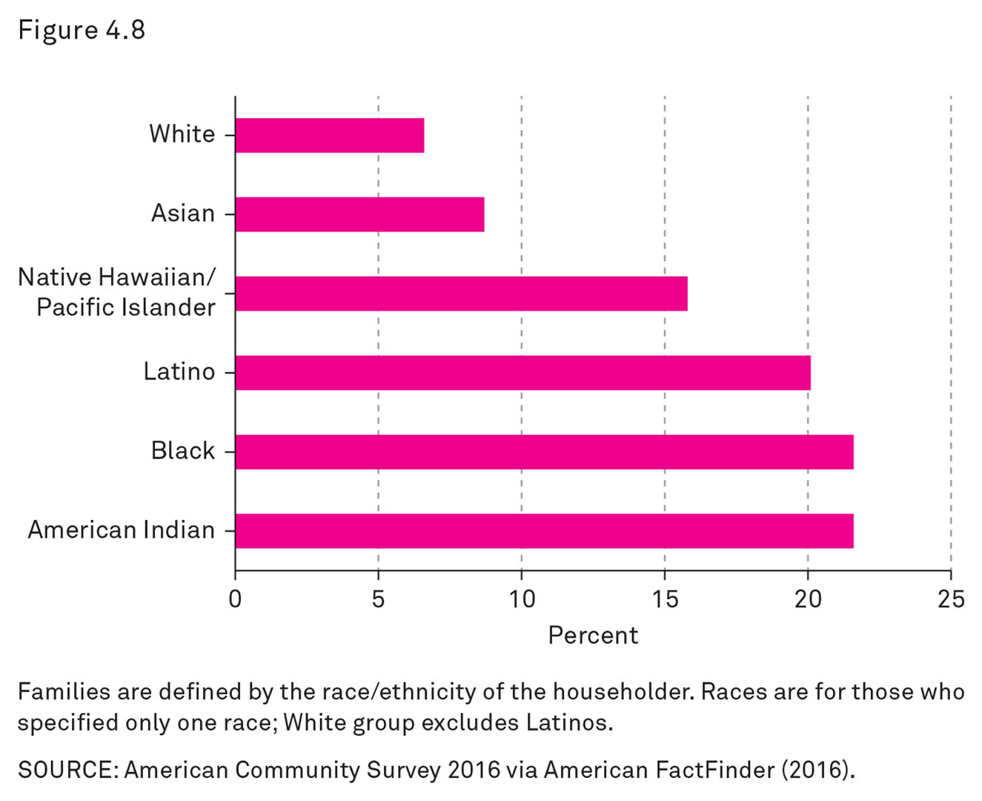
U.S. Family Poverty Rates by Race/Ethnicity, 2011
Notes:
This graph compares poverty rates by race/ethnicity.
Families are defined by the race/ethnicity of the householder.
Races are for those who specified only one race.
The White group excludes Latinos.

Slide 41
The American Class Structure: Poverty and Family Structure
Poverty and Policy
Poverty in the United States
Poverty increased dramatically during the 2000s.
Poverty is concentrated by race/ethnicity.
Poverty is closely related to family structure.
Notes:
Families with a single-mother head of household are more likely to be poor than any other group in the United States.
African Americans and people with less education are less likely to marry.
Women with less education have more children, on average.
A single woman who lives with her children is especially likely to become poor or be unable to rise out of poverty.

Slide 42
The American Class Structure: Poverty and Older People
Poverty and Policy
Poverty in the United States
Poverty increased dramatically during the 2000s.
Poverty is concentrated by race/ethnicity.
Poverty is closely related to family structure.
Poverty for old people has dropped dramatically since the 1960s.
Notes:
In 1959, more than one-third of people age 65 years or older lived in poverty.
As the Social Security program distributed more money to retired people, and people started working longer into old age, poverty rates plummeted.
By 2015, only 9 percent of people age 65 years or older lived below the poverty line.

Slide 43
The American Class Structure: Deprivation
Poverty and Policy
Poverty in the United States
Poverty increased dramatically during the 2000s.
Poverty is concentrated by race/ethnicity.
Poverty is closely related to family structure.
Poverty for old people has dropped dramatically since the 1960s.
People in poverty suffer from serious deprivation.
Notes:
Those who are poor go without many of the things most people consider necessary.
Deprivation can be episodic.

Slide 44
The American Class Structure: Homelessness
Poverty and Policy
Poverty in the United States
Poverty increased dramatically during the 2000s.
Poverty is concentrated by race/ethnicity.
Poverty is closely related to family structure.
Poverty for old people has dropped dramatically since the 1960s.
People in poverty suffer from serious deprivation.
Homelessness has declined but remains a serious problem.
Notes:
Approximately 600,000 people are homeless.
About one-third of unhoused people live with their family; the rest live alone.

Slide 45
The American Class Structure: Moving In and Out of Poverty
Poverty and Policy
Poverty in the United States
Many people move in and out of poverty.
Notes:
Poverty is an experience many Americans have at some point in their lives.
Individuals and families near or just slightly about the poverty line may fall in and out of poverty.
Even if an individual is not officially poor, he or she may experience extreme economic uncertainty.
And still more people face chronic housing insecurity, moving in and out of substandard housing, unable to pay both rent and utility costs, or facing eviction.

Slide 46
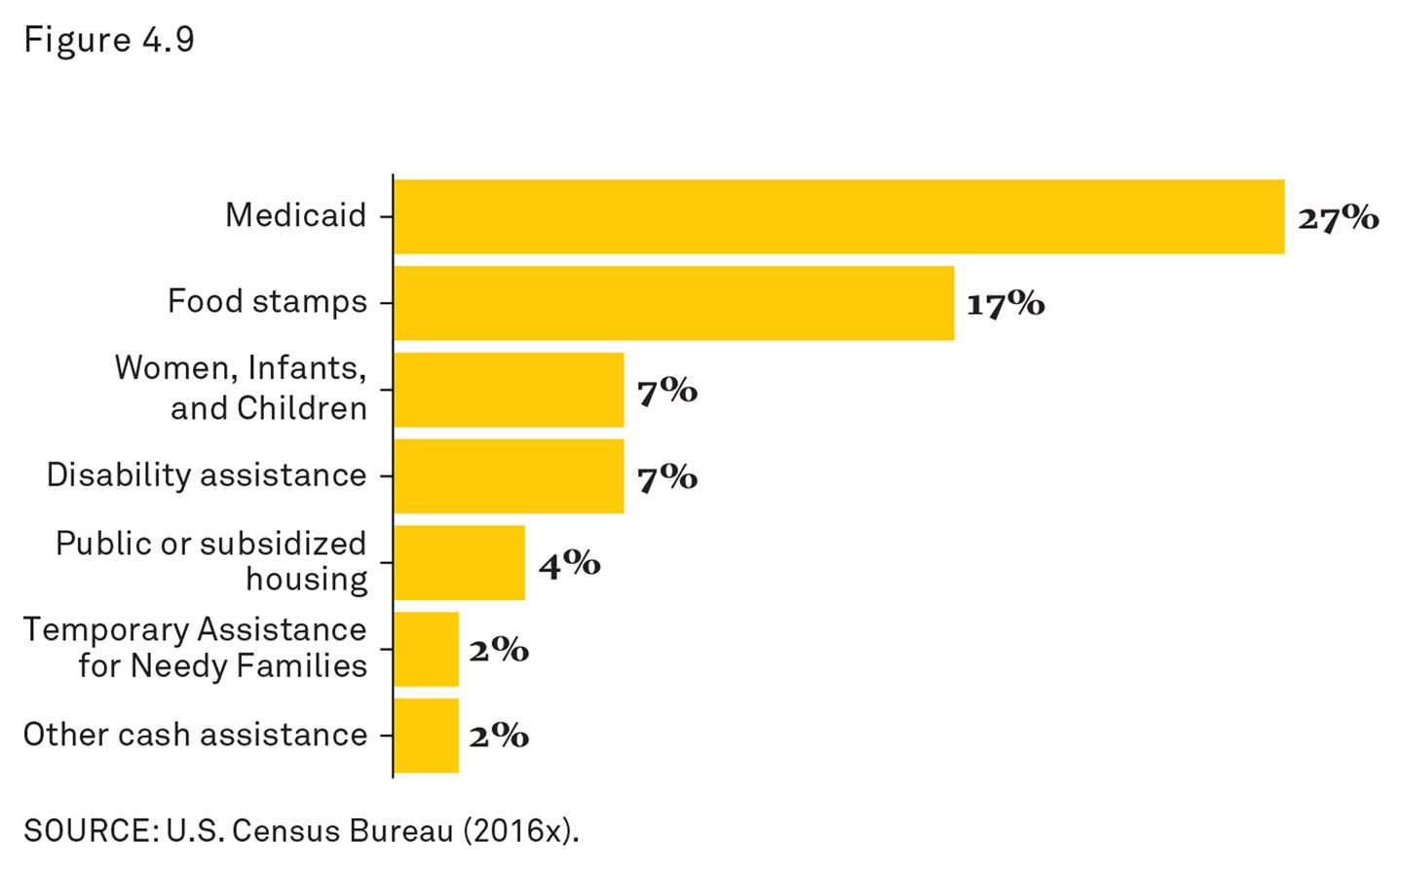
The American Class Structure: Households Where Someone Receives Federal Assistance
Notes:
This graph shows the most common poverty assistance programs in the United States.
Programs include Medicaid, “food stamps” (Supplemental Nutrition Assistance Program [SNAP]), and WIC (Women, Infants, and Children program), among others.
It is estimated that these benefits reduce the number of people in real poverty by half.
But even after taking government benefits into account, almost one in six Americans does not have the income necessary to support their basic needs (Short 2011).
This number includes a significant portion of the working class who have become the working poor because the income from their jobs is not enough to live on.

Slide 47
The Story behind the Numbers: Unmarried Male-Headed Families
Notes:
Single parents with children are much more likely to be poor than married couples with children.
This graphic shows the number and percentage of unmarried male-headed families (2.9 million; 16 percent of this population).
Source: U.S. Census Bureau (2012).

Slide 48
The Story behind the Numbers: Families in Poverty
Notes:
(Again, single parents with children are much more likely to be poor than married couples with children.)
Single mothers, in particular, are more likely to be poor.
Thirty percent of single-mother families live below the official poverty line.
This graphic shows the number and percentage of unmarried female-headed families (14.7 million; 30 percent of this population).
Source: U.S. Census Bureau (2016).

Slide 49
The Story behind the Numbers: Married Couple Families
Notes:
This percentage can be compared to just 6 percent of married-couple families who live below the official poverty line.
There are almost as many poor people in married-couple families (12.3 million) as there are in poor single-mother families (14.7 million).
This is because there are many more married-couple families than single-mother families in the population.
This graphic shows the number and percentage of married-couple families (12.3 million; 6 percent of this population).
Source: U.S. Census Bureau (2016).

Slide 50
The Story behind the Numbers: Unrelated Individuals
Notes:
This graphic shows the number and percentage of unrelated individuals who are poor in the United States (12.7 million; 21 percent of this population).
Even if poverty were eliminated among all single-mother families, there would still be almost 28 million people in the United States who live below the official poverty line.
Source: U.S. Census Bureau (2016).

Slide 51
Eviction
The experience of eviction has become much more common.
Legal vs Informal
Notes:
Sociologist Matthew Desmond, in his book Evicted (2016), reported that most poor families in the rental market spend more than half their income on housing expenses, one in eight is unable to pay all their rent in a given year, and millions are evicted.
Some evictions are legal: landlords get court orders and sheriff’s crews carry out the family’s possessions.
But more are informal “forced moves”: landlords pressure tenants to leave or threaten to evict them as a way to get them out of the residence.

Slide 52
Social Class Mobility and Class Persistence
Social Mobility
Notes:
Most children follow in their parents’ footsteps when it comes to social class.
Most children obtain a similar education and occupation, and tend to marry within their social class (endogamy), however this is not always true.
How social classes reproduce from generation to generation (social mobility) is a major sociological issue (Beller and Hout 2006).

Slide 53
Social Class Mobility and Class Persistence: Social Mobility Definition
Social Mobility
The movement, up or down, between social classes
Notes:
Social class status of parents versus the social class status of an individual as an adult is an important area of sociological research.
Most Americans believe we live in a society with a high degree of social mobility.
The prevailing American belief is that any one individual, with enough hard work, can achieve a higher social status than his or her parents.
In fact, however, although social mobility is possible in our society, it is also unlikely.
Compared with most other wealthy countries, the United States has less social mobility.
American children are more likely to end up in economic conditions similar to their parents, especially those at the high and low ends of the economic scale.
The tendency of children to reproduce their parents’ social class is termed social persistence.

Slide 54
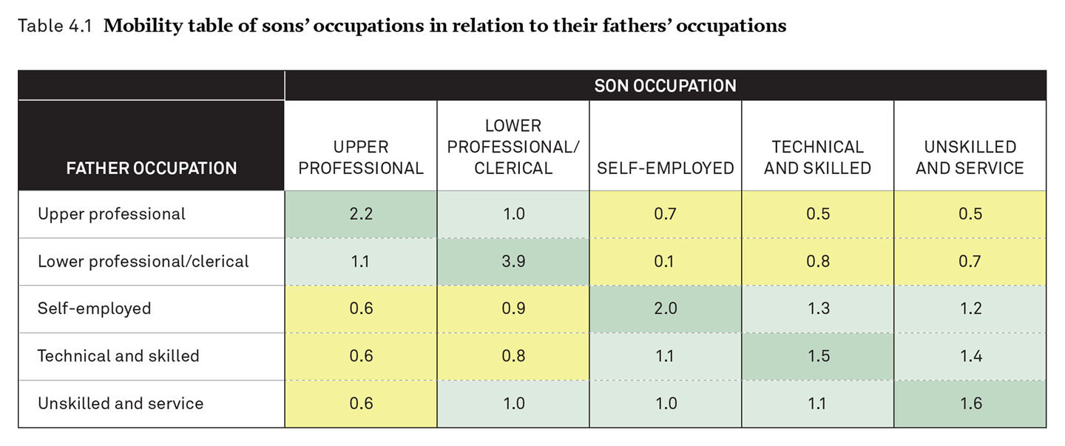
Mobility Table
Notes:
This is a table created by Cohen using his calculations from the General Social Surveys, 2006–2010 (Smith et al. 2014), and the categories from Beller and Hout (2006).
This shows the general extent of social class persistence in the United States.
Numbers higher than 1.0 (in green) indicate that sons are more likely to be in that occupational category; numbers less than 1.0 (in yellow) indicate that the outcome is less likely.

Slide 55
Social Class Mobility and Class Persistence: Family Structure
Family Structure
Notes:
Family structure has an impact on social class, social class mobility, and social class persistence.
Children are likely to remain in the same social class as the one in which they grow up.
More in-depth facts will be discussed in later chapters.
People with lower incomes are less likely to marry (Chapter 8).
People with less schooling have more children than those with higher levels of education (Chapter 9).
People with less schooling have a higher risk of divorce (Chapter 10).
As a result of these facts (which will be examined in more detail in later chapters):
Children who live with married parents are concentrated in higher-income families.
Children who live with single parents (most often the mother) tend to live in families on the lower end of the income scale or in poverty.

Slide 56
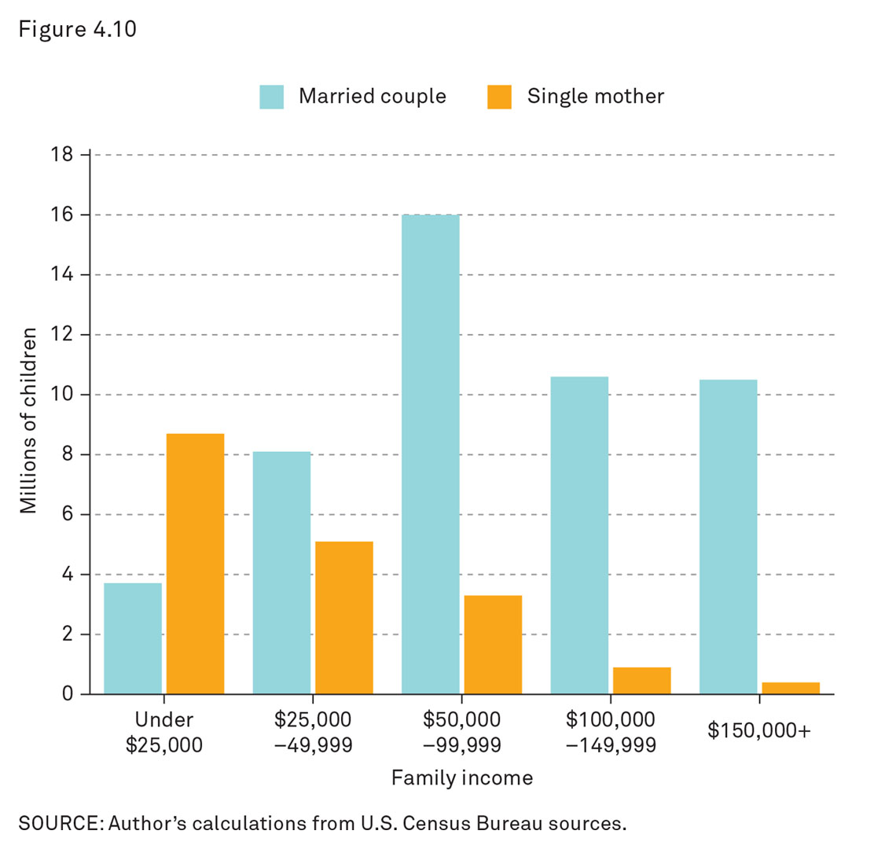
Distribution of Children by Family Type and Family Income, 2010
Notes:
This is a graph created by Cohen using his calculations from U.S. Census Bureau sources.
The most common situation for children of single mothers is a family income below $25,000.
There are more than 8 million children in this category.
The most common situation for children of married parents is a family income between $50,000 and $99,999.
Family structure clearly affects children’s lives.
Given the tendency toward social class reproduction from parent to child, this suggests children of single mothers are most likely to be in the lower and working classes.
Children with single parents have three main obstacles to reaching the middle and upper classes: money, time, and social capital.

Slide 57
Social Class Mobility and Class Persistence: Money
Family Structure
Money
Notes:
The most important factor separating children of single mothers from children with married parents is money, or lower income.
If is difficult for many single-mother families to meet basic needs.
Children in these families live with economic uncertainty and insecurity.

Slide 58
Social Class Mobility and Class Persistence: Time
Family Structure
Money
Time
Notes:
Single mothers have less time to spend with their children (Vickery 1977).
There are crushing time demands on low-income mothers who must work to support their families (Kendig and Bianchi 2008).
Lack of parental time reduces the ability of parents to supervise and support their children.

Slide 59
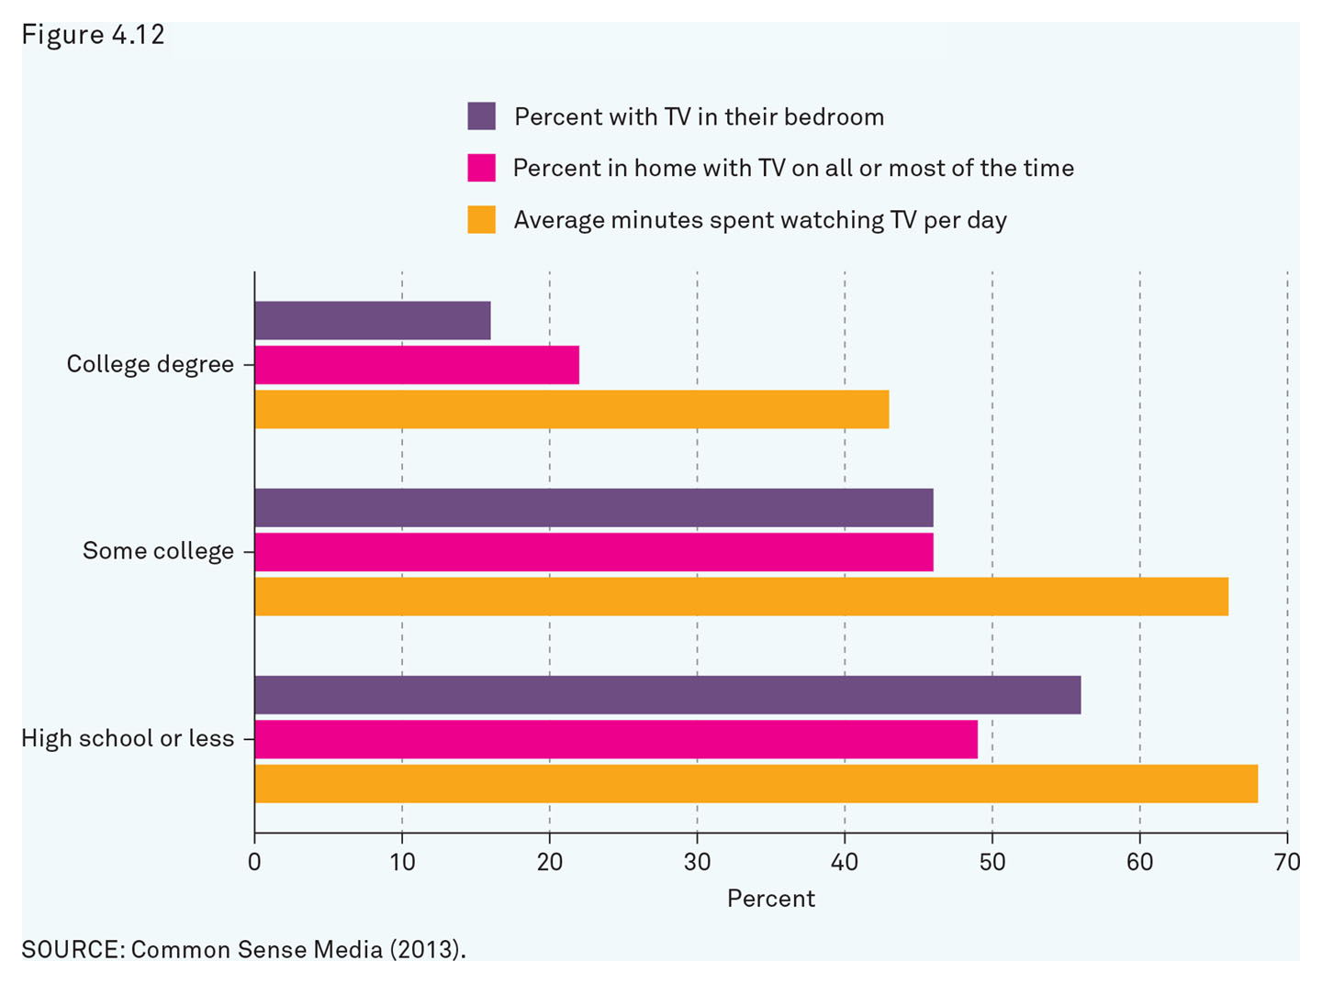
Media Time for Children
Notes:
The digital divide is an important area of study because it plays a role in the reproduction of social class inequality.
Even though the percentage of households with Internet access increased to 75 percent by 2012, fewer than 40 percent of those with less than a high school degree have access at home.
The gap in media time reflects the stresses and demands lower-income parents face (among other factors).
For example, some parents might have concerns about the neighborhoods in which they live and restrict children to indoor activities (e.g., television, video games).
Media time for children might be a practical necessity for parents who work long hours and commute.
The biggest difference is in television watching: the children of those with only a high school degree or less spend 25 minutes more per day watching TV than those whose parents graduated from college.
The quality of media time is just as much of a concern as the quantity.
Source: Common Sense Media (2014).

Slide 60
Social Class Mobility and Class Persistence: Social Capital
Family Structure
Money
Time
Social Capital
Notes:
Social capital is also a scarce resource for single-parent families.
Children in single-parent families may have access and exposure to fewer cultural resources as they grow up.
The challenges low-income children (and their families) face from lack of money, time, and social capital do not determine lack of social mobility, but certainly make it more difficult.

Slide 61
Social Class Mobility and Class Persistence: Family Practices
Family Structure
Family Practices
Notes:
Most American parents try to help their children succeed in life.
American society puts pressure on parents to improve the life chances of their children.
Even when parents do everything “right,” their children still may not succeed.
Family practices differ across social classes.
In Melvin Kohn’s classic studies, he found that parents with jobs that required self-direction were more likely to raise their own children to value that quality (Kohn 1977).
Alternately, he found that parents with jobs that required them to follow orders tended to raise children who valued conformity.
Most parents prepare their children (often unintentionally) to follow in their own occupational track.
Sociologist Annette Lareau studied social class and parenting (2011) for more than a decade in an in-depth study of carefully selected families.
Lareau found major differences between middle-class parents and working-class parents.

Slide 62
Social Class Mobility and Class Persistence: Concerted Cultivation
Family Structure
Family Practices
Concerted Cultivation
Notes:
Middle-class parents practice what Lareau termed concerted cultivation.
This is an intensive approach to parenting that involves parents engaging their children in age-targeted activities designed to enhance their cognitive and social development.
Specifically, middle-class parents teach their children to actively engage with authority figures rather than passively submitting to authority.
Alternately, Lareau found that working-class and poor parents practice the accomplishment of natural growth.

Slide 63
Social Class Mobility and Class Persistence: Natural Growth
Family Structure
Family Practices
Concerted Cultivation
Accomplishment of Natural Growth
Notes:
Working-class and poor parents tend to see a child’s successful development as a natural process stemming from protection, comfort, and care.
Working-class and poor parents do not schedule as many formal activities as do middle-class parents.
Working-class and poor parents permit more informal, unscheduled play time with peers in the neighborhood.
As a result, working-class and poor children tend to be less assertive and to defer to the decision-making of authority figures.
Class differences result in different attitudes and perspectives toward adulthood and independence.
Children raised with concerted cultivation are more likely to grow up with confidence, empowerment, and a sense of entitlement.
Working-class and poor parents may miss opportunities for their children to move up in the class hierarchy.

Slide 64
Social Class Mobility and Class Persistence: Gini Index
Family Structure
Family Practices
Concerted Cultivation
Gini index: a measure of inequality, in which 0 represents complete equality and 1 represents complete inequality

Slide 65
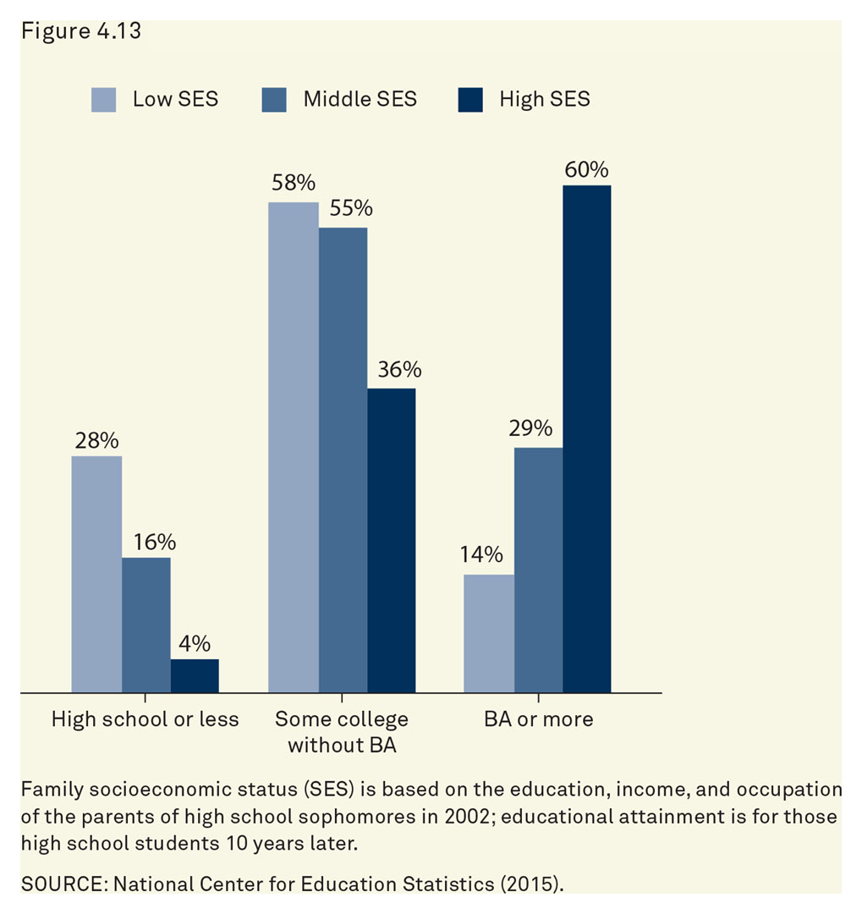
Changing Culture: Educational Inequality (High School Dropout and College Completion Rates)
Notes:
Education has grown more important for separating people into higher and lower social classes.
Children from higher social classes are more likely to succeed in the educational system.
Children from families of high socioeconomic status (SES) are four times more likely to complete a 4-year college degree than those from families of low SES (60 percent vs 14 percent).
Source: National Center for Education Statistics (2015).

Slide 66
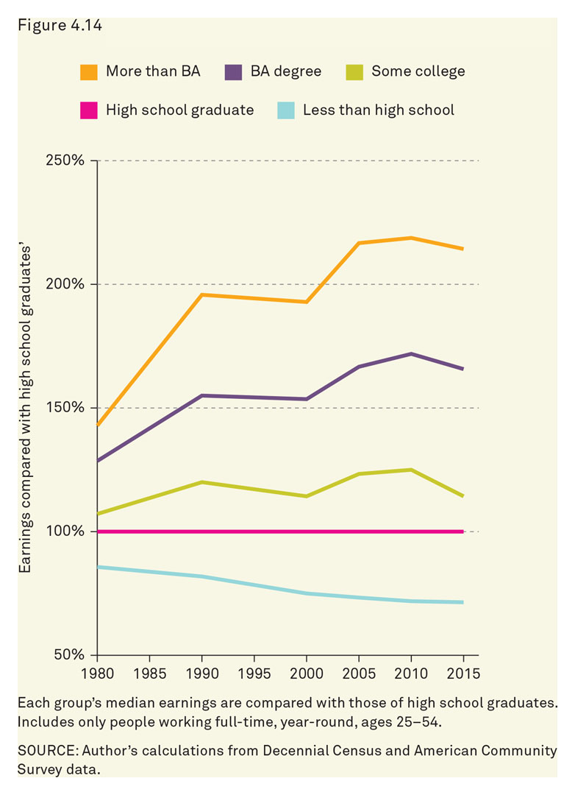
Changing Culture: Educational Inequality (Differences in Earnings by Education)
Notes:
The best chance for social mobility is still through the higher education system (Breen 2010).
The achievement gap between those from rich families and those from poor families has been increasing (Reardon 2011).
This growing inequality also increases pressures on parents to help children succeed.
Since the 1980s, those with BAs and higher degrees have been pulling away from workers who only completed high school, with the former now earning about 1.7 times and 2.1 times more, respectively, than the latter.

Slide 67
The 1 Percent
United States Has Seen Rising Income Inequality for the Last Several Decades
Will This Trend Continue?
Notes:
In 1980, the richest 1 percent of individuals earned 11 percent of all income; by 2014, that share going to the very richest had increased to 20 percent.
The bottom 50 percent of all earners pull in only 13 percent of all income.

Slide 68
Class Activity
The “SNAP Challenge”
How Much Do Your Meals Cost?
Notes:
Class Activity
Have students research how much SNAP benefits an average family receives in their area.
Alternately, instructors can assign a specific daily dollar amount.
The SNAP/Food Stamp Challenge has been gaining in popularity over the last few years.
There are charitable websites that use the challenge to increase awareness for food insecurity, and even members of Congress have participated in different versions of the challenge.
Instructors can draw up their own list of SNAP Challenge rules or visit websites that provide ready-made challenge instructions.
Here is one good website that provides a comprehensive toolkit:
Designate a time in which to complete the challenge (24 hours is sufficient for most classes).
Students may participate individually or in small groups.
Have students or groups report the results of the challenge to the entire class.

Slide 69
Review Question 1
1. Functionalist theories argue that since social inequality exists in all societies, it
must be eliminated.
is harmful.
serves an essential purpose.
prevents exploitation.
Notes:
Answer: C
Discussion: Because it exists in all societies (to varying degrees), functionalists argue that social inequality is necessary. They argue that unequal rewards provide incentives for people to get the best jobs they can, which may include acquiring the education and training to do difficult work. Inequality is beneficial and necessary for society to function well.

Slide 70
Review Question 2
2. The fact that American Indians, Latinos, and African Americans are about three times more likely to be poor than Whites is evidence of
cultural deficiency.
the poverty line.
the concentration of poverty by race/ethnicity.
equitable distribution of wealth.
Notes:
Answer: C
Discussion: The percentage of American Indians, Latinos, and African Americans living in poverty is higher than the percentage of Whites living in poverty even though Whites make up the numerical majority of the population. This concentration of poverty is related to educational access, incarceration, and family structure, as well as racism and sexism.

Slide 71
Review Question 3
4. Octavia’s parents are professionals, as are her parents’ siblings and most of their friends. They are able to draw on their social networks to help Octavia achieve her goals. This is an example of
Bourdieu’s social capital.
Marx’s conflict theory.
Weber’s iron cage.
Durkheim’s division of labor.
Notes:
Answer: A
Discussion: Octavia has social capital because she has access to a network of people who have connections and resources that can help her make connections.

Slide 72
Review Question 4
5. Beth takes piano lessons, plays on a youth soccer team, attends after-school tutoring, and goes to science camp. Beth’s college-educated professional parents engage in a style of parenting called
helicopter parenting.
accomplishment of natural growth.
conformity.
concerted cultivation.
Notes:
Answer: A
Discussion: Social networks can be important resources for gaining opportunities and access to education, jobs, experiences, friends, and romantic partners.

Slide 73
This concludes the Lecture Slide Set for Chapter 4
© 2018 W. W. Norton & Company, Inc.
Independent and Employee-Owned

