Slide 1
3
Race, Ethnicity,
and Immigration
Slides by Joanna Pepin

Slide 2
What Are Race and Ethnicity?
Biology and Race
Notes:
Eighteenth-century creation of race as a category
Roughly corresponded to the populations of the different continents (Banton 1998)
Influence of Charles Darwin’s theory of evolution by natural selection
Created hierarchical ranking of cultural superiority
Reinforced the legitimacy of more industrially “advanced” populations (Gould 1996)
Race not supported by biology or scientific principles
Race does not fit scientific criteria (Keita et al. 2004)
Social construction of race now acknowledged by (most) social science

Slide 3
What Are Race and Ethnicity? Definitions
Biology and Race
Definitions
Race: A group of people believed to share common descent, based on perceived innate physical similarities
Ethnicity: A group of people with a common cultural identification, based on a common language, religion, ancestral origin, or traditional practices
Notes:
Race is socially constructed and is a social definition.
Race is not strictly biological or natural.
Racial identification usually conforms to how others see us and involves self-identification.
The American definition of “Black” emerged from the economic interests of slavery, not a scientific understanding of race (Moran 2001).
The rule of hypodescent, or the “one-drop” rule, identified anyone with any amount of Black ancestry as Black in the eyes of the law and white society (Moran 2001).
Race reflects social perceptions of biological categories.
Race is a social category.
Categories and perceptions are passed from parents to children.
Family and family interaction are the first site of racial self-awareness.
Race is distinct from ethnicity.
Race reflects perceived biological differences; ethnicity reflects perceived cultural differences.
Ethnicity and race are different social categories, but the concepts often overlap.
Ethnicity can sometimes be voluntary or an option, whereas race (even though it can be self-identified) is more stable.
In American culture, race and ethnicity can be (and often are) used interchangeably.
Ethnic groups can be racialized.

Slide 4
What Are Race and Ethnicity? Definition of Racial Ethnicity
Biology and Race
Definitions
Racial Ethnicity: An ethnic group perceived to share physical characteristics
Notes:
In racial ethnicity, an ethnic group is thought about in racial terms.
It involves conflating physical similarities with cultural identification.
Example: Using the terms African American (ethnic) and Black (racial) interchangeably
Example: Identifying a woman as Latina because she “looks Latina”
Aspects of family life reflect racial and ethnic categories.

Slide 5
What Are Race and Ethnicity? Definitions of Endogamy and Exogamy
Biology and Race
Definitions
Endogamy: Marriage and reproduction within a distinct group
Exogamy: Marriage and reproduction outside one's group
Notes:
Exogamy is marrying someone from outside your group.
Marriage between people from different racial and ethnic groups is on the rise.
The increasing occurrence of exogamy indicates acculturation, acceptance, and similar factors, which will be discussed at the end of the chapter.
Interracial marriage is defined later in this chapter.
Endogamy is marrying someone “like yourself.”
It is an important way of maintaining racial and ethnic divisions.
It is one of the ways in which racial and racial-ethnic boundaries persist.
Marriage is discussed further in Chapter 8.

Slide 6
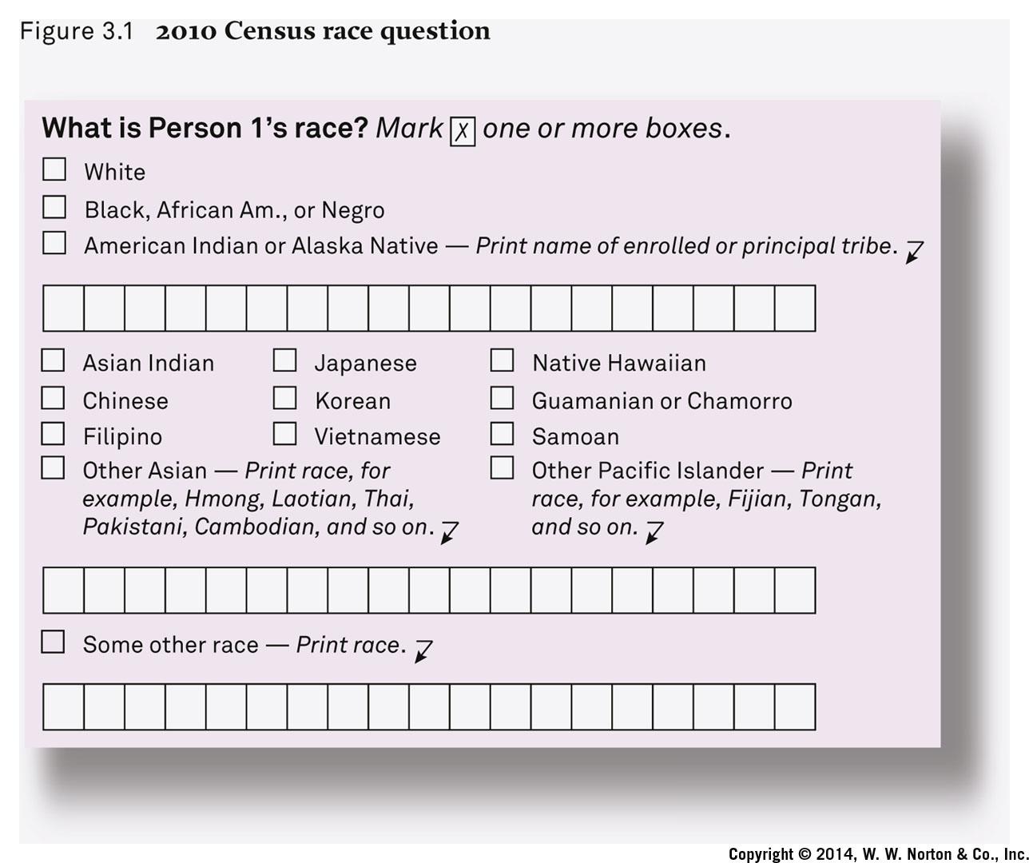
How the U.S. Government Measures Race
Notes:
The U.S. government currently counts five distinct races.
Individuals are allowed to identify with as many races as they choose.
Ethnicity (including Hispanic and Latino) is counted in a separate category.
The census is undertaken every 10 years, as mandated by the U.S. Constitution.
An analysis of the census race question can give us insight on how Americans view race.
In 2020, the Census Bureau will probably begin using a new form to clear up confusion many people have over the difference between race and ethnicity.
The Census Bureau proposes combining the races and Latino ethnicity into one question.

Slide 7
What Are Race and Ethnicity? Whiteness
Biology and Race
Definitions
What about Whites?
Notes:
Whiteness is another culturally constructed category.
Who is considered “White” has changed over history.
European ethnic groups from the nineteenth and twentieth century became what we now perceive as White Americans.
This involved a process of immigration and assimilation, which will be discussed later in this chapter.
Whiteness is often taken for granted or goes unrecognized.
Whiteness is also perceived as biological but is in fact culturally constructed.
Racial-ethnic groups have more difficulty identifying as White.

Slide 8
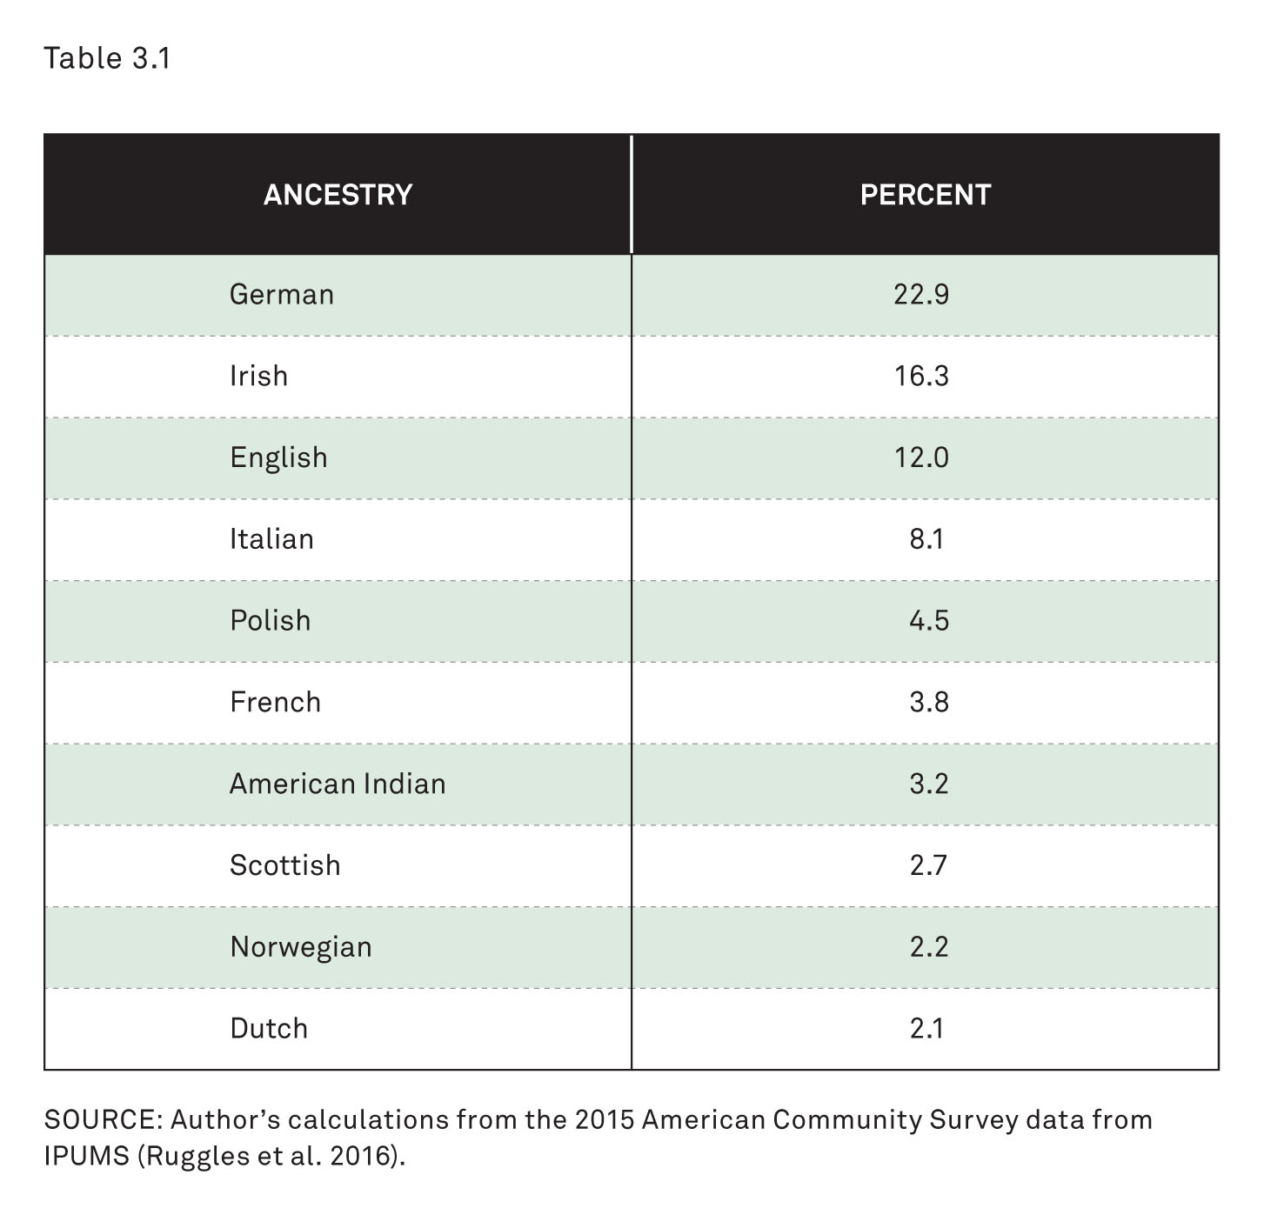
American White (Non-Hispanic) Ancestry
Notes:
Racial identification question from 2010 U.S. Census
Different category and question for ethnicity
Note the fill-in-the-blank responses, which are mostly European ethnic.
The difficulty of question is indicated by confusing answers that do not fit the category, like “American.”

Slide 9
What Are Race and Ethnicity? Minority Group
Biology and Race
Definitions
What about Whites?
Minority Group: A racial or ethnic group that occupies a subordinate status in society
Notes:
Minority status does not necessarily mean a group of fewer people.
Minority refers more to a group’s relationship to the majority group
A majority group is one that has access to power, status, privilege, and resources.
The unequal power relationship between minority and majority is especially important.

Slide 10
American Stories: American Indians
American Indians
Traditional Family Life
On and Off the Reservations
Notes:
Population decimated by conquest, oppression, disease, and genocide
Many still live in very harsh conditions far from ancestral homelands.
Family life has been crucial to survival and resistance.
Population beginning to grow again, especially in last 50–100 years
Self-identification has become more culturally acceptable
More willingness today to identify with (mixed) heritage than previously
Relatively high rates of mixing and intermarriage historically with Whites and Latinos
Family life was central to social structure.
It stressed values of cooperation over competition and collectivity over individualism.
Family boundaries were not strict or narrow; rather, they were broadly defined.
Diverse family practices
Included acceptance of same-sex marriage and a third gender identity
Some polygamy, but it was not a predominant practice
The majority left tribal lands in the twentieth century.
Forced relocation, boarding schools, and placement of children with White foster families disrupted social and family life.
In 2010, only 22 percent of American Indians were living on tribal land.
This weakened the hold of traditional values and practices, and of families.
Modern problems include obesity, diabetes, alcoholism, suicide, and violence (especially against women).

Slide 11
American Stories: African Americans and Slavery’s Legacy
American Indians
African Americans
Slavery’s Legacy
The Moynihan Report—1965
Notes:
Racial inequality experiences through family life
Issues such as slavery, discrimination, poverty, unemployment, high mortality, and segregation
Longer-term role of slavery’s legacy
Powerful presence in Black families, but also resilience
Families shaped more by slavery, discrimination, and poverty than by cultural traditions from Africa
Families more fluid, less stable
Informal, common-law marriage and higher divorce rates than for other groups
Weak tradition of nuclear family
Matriarchal, female dominated
Led to assessment by Senator Daniel Patrick Moynihan in the Moynihan Report
Daniel Patrick Moynihan, U.S. senator (NY), sociologist and government analyst
Contributed to the belief that the nature of the Black family was fundamentally flawed
“Problem” of female domination
Judged Black family as too female centered and matriarchal
A type of “blame the victim” approach
Created further racist stereotypes
Countered by the Family Resilience approach

Slide 12
American Stories: African Americans
American Indians
African Americans
Slavery’s Legacy
Family Resilience
Urban Poverty
Notes:
Economic hardship even after slavery
Kept traditional nuclear family out of the reach of most African Americans
Newer theoretical approach focusing on the Black family as resilient and adaptive rather than problematic
Matrifocal, not a “problem with matriarchy”
Family resilience in the face of discrimination, migration, poverty, mortality, and lack of opportunity
Increase in industrialization and urbanization
The Great Migration between World War I and the 1950s created changes, new opportunities, and new problems.
Migration from southern rural areas to northern urban cities
Creation of residential segregation through formal and informal practices (e.g., redlining and preferential home mortgages for White families)
Deindustrialization contributed to unemployment, urban decline, and higher residential segregation (e.g., White flight)
High-profile images of Black middle class (e.g., Cosby Show) inconsistent with reality

Slide 13
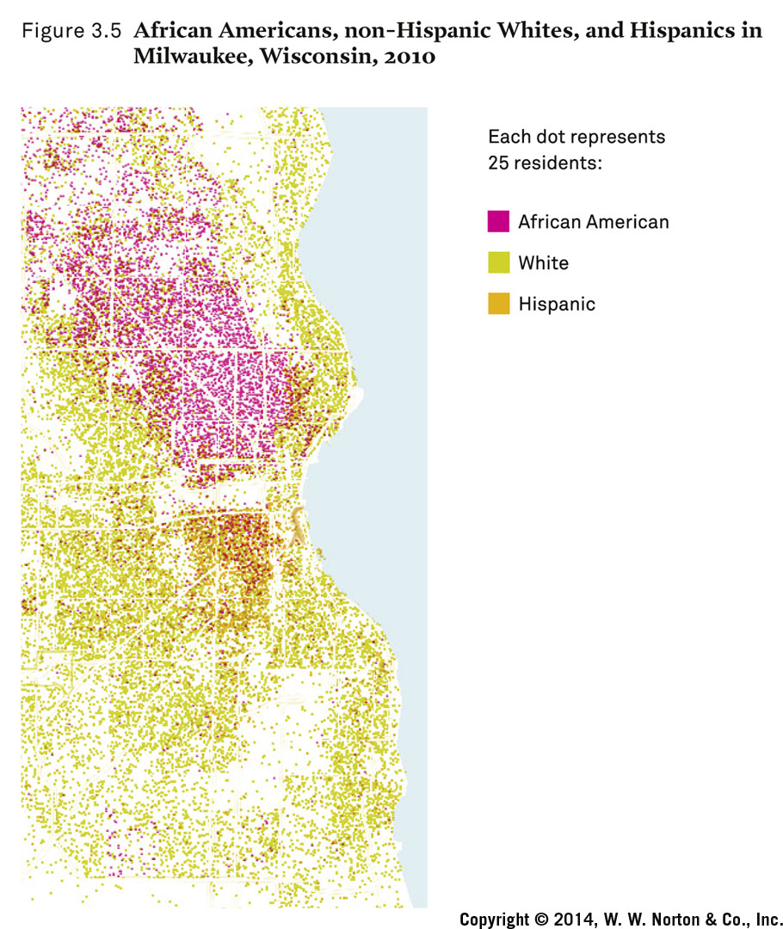
Residential Segregation in Milwaukee, Wisconsin, 2010
Notes:
Data obtained from 2010 U.S. Census
Depicts persistent patterns of residential segregation in Milwaukee, Wisconsin
Milwaukee: “The most residentially segregated city in 2010”
Residential segregation created by intentional government policies and informal social practices
Examples: Redlining and preferential home mortgage programs for White families

Slide 14
American Stories: African Americans and Marriage
American Indians
African Americans
Slavery’s Legacy
Family Resilience
Urban Poverty
Retreat from Marriage?
Notes:
Marriage rates of African Americans differ from those of the rest of the U.S. population.
Significantly lower rates of marriage for African Americans
Demographic and economic pressures cause reduced availability of Black men for Black women to marry.
Higher rates of incarceration, mortality, and unemployment for Black men than for other groups

Slide 15
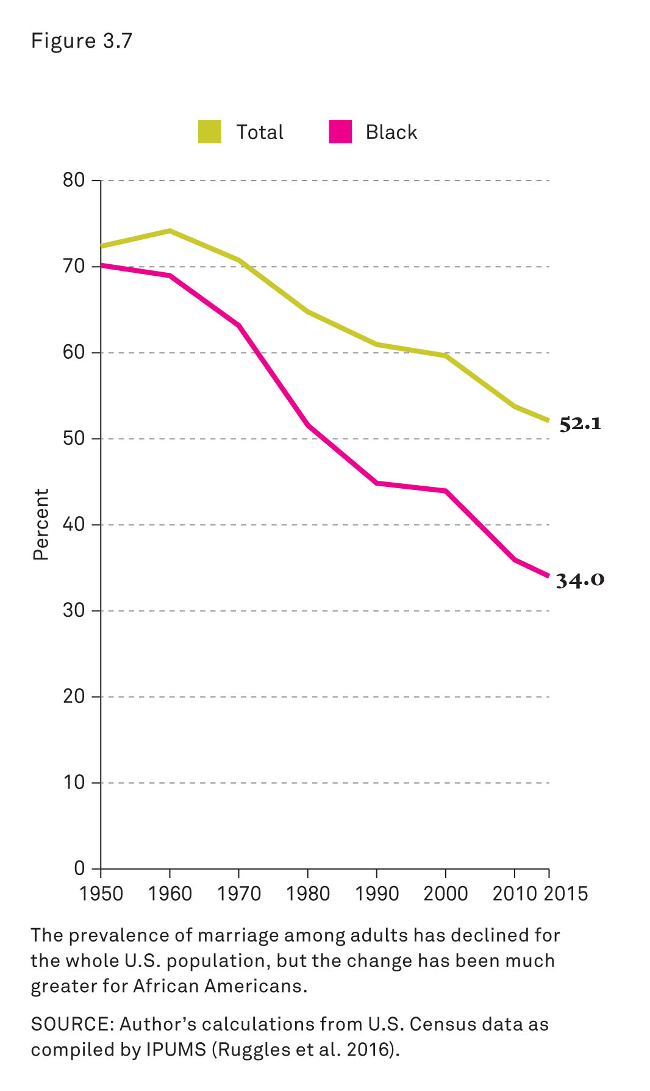
Prevalence of Marriage in the United States, 1950–2015
Notes:
Data obtained from U.S. Census and results calculated by author
Percentage of adults married: total U.S. population and Black population
1950 through 2015
Marriage rates overall have been in decline.
Greater decrease in marriage for African Americans
Retreat from marriage itself versus other demographic and economic pressures that prevent marriage (e.g., higher mortality and incarceration rates for Black men)

Slide 16
American Stories: Latinos
American Indians
African Americans
Latinos
Culture and Diversity
Notes:
Population more than 50 million
Largest and fastest-growing minority group
Includes recent and older immigrants from Mexico, Puerto Rico, Cuba, and other countries
Different groups, very different experiences
Diverse origins and history
Part of Mexico annexed by United States after Mexican-American War in 1848
Also new Mexican immigrants
Commonwealth of Puerto Rico, 1898
Cuban revolution of 1959
New waves of immigrants from Central and South America

Slide 17
American Stories: Latinos and Familism
American Indians
African Americans
Latinos
Culture and Diversity
Familism: A personal outlook that puts family obligations first, before individual well-being
Notes:
Familism: Cultural trait associated with Latino culture
Emphasizes family role in daily life
Strong intergenerational ties
Younger average age of families
More children per family
Extended households
Helps maintain traditional culture
Sometimes exaggerated by observers and pop culture
Can slow integration into American mainstream, but also a mechanism of support

Slide 18
American Stories: Asian Americans
American Indians
African Americans
Latinos
Asian Americans
Family Traditions, Modern Times
Inequality and Diversity
Notes:
Chinese workmen in the nineteenth century were the first large Asian group
Did not have many legal rights; many did not stay
Twentieth-century waves of migration from China, the Philippines, and India
Twentieth- and twenty-first–century waves of immigration from Southeast Asia (e.g., Cambodia, Korea, Vietnam, Hmong)
Different national-origin groups with diverse populations
Common, but not universal, characteristics
Emphasis on educational excellence and higher levels of education (problematic stereotypes of “model minority myths” and “tiger moms”)
Respect and care for elders
Relatively likely to live in multigenerational households
More authoritarian parenting style
Less value on children’s independence
Lower levels of unmarried childbearing
Lower poverty rates than overall U.S. population (except for smaller groups from Southeast Asia)
Hostility and cultural division
Southeast Asian political and economic refugees
Chinese Exclusion Act of 1882
Japanese American internment during World War II
“Model minority” myths and expectations

Slide 19
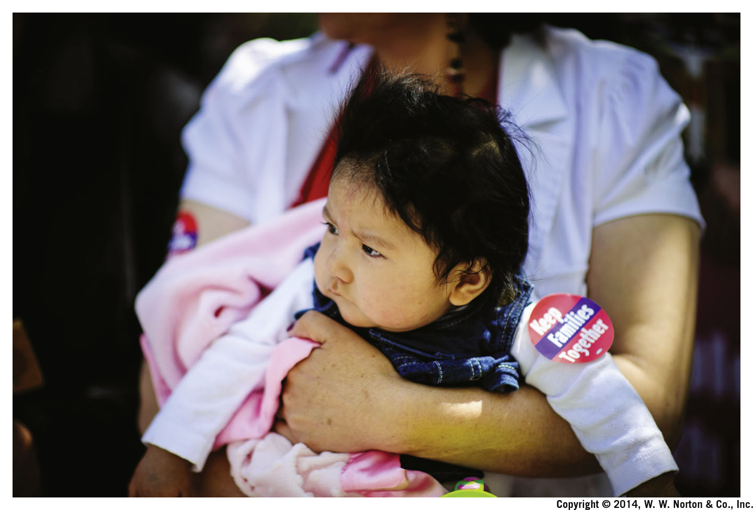
Immigration
Notes:
Profound effect on individuals, families, and U.S. society and culture

Slide 20
Immigration: The New Immigration
The New Immigration
Notes:
15 percent of U.S. residents born outside the United States
Currently the highest number of immigrants in U.S. history
Acceleration of immigration over the last three decades
Influenced by changes in federal laws
Creation of stronger, family-based immigration
Family reunification through immigration
Most legal migration has been family related.
This helps solidify immigrant communities but may increase social distance between immigrant groups and rest of society.

Slide 21
Immigration: Uniting and Dividing Families
Immigration Uniting and Dividing Families
Notes:
Immigration opportunities and obstacles
Chance for new life
Family dislocation and disruption
Influence of changes in laws and law enforcement
Confusing patterns of family division and unification

Slide 22
Immigration: 1882
Immigration Uniting and Dividing Families
1882: Chinese Exclusion Act
Notes:
Chinese workmen immigrated to the American West, where many worked on the new and expanding railroad.
Anti-Chinese sentiment in the United States.
1882 Exclusion Act influenced by White-dominated labor movement
Barred Chinese from becoming citizens and blocked most new Chinese immigration until 1943
United States v. Wong Kim Ark, 1898: an important Supreme Court case
Declared that citizenship by birth was guaranteed under the Constitution
Used in current immigration debate

Slide 23
Immigration: 1924
Immigration Uniting and Dividing Families
1882: Chinese Exclusion Act
1924: Immigration Act
Notes:
Severely restricted immigration
End of the wave of European immigration
Established a country-based quota system
Eliminated immigration from Asia

Slide 24
Immigration: 1945
Immigration Uniting and Dividing Families
1882: Chinese Exclusion Act
1924: Immigration Act
1945: War Brides Act
Notes:
Allowed immigration of wives and children of World War II servicemen from Europe and Asia
Extended to Korean War brides
Hostile reception for new immigrants

Slide 25
Immigration: 1942–1964
Immigration Uniting and Dividing Families
1882: Chinese Exclusion Act
1924: Immigration Act
1945: War Brides Act
1942–1964: Bracero Program
Notes:
Need for agricultural workers
Bracero means “manual laborer” in Spanish.
Resistance to full-scale immigration
“Temporary” work permits to Mexican workers

Slide 26
Immigration: 1965
Immigration Uniting and Dividing Families
1965: Amendments to the Immigration and Nationality Act
Notes:
Amendments to the restrictive 1952 Immigration Act
Lifted all numerical restrictions on immigration of family members
Ended the country-based quota system
Impact on immigrant family members from Latin America and Asia

Slide 27
Immigration: 2002
Immigration Uniting and Dividing Families
1965: Amendments to the Immigration and Nationality Act
2002: Homeland Security Act
Notes:
Department of Homeland Security took over immigration enforcement
Made illegal crossing more difficult and dangerous.
Unintended consequence: Immigrants are now more likely to establish permanent residence in the United States because of difficulties crossing the border

Slide 28
Immigration: 2012
Immigration Uniting and Dividing Families
1965: Amendments to the Immigration and Nationality Act
2002: Homeland Security Act
2012: Deferred Action for Childhood Arrivals
Notes:
Restrictions in an attempt to protect abuse of immigrants from marriage brokers (e.g., “mail-order bride” abuses)
In 2012, the Obama administration implemented a rule protecting from deportation people who had entered the country illegally as children and allowing them to work.
Because it was done without Congressional approval, any president has the authority to reverse it without approval.

Slide 29
Immigration: Generations
The New Immigration
Generations
Notes:
Researchers refer to immigrants according to the generation of the family’s migration (e.g., first generation = immigrants; second generation = immigrants’ children)
Generational change
Each successive generation has a different experience and self-identity.
Generational conflicts (including acceptance of intermarriage) can occur when one generation changes more quickly than the other.
However, recent research suggests that the age of immigration, not just the generation of immigration, influences the acculturation experience with the new culture.

Slide 30
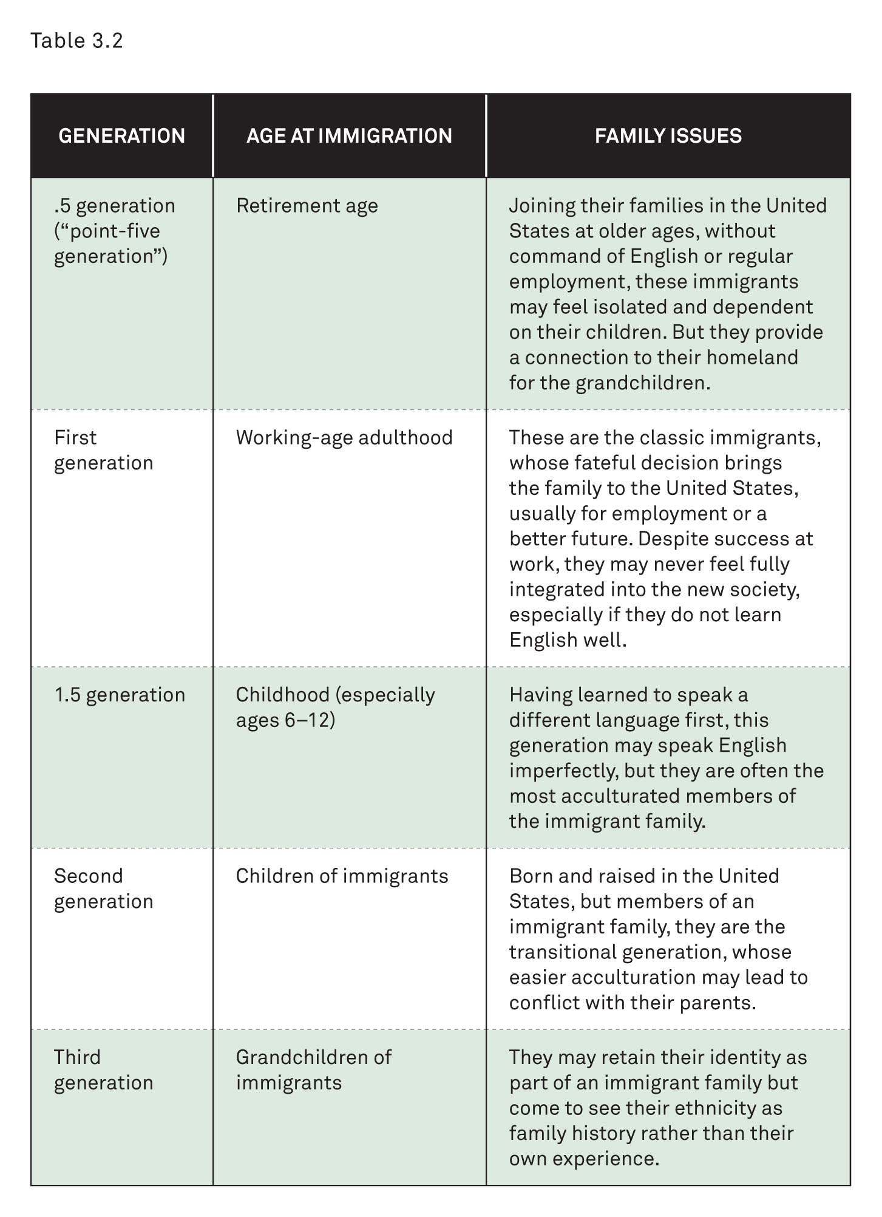
Immigrant Generations
Notes:
.5 generation: older retirement age; connection to homeland but may feel isolated and dependent on children
First generation: classic immigrants; usually immigrated for employment; may never feel fully integrated
1.5 generation: immigrate as children; learn language and are more integrated than older immigrants
Second generation: children of immigrants; born and raised in United States; transitional generation
Third generation: grandchildren of immigrants; may retain immigrant family identity as a part of family history

Slide 31
Immigration: Acculturation
The New Immigration
Generations
Acculturation: The acquisition of a new culture and language
Notes:
Learning ways of the new homeland through acculturation process
The acquisition of a new culture and a new language
In the United States, new groups have received very different levels of acceptance, depending on the timing of their arrival, the economic and social roles they play, and the attitudes of the dominant group toward them.
Each of these circumstances leads to a very different experience of acculturation and assimilation.

Slide 32
Immigration: Consonant and Dissonant Acculturation
The New Immigration
Generations
Acculturation
Consonant Acculturation
Dissonant Acculturation
Notes:
The process may be consonant (i.e., parents and children transition together).
The process may be dissonant (i.e., the children integrate more quickly and easily than the parents).

Slide 33
Immigration: Assimilation
The New Immigration
Generations
Acculturation
Assimilation: The gradual reduction of ethnic distinction between immigrants and the mainstream society
Notes:
The gradual reduction of ethnic distinction between immigrants and mainstream society
The immigrant group and mainstream society adapt to one another.
Sometimes can include the elimination of ethnic distinctions between the groups (but not always and not completely)
Different from acculturation because assimilation is only successful with acceptance of ethnic group by the dominant group

Slide 34
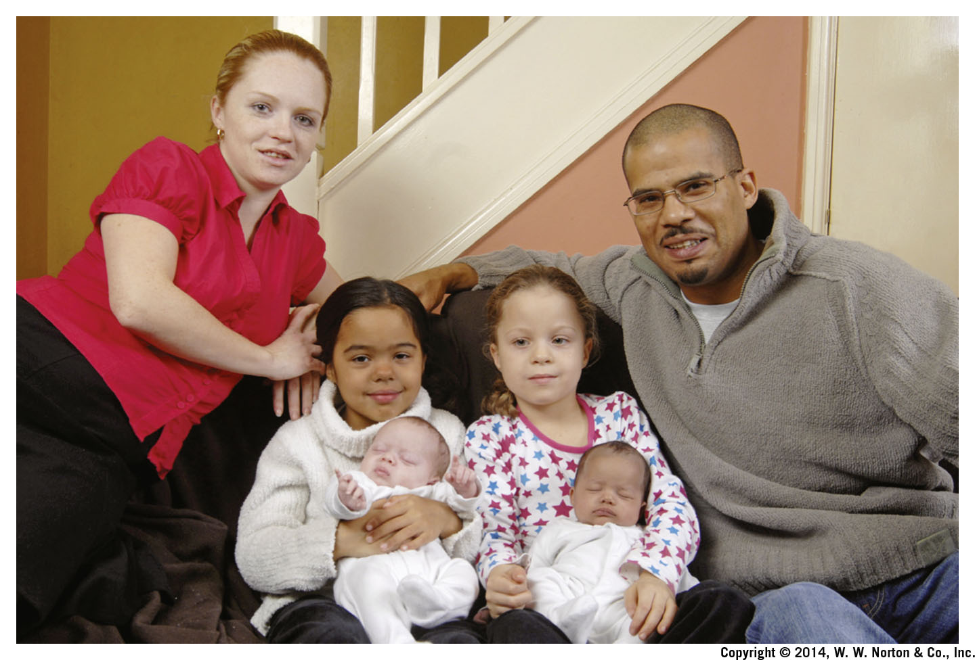
Intermarriage
Notes:
When people from different racial or ethnic groups marry, the groups become integrated.
Intermarriage between racial and/or ethnic groups is discussed further in Chapter 8.

Slide 35
Intermarriage: Definition
Intermarriage: Marriage between members of different racial or ethnic groups
Notes:
Intermarriage allows for more interaction of extended families.
It can be an indication of integration between groups.
It can be used to observe the acceptance of integration and difference.
It allows for some measurement of social acceptance.

Slide 36
Intermarriage: Black and White
Black and White
Notes:
First law prohibiting Black-White marriage in Maryland, 1661.
Applied to most African Americans until 1960
Influence of slavery and “one-drop rule” applied to children of White slave owners and Black slaves
Black men fathering children with White women was considered unacceptable, especially in the southern United States.
Use of violence to prevent miscegenation and interracial sex
Prevalence of legal executions and illegal lynching
1967 U.S. Supreme Court case Loving v. Virginia declared laws against interracial marriage (miscegenation laws) unconstitutional
Steady growth of interracial marriage since 1970s

Slide 37
Intermarriage: Social Distance
Black and White
The Future of Social Distance
Social Distance: The level of acceptance that members of one group have toward members of another group
Notes:
Intermarriage can be used as a measure of social distance.
Intermarriage contributes to integration.
When people from different racial or ethnic groups marry, their extended families interact.
Measuring the frequency of intermarriage allows for some measurement of integration.
We can observe the acceptance of difference and changing attitudes toward social distance.

Slide 38
Social Distance Workshop
Notes:
This workshop may be used either as a Peer Instruction) exercise or without preparation.
Have students fill out this table before class, preferably having gotten input from parents and grandparents, and having given the topic some personal reflection.
Students may break into pairs to discuss their findings with each other either before or after answering the questions posed on the following 10 slides.
Then results may be shared or discussed with the entire class.

Slide 39
Social Distance Workshop: Question 1
How many of you would be unwilling to have a close friend who is a member of a different racial group?
yes
no
unsure
Notes:
Have students answer each Social Distance Workshop question using clickers.
Ensure anonymity and make it clear to students that their answers will be kept strictly anonymous.
Display aggregate results to the class.

Slide 40
Social Distance Workshop: Question 2
How many of you have a parent who would disapprove of you having a close friend who is a member of a different racial group?
yes
no
unsure
Notes:
Have students answer each Social Distance Workshop question using clickers.
Ensure anonymity and make it clear to students that their answers will be kept strictly anonymous.
Display aggregate results to the class.

Slide 41
Social Distance Workshop: Question 3
How many of you have a grandparent who would disapprove of you having a close friend who is a member of a different racial group?
yes
no
unsure
Notes:
Have students answer each Social Distance Workshop question using clickers.
Ensure anonymity and make it clear to students that their answers will be kept strictly anonymous.
Display aggregate results to the class.

Slide 42
Social Distance Workshop: Question 4
How many of you would be unwilling to date a member of a different racial group?
yes
no
unsure
Notes:
Have students answer each Social Distance Workshop question using clickers.
Ensure anonymity and make it clear to students that their answers will be kept strictly anonymous.
Display aggregate results to the class.

Slide 43
Social Distance Workshop: Question 5
How many of you have a parent who would disapprove of you dating a member of a different racial group?
yes
no
unsure
Notes:
Have students answer each Social Distance Workshop question using clickers.
Ensure anonymity and make it clear to students that their answers will be kept strictly anonymous.
Display aggregate results to the class.

Slide 44
Social Distance Workshop: Question 6
How many of you have a grandparent who would disapprove of you dating a member of a different racial group?
yes
no
unsure
Notes:
Have students answer each Social Distance Workshop question using clickers.
Ensure anonymity and make it clear to students that their answers will be kept strictly anonymous.
Display aggregate results to the class.

Slide 45
Social Distance Workshop: Question 7
How many of you would be unwilling to marry a member of a different racial group?
yes
no
unsure
Notes:
Have students answer each Social Distance Workshop question using clickers.
Ensure anonymity and make it clear to students that their answers will be kept strictly anonymous.
Display aggregate results to the class.

Slide 46
Social Distance Workshop: Question 8
How many of you have a parent who would disapprove of you marrying a member of a different racial group?
yes
no
unsure
Notes:
Have students answer each Social Distance Workshop question using clickers.
Ensure anonymity and make it clear to students that their answers will be kept strictly anonymous.
Display aggregate results to the class.

Slide 47
Social Distance Workshop: Question 9
How many of you have a grandparent who would disapprove of you marrying a member of a different racial group?
yes
no
unsure
Notes:
Have students answer each Social Distance Workshop question using clickers.
Ensure anonymity and make it clear to students that their answers will be kept strictly anonymous.
Display aggregate results to the class.

Slide 48
Social Distance Workshop: Question 10
Were you surprised by the results of any of the previous questions?
yes
no
unsure
Notes:
Have students answer each Social Distance Workshop question using clickers.
Ensure anonymity and make it clear to students that their answers will be kept strictly anonymous.
Display aggregate results to the class.

Slide 49
Review Question 1
Lin marries someone from his cultural group. Which term best applies to this situation?
exogamy
endogamy
acculturation
miscegenation
Notes:
Answer: B
Discussion: Even though laws (formal boundaries) against interracial marriage (miscegenation) have been ruled unconstitutional and many of the informal boundaries between racial-ethnic groups have faded, individuals still tend to marry and reproduce within their own racial-ethnic group.

Slide 50
Review Question 2
Ernesto is a Cuban American living near Miami in South Florida. Which of the following statements about Ernesto is correct?
Ernesto’s race is Hispanic.
Ernesto’s ethnicity is Cuban.
Ernesto’s ethnicity is Caucasian.
Ernesto is not a minority because of the large number of Cuban Americans living in South Florida.
Ernesto does not have an ethnicity.
Notes:
Answer: B
Discussion: Based on the way race and ethnicity are currently understood in the United States, Cuban is an ethnicity because Cubans are viewed (and may identify themselves) as a group of people who share a common cultural identification that includes a combination of language, religion, ancestral origin, and traditional practices.

Slide 51
Review Question 3
Sarah, a U.S. citizen, was working in Argentina when she met and married Marcos, an Argentinian. When Sarah’s job was transferred back to the United States, Marcos was able to immigrate because of the
1924 Immigration Act.
1965 amendments to the Immigration and Nationality Act.
2002 Homeland Security Act.
2012: Deferred Action for Childhood Arrivals.
Notes:
Answer: B
Discussion: In 1965, amendments to the Immigration and Nationality Act lifted restrictions on the number of immigrants allowed into the United States who are family members of U.S. citizens.

Slide 52
Review Question 4
Maria, a Latina immigrant, set aside her dreams of continuing her education in order to work and send money to her family in her country of origin. This is an example of the cultural trait of
familism.
matriarchy.
tradition.
assimilation.
Notes:
Answer: A
Discussion: Familism is the belief and practice that puts family before personal desires. This is common among Latinos, as illustrated by the greater likelihood that they will live in extended families.

Slide 53
Review Question 5
Rose is often told she “looks Latina,” and, in fact, her grandparents came to the United States from Mexico. This is an example of
immigration.
endogamy.
racial ethnicity.
assimilation.
Notes:
Answer: C
Discussion: Racial ethnicity is a concept that describes an ethnic group that is perceived to share physical characteristics.

Slide 54
Review Question 6
Jose and Maria came to the United States from Mexico with their parents. They quickly learned English, but their parents struggle with it and also want to continue to speak Spanish at home to maintain their culture. This is an example of
generational continuity.
dissonant acculturation.
consonant acculturation.
assimilation.
Notes:
Answer: B
Discussion: Dissonant acculturation occurs when children learn the dominant language and integrate into the host society more quickly than do their parents.

Slide 55
The Story behind the Numbers: Peer Instruction Question
Why are there so many single Black women?
Most Black men do not want to get married.
Black women experience a shortage of men to marry.
Many single Black women do not like men.
All of the above are correct.
Notes:
For Peer Instruction in the classroom, give students the opportunity to answer the question using clickers or colored cards. Results may be displayed to the class or postponed until after the peer-sharing process. Have students pair with another student who gave a different answer. Allow time for discussion (we suggest approximately 2–3 minutes, but this time may be modified). Then have students share the new answers, again through individual clickers or colored cards. Discuss results as a class.
Answer: B
Discussion: There has been a drop in marriage rates for all groups. However, Black women experience a disproportionate rate of decline in marriage rates. Many of the factors for this involve issues with the economy, job discrimination, incarceration policies, and health disparities for Black men, which combine to hurt the chance of marriage—and many other life chances—for Black men and women. The “marriage market” is more even for White men and women.

Slide 56
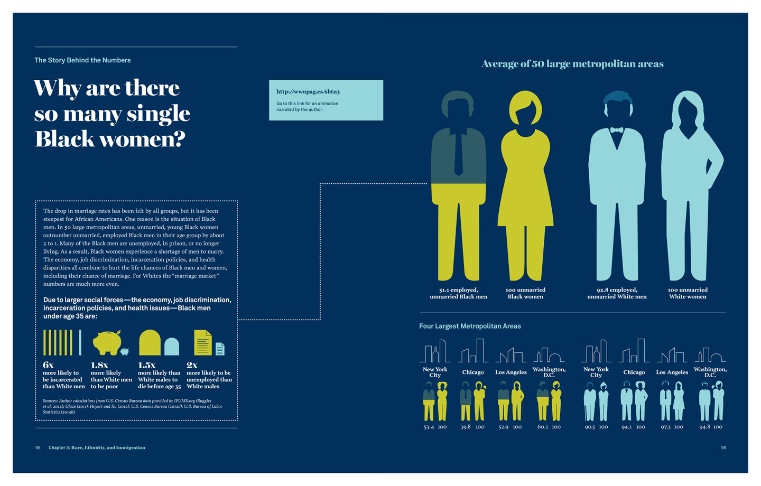
The Story Behind the Numbers
Notes:
Ideally for a flipped classroom, students will have already reviewed this material and the accompanying animation.
This graphic may be used either before or after “The Story behind the Numbers” clicker question.
An animated version of this infographic is available here: http://wwnpag.es/By54N

Slide 57
Lecture Slides
The Family: Diversity, Inequality, and Social Change, 2nd Edition
This concludes the Lecture Slide Set for Chapter 3
© 2018 W. W. Norton & Company, Inc.
Independent and Employee-Owned

