Slide 1
2
The Family in History
Slides by Joanna Pepin

Slide 2
The Family in History
Four Historical Trends
Notes:
This chapter focuses on the development of the family as an institutional arena.
Four overarching historical trends discussed throughout book
People today live much longer than people did in the past.
People today have many fewer children than people did in the past (more in Chapter 9).
Family members perform fewer tasks at home (more in Chapter 11).
Families have become more diverse in recent decades (more in Chapter 13).

Slide 3
The Family in History: Longer Lifespan
Four Historical Trends
Most people today live much longer than people did in the past.
Notes:
In the Middle Ages, the average life span was about 30 years.
In 1850, this had only increased to about 40 years.
In 1850, one in five children died before reaching age 5 years (Weeks 2011).
Today, three out of four Americans live to age 70 years (Arias 2015).
Increased longevity is a result of better sanitation, nutrition, medical care, and improvements in the standard of living.

Slide 4
The Family in History: Fewer Children
Four Historical Trends
Most people today live much longer than people did in the past.
People today have fewer children than people did in the past .
Notes:
A “typical” White woman in 1800 bore about seven children during her lifetime.
This number has fallen to fewer than two.
This will be covered more in Chapter 9.

Slide 5
The Family in History: Fewer Functional Tasks at Home
Four Historical Trends
Most people today live much longer than people did in the past.
People today have fewer children than people did in the past.
Family members perform fewer functional tasks at home.
Notes:
Work, both formal and informal, has shifted from the public sphere to the private sphere.
The household is increasingly becoming more of a site of consumption than one of production.
For example, tasks such as clothing production and education have moved out of the home into the public arena.
This will be covered more in Chapter 11.

Slide 6
The Family in History: More Diverse Families
Four Historical Trends
Most people today live much longer than people did in the past.
People today have fewer children than people did in the past.
Family members perform fewer functional tasks at home.
Families have become more diverse in recent decades.
Notes:
Decline of the two-parent nuclear family
Increase in single-parent families, married couples, nonfamily group situations, and people living alone
This will be covered more in Chapter 13.

Slide 7
The Family in History: Types and Terms
Family Types and Terms
Notes:
There is a wide variety of family systems.
Each of these terms represents whole systems or patterns of family life.
There is so much diversity in history that it is difficult to conclude that there is one natural or normal form of the family.
The following types and terms will be used to differentiate how societies have evolved around a wide variety of family systems.

Slide 8
The Family in History: Monogamy Definition
Family Types and Terms
Monogamy
The marriage of one person to one other person
Notes:
Most societies have a family system based on monogamy.
Monogamy occurs in a few species of mammals but is more common in primates (Fuentes 1998).
Some people speculate that monogamy is “natural” for human mammals because of this.
But different forms of marriage and mating arrangements exist and have often been practiced.
There is a history of diversity when it comes to marriage arrangements.

Slide 9
The Family in History: Polygamy Definition
Family Types and Terms:
Monogamy
Polygamy
A marriage in which one person has several spouses
Notes:
Polygamy is another marriage arrangement.
Usually occurred in societies in which most people practiced monogamy
Polygamy very common in some African countries in the 1970s
Less common today
Was the most prevalent form of marriage throughout human history
Has almost always been practiced as one man having more than one wife (polygyny), rather than one woman having more than one husband (polyandry)
This unequal practice reflects a power differential between men and women throughout history.
Polygamy predominantly found in societies with high levels of inequality between men and women

Slide 10
The Family in History: Nuclear Family Definition
Family Types and Terms
Monogamy
Polygamy
Nuclear Family
A married, monogamous couple living with their own (usually biological) children and no extended family members
Notes:
Nuclear family: a married, monogamous couple living with their own (usually biological) children and no extended family members

Slide 11
The Family in History: Conjugal Family
Family Types and Terms
Monogamy
Polygamy
Nuclear Family
Conjugal Family
A nuclear family that is also functionally independent of extended family members
Notes:
Conjugal family: a nuclear family that is also functionally independent of extended family members
This seems to be the modern ideal of the family, which many Americans adhere to.
Associated with families of the 1950s and 1960s, when many nuclear families moved into single, detached homes in the suburbs
Reinforced the image of the family as independent

Slide 12
The Family in History: Patrilineal Definition
Family Types and Terms:
Patrilineal
A family system in which wealth and power are transmitted from fathers to their sons
Notes:
Families are central in the accumulation and maintenance of wealth, status, and hierarchy.
Family systems can also be organized according to the different types of inheritance and wealth distribution patterns.
When property, title, or power are transmitted from father to son
Many American families have a patrilineal affiliation.
American wives and children usually take their surnames from the male side of the family, as a result.

Slide 13
The Family in History: Matrilineal
Family Types and Terms
Matrilineal
A family system in which wealth and power are transmitted from mothers to daughters
Notes:
When property, title, or power are transmitted from mother to daughter
Many American Indians had matrilineal traditions.
European Americans were more patrilineal.

Slide 14
The Family in History: Patrilocal Definition
Family Types and Terms:
Patrilocal
A living arrangement in which a young married couple lives in or near the husband’s family home
Notes:
Family systems can also be organized according to different types of residence patterns.
The type of family system contributes to a newly married couple’s place of residence.
Young couples often live in or near the family home of a parent.
Patrilocal: when a young married couple lives with or near the husband’s family
In China, it is still common for the woman to move into her husband’s household.

Slide 15
The Family in History: Matrilocal
Family Types and Terms
Patrilocal
Matrilocal
A living arrangement in which a young married couple lives in or near the wife’s family home
Notes:
Matrilocal: when a married couple lives with or near the wife’s family

Slide 16
The Family in History: Patriarchal Definition
Family Types and Terms
Patriarchal
A family system in which power is wielded by men in the family
Notes:
Family systems can also be organized into different arrangements of power.
When the men in the family have the power, the family is called patriarchal.

Slide 17
The Family in History: Matriarchal
Family Types and Terms:
Patriarchal
Matriarchal
A family system in which power is wielded by women in the family
Notes:
When the women in the family have the power, the family is called matriarchal.

Slide 18
The Family in History: Heterogamy Definition
Family Types and Terms
Heterogamy
Marriage between a man and a woman
Notes:
All the previous terms have been based on an assumption of heterosexual marriage (i.e., marriage between a man and a woman).
With the increase in the number and legitimacy of same-sex marriages, the author of the text proposes new terms for marriage to include same-sex couples.
Heterogamy: Cohen’s term to refer to marriage between a man and a woman

Slide 19
The Family in History: Homogamy
Family Types and Terms
Heterogamy
Homogamy
Marriage between two people of the same sex
Notes:
Homogamy: Cohen’s term to refer to same-sex marriage

Slide 20
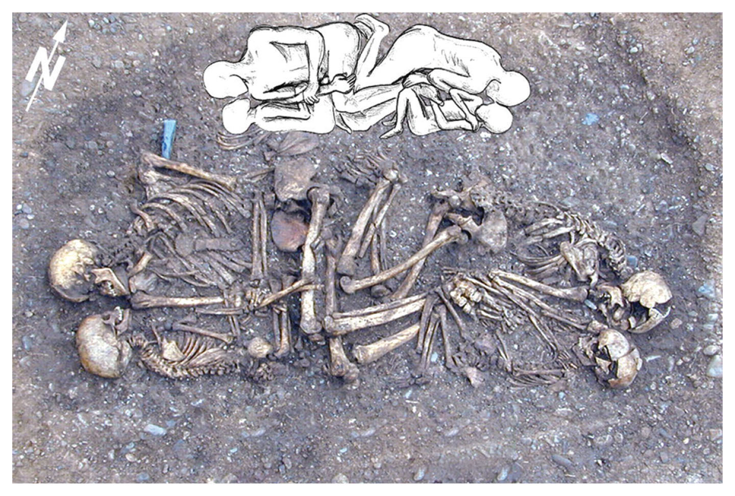
Early History
Notes:
Background history of families beginning with ancient times

Slide 21
Early History: Patriarchy Definition
Prehistory: Cooperation and Survival
From Europe to the United States
Patriarchy
The system of men’s control over property and fathers’ authority over all family members

Slide 22
Origins of the American Family: American Indians
Colonial America (before 1820)
American Indians: The Family as Social Structure
Notes:
Two historical periods before the emergence of the modern family: the Colonial period, before 1820, and the early modern period of the nineteenth century
American history is primarily the story of three interrelated groups: American Indians, White Europeans, and African Americans.
Precolonial traditions of the many and varied indigenous American tribal groups are difficult to generalize.
In many (but not all), there was a strong respect for elders and a reliance on family networks for sharing resources and meeting essential needs, and the family was the basis of social structure.
Common (but not universal) characteristics that differentiated indigenous Americans from Europeans included matrilineal descent, more gender equality, and higher rates of divorce.
Common traits shared with Europeans included monogamous marriage, a gender division of labor, and more political power afforded to men.

Slide 23
Origins of the American Family: Coverture
Colonial America (before 1820)
American Indians: The Family as Social Structure
Colonial Americans: “So Chosen, He Is Her Lord”
Coverture: a legal doctrine that lasted until the late nineteenth century, under which wives were incorporated into their husbands’ citizenship
Notes:
Colonial Americans brought many traditions from Europe.
Marriage was a necessary, practical arrangement, not a source of love or affection.
Marriage was viewed as a stabilizing influence on men and important to maintain civility and social structure.
Even though “mail-order brides” were common, the ideas of free will and choice were becoming increasingly important in marriage arrangements.
Protestant doctrine, reinforced by the government, gave husbands authority over their wives.
A system of marriage supported by the Christian (Protestant) Church
Gave power to local community leaders, who imposed their interpretation of Christian doctrine on marriage and divorce
Women could not vote, hold political office, serve on juries, or have a legal existence separate from their husbands.
Women were incorporated into their husbands’ citizenship under the doctrine of coverture.
Women bound to comply with the marriage system
Women’s survival depended on conformity.

Slide 24
Origins of the American Family: Children and Families
Colonial America (before 1820)
American Indians: The Family as Social Structure
Colonial Americans: “So Chosen, He Is Her Lord”
Children and Families: More Work and Less Play
Notes:
Colonial American families were large.
The average woman bore seven children.
High infant mortality rate
Children contributed to the economy and survival of the family.
The idea of childhood as a uniquely innocent stage of life was not common.
Children’s evil impulses needed to be controlled through discipline and work.
Parents (even wealthy ones) did not spend much time with their children.
Family bonds were less sentimental than they are now.

Slide 25
Origins of the American Family: Extended Families
Colonial America (before 1820)
American Indians: The Family as Social Structure
Colonial Americans: “So Chosen, He Is Her Lord”
Children and Families: More Work and Less Play
Extended families: family households in which relatives beyond parents and children live together
Notes:
Even with the birth of many children per couple, living in extended families arrangements was not common.
Households mostly consisted of nuclear family units plus boarders and servants.
Extended families did have an important support role.
Most people lived close to siblings’ families and shared labor and other resources.

Slide 26
Origins of the American Family: Stem Family
Colonial America (before 1820)
American Indians: The Family as Social Structure
Colonial Americans: “So Chosen, He Is Her Lord”
Children and Families: More Work and Less Play
Stem family: the household formed by one grown child remaining in the family home with his or her parents
Notes:
Among extended families, stem families were created.
Typically, the eldest son would inherit the family home and remain in the home with his parents.
Common among farm families and those with enough wealth to provide an inheritance
Colonial family life represented the first phase of transition to the modern family.

Slide 27
Origins of the American Family: African Americans
Colonial America (before 1820)
American Indians: The Family as Social Structure
Colonial Americans: “So Chosen, He Is Her Lord”
Children and Families: More Work and Less Play
African Americans: Families Enslaved
Notes:
Forcible removal of Africans from their homeland; the first arrival of African slaves in America was in Jamestown in 1619 and continued until the mid-1800s
Disruption of many different cultural groups with many different languages, traditions, and kinship networks
Family life of African Americans was affected by the slave system.
Difficult to determine how much slave family life was a reflection of African heritage and how much was adaptation to American conditions and treatment
Keeping a family together was difficult.
Recognition of family lineages difficult because of lack of family names
But most slaves lived in families for some or all of their lives.
Most slaves married (not always legally) and most children lived with both parents.
On large plantations, larger groups of slaves could create protection through communities and family life.
However, most African Americans were excluded from emerging modern family practices until after the end of the slave system.

Slide 28
Origins of the American Family: Marriage
Colonial America (before 1820)
The Emerging Modern Family (1820–1900)
Marriage: New Ideals, New Traditions
Notes:
This period represents the second phase of the transition to the modern family.
The spread of democracy and industrial capitalism, and the growth of the market contributed to the decline of patriarchal power and authority in the colonial family.
The changes to the family at this time created a new family structure consisting of the husband as breadwinner and the wife as homemaker.
This is the family we now think of as “traditional.”
The ideal of the man as breadwinner became a powerful symbol in American culture.
Men and women began to think of themselves as individuals with personal freedoms and rights.
Political democracy encouraged the idea of individual free choice in marriage.
Conservative backlash feared women’s growing freedoms threatened the (traditional) family.
As a compromise, male authority began to be replaced by the ideology of men as “protectors.”
Women were still considered free, but their role was to love, care for, and nurture their husbands.
These emerging gender roles came to be known as the separate spheres.
The political and economic functions of marriage began to erode.
Companionship, love, and affection started to become important considerations for marriage partners.

Slide 29
Origins of the American Family: Courtship
Colonial America (before 1820)
The Emerging Modern Family (1820–1900)
Marriage: New Ideals, New Traditions
Courtship: the mate selection process in which couples begin in a relationship with supervised contact in public, then proceed to additional dates in the woman’s home, and then, if the parents approve, to marriage
Notes:
Youth began to consider love and affection when seeking a spouse.
The practice of courtship emerged as a compromise between parents’ and young couples’ conflicting ideas concerning the selection of marriage partners.
Young couples initiated courtship, which involved supervised contact in public.
The system offered some elements of free choice but also included parental authority and approval.

Slide 30
Origins of the American Family: Fewer Children, More Tender Families
Colonial America (before 1820)
The Emerging Modern Family (1820–1900)
Marriage: New Ideals, New Traditions
Children and Families: Fewer and More Tender
Notes:
There was a decline in the number of children per family in the nineteenth century, even as the infant mortality rate was decreasing.
Fewer children per family and the increasing survival rate for children changed child-rearing practices.
Children’s individuality emerged as a valued ideal and emotional bonds between parents and children strengthened.
A more tender form of parenting developed as men increasingly worked outside the home and women stayed home to take care of children.
Children began to be seen as innocent and requiring nurturing.
Harsh discipline began to be replaced with reason and persuasion.

Slide 31
Origins of the American Family: Institutional Arenas
Colonial America (before 1820)
The Emerging Modern Family (1820–1900)
Marriage: New Ideals, New Traditions
Children and Families: Fewer and More Tender
Institutional Arenas
Notes:
In the nineteenth century, the market and the state emerged as dominant features of modern society.
This transformed the family arena.
The family lost its place as the center of the economy and began to become more regulated by the state.
The state started providing services that had once been provided within the family.

Slide 32
Institutional Arenas: Separate Spheres Definition
Family and Market: Men and Women, Separate and Together
Separate Spheres
The cultural doctrine under which women were to work at home, to make it a sanctuary from the industrial world in which their husbands worked for pay
Notes:
Increasing numbers of men began working outside the home in the nineteenth century.
This work was termed free labor (as opposed to slavery).
A wage-labor relationship with the market further reinforced the modern idea of the individual, freedom, and free will.
This also reflected the American democratic ideals.
New, modern male identities were reinforced by industrial workforce participation outside of the home.
Also helped reinforce the division of gender roles for men and women
The development of new market relationships took families away from strictly economic functions.
Women were expected to stay at home; men were expected to leave the home to work.
This reinforced the idea of the family as a separate social sphere from the state and the market.
The family became a place for new (modern) types of emotional relationships.
The modern family was emerging as its own institutional arena.
As men more often worked outside the home in an increasingly alienating industrial world, women were expected to provide a safe haven for men.
This new doctrine was viewed as necessary to provide balance and social harmony in modern, industrial society.
This family arrangement was embraced especially by white-collar, middle-class residents of urban areas.
Important exceptions to the separate spheres doctrine included young, unmarried women hired to work in the textile mills of New England and farm families.
Industrialism and separate spheres shifted the power from the home to the workplace and increased economic inequality between husbands and wives.
Created a dependency of wives on their husbands
Strengthened husbands’ authority

Slide 33
Institutional Arenas: Family and State
Family and Market: Men and Women, Separate and Together
Family and State: “Monogamous Morality”
Notes:
The family household increasingly became seen as a private place.
Caring for family members and raising children replaced the production of goods and services within the home.
State and federal regulations of the family increased.
State rules for marriage were established.
Rules for marriage included monogamy.
A moral standard also required a wife to be faithful to her husband and for the husband to provide for his wife and children.
Moral standard reinforced by the state (e.g., the Comstock Act of 1873, the Dawes Act of 1887)
State-enforced monogamy

Slide 34
Institutional Arenas: No Families
Family and Market: Men and Women, Separate and Together
Family and State: “Monogamous Morality”
No Families: Widows and Orphans
Notes:
Widows and orphans created a dilemma in the new male-centered wage economy.
There was often no one to provide for widows, orphans, and others without (male) family connections.
New specialized institutions (e.g., poorhouses, orphanages) were developed to provide services once provided by the extended family.
A new welfare system emerged that isolated those in need of assistance from the rest of the population and provided care, which was usually inadequate.
Early pension and welfare programs were developed in response to these needs.

Slide 35
Institutional Arenas: African Americans, Asian Americans, Mexican Americans
Family and Market: Men and Women, Separate and Together
Family and State: “Monogamous Morality”
No Families: Widows and Orphans
African Americans, Asian Americans, and Mexican Americans: Families Apart
Notes:
Being without a family was problematic and was often the experience of many minority group members.
Each group developed its own family arrangements to deal with particular historical challenges.
African Americans developed strong, extended family networks of caring and cooperation.
Many Chinese men migrated to work in the mines and build railroads, and lived separately from their families in split households.
Mexican-American family life included long periods of separation as (many) men traveled around the country for work.
All minority groups required strong family bonds and extended care relationships to counter horrific historical circumstances.

Slide 36
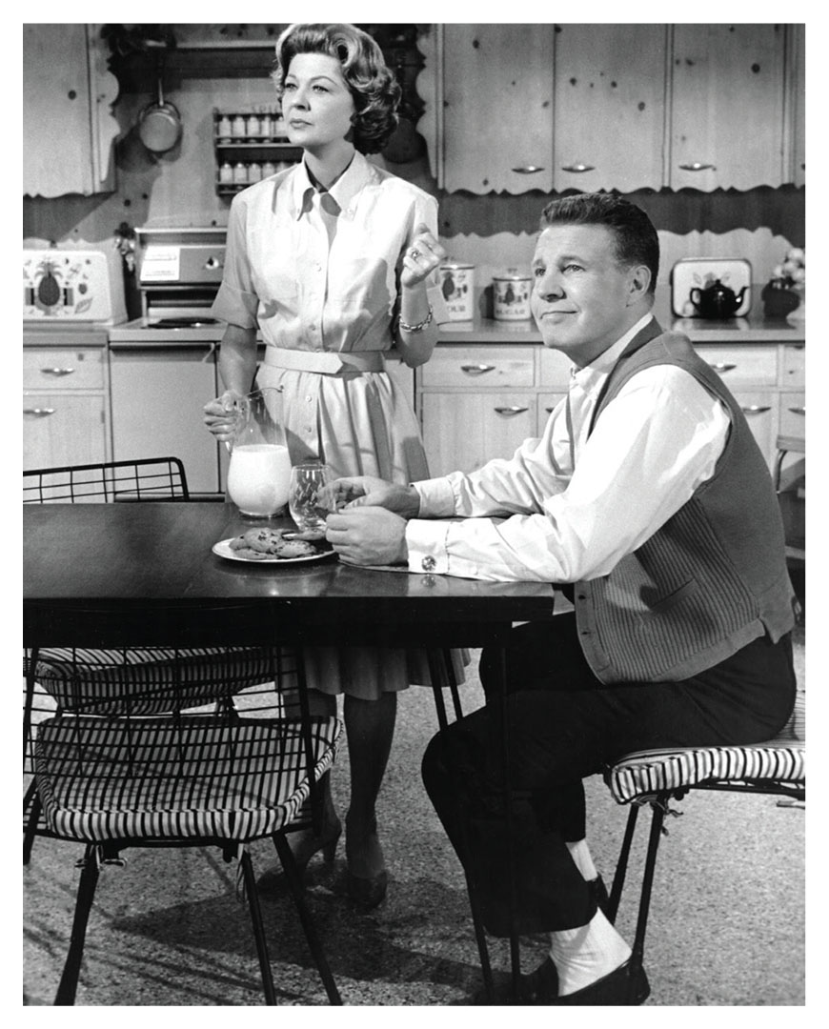
The Modern Family (1900–1960s)
Notes:
In the nineteenth century, the ideal of the nuclear family emerged because of a number of forces.
These included the ideal of separate spheres, men working for wages outside of the home, and state-enforced monogamous marriage.
Many families could not live up to this ideal.
Most men did not make enough to provide for a homemaker wife and children, and to purchase the type of home that afforded privacy.

Slide 37
The Modern Family (1900–1960s): Companionship Family
Companionship Family
An ideal type of family characterized by the mutual affection, equality, and comradeship of its members
Notes:
By the mid-twentieth century, the goal of the nuclear family was more attainable.
Those who achieved the goal attempted a new ideal type of marriage based on friendship, companionship, and romance.
The companionship family was the ideal in the 1950s.

Slide 38
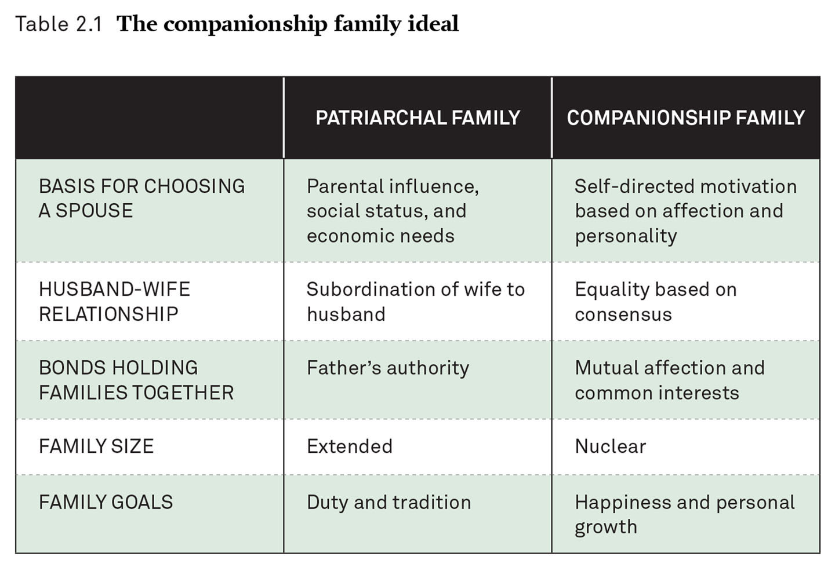
The Companionship Family Ideal
Notes:
The companionship family was beginning to replace the patriarchal family.
It included self-directed motivation based on affection and personality as opposed to parental status and economic needs.
There was more equality between husband and wife instead of mere subordination of the wife to the husband.
Mutual bonds of affection began to replace patriarchal authority.
Happiness, individuality, and personal growth began to replace duty and tradition.

Slide 39
The Modern Family (1900– 1960s): Companionate Marriage Definition
Marriage: Unequal Companions
Companionate Marriage
A view of marriage as a companionship, a friendship, and a romance, rather than as a practical platform for cooperation and survival
Notes:
The companionship family was an ideal at the time when marriage was undergoing a cultural shift from an economic institution to an institution for personal companionship.
Many individuals were starting to look at the family as a potential source of happiness and personal growth.
This was an ideal especially for White, middle-class families.
The underlying relationship to this new family ideal was the companionate marriage.
Many men working in white-collar, corporate jobs felt alienated and frustrated.
The companionate marriage was attractive to these workers to counter the impersonal tedium of bureaucratic work.

Slide 40
The Modern Family (1900–1960s): Dating Definition
Marriage: Unequal Companions
Dating
The mate selection process in which young adults spend time with a variety of partners before making a long-term commitment
Notes:
The promise of companionate marriage contributed to the breakdown of the courtship system.
Courtship was replaced by unsupervised interaction, especially in urban areas.
Young adults began spending time with a variety of partners before making a marriage choice.
Dating further eroded parental authority.

Slide 41
The Modern Family (1900–1960s): Family Wage Definition
Marriage: Unequal Companions
Family Wage
The amount necessary for a male earner to provide subsistence for his wife and children without their having to work for pay
Notes:
Economic opportunities made the companionship family and the companionate marriage a possibility.
It was becoming an increasing possibility for an employed man to support a homemaking wife in their own home.
As American industry grew, more companies started paying workers enough to support a whole family.
This wage was thought to promote workforce stability, home ownership, worker loyalty, and consumption in the marketplace.
The federal government also started providing economic incentives for marriage.
All these factors and cultural shifts increased the motivation for and the ability of young people to marry.

Slide 42
The Modern Family (1900–1960s): Baby Boom Definition
Marriage: Unequal Companions
Children and Families: From Bust to Boom
Baby Boom
The period of high birth rates in the United States between 1946 and 1964
Notes:
Birth rates (especially for White women) continued to decline into the first half of the twentieth century.
That temporarily changed at the end of World War II.
Baby boom parents experienced a rare sequence of events that encouraged them to embrace the prospect of stability after living through war and economic depression.
Many people married, purchased homes, and had an unprecedentedly large number of children.
Many people turned to the family for fulfillment and stability; they had a large number of children, and thus created a “baby boom” during this time.
The 1950s have come to be revered as the golden age of the traditional nuclear family.
But this type of family was an ideal created in the nineteenth century, and it has a very short history.
For many individuals and families, it has always been more of an ideal than a reality.
However, the idea of the traditional 1950s family still exists in our cultural imagination and has taken on mythical proportions.

Slide 43
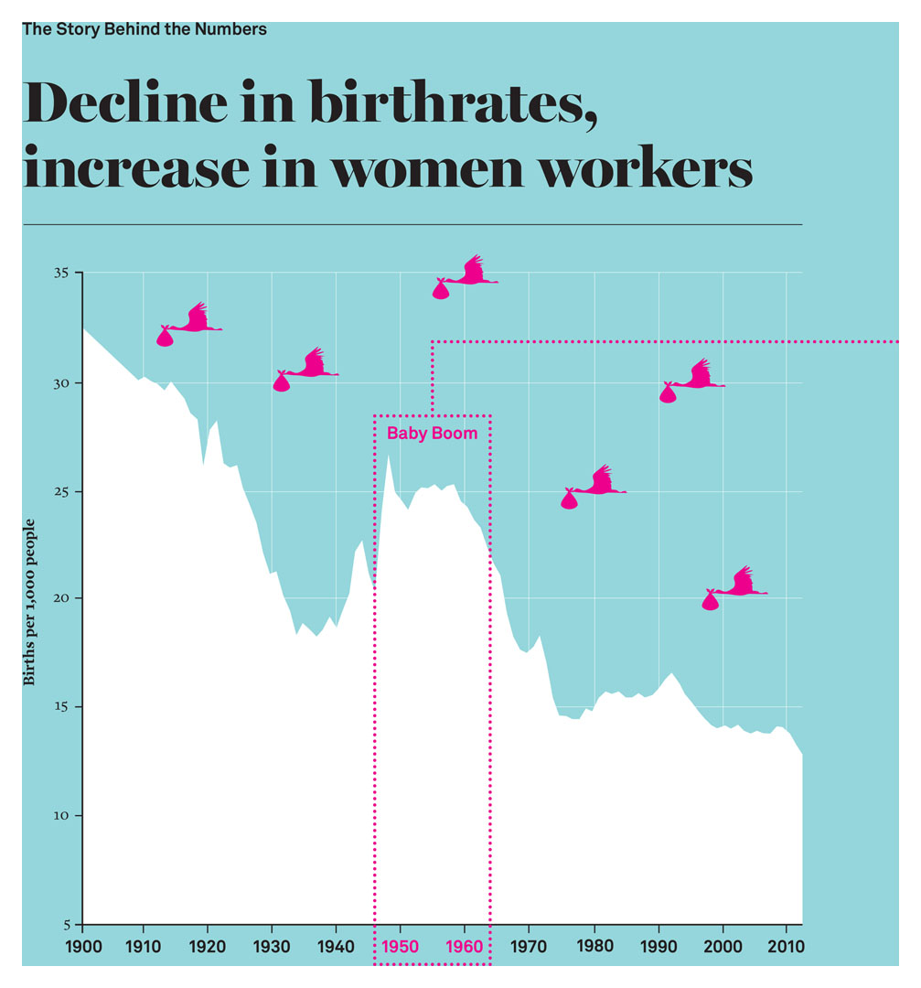
The Story behind the Numbers: Birth Rates and Women Workers
Notes:
The total number of births declined from 32 births per 1,000 people in 1900 to 13 births per 1,000 people in 2010.
Thus, there was an approximately 60 percent drop in the birth rate from 1900 to 2010.
This is often attributed to the fact that women began entering the workforce in ever-increasing numbers during the modern era.
In fact, the number of women in the workforce has been increasing steadily from 1900 to 2010.
Sources: Vital Statistics of the United States, Statistical Abstracts of the United States, Current Population Surveys.

Slide 44
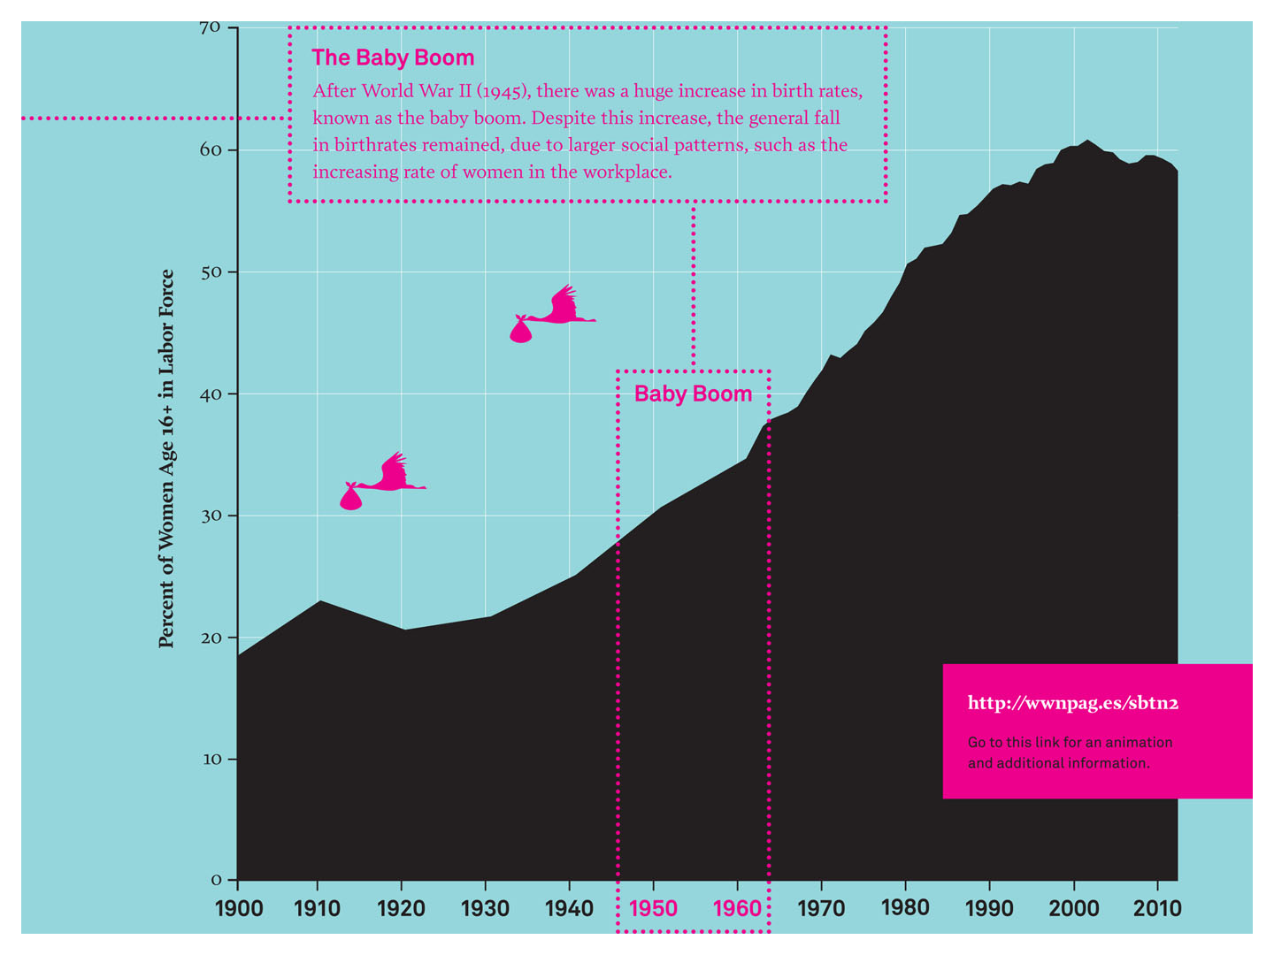
The Story behind the Numbers: Baby Boom
Notes:
But in 1945, at the end of World War II, there was a dramatically sharp increase in the birth rate.
The birth rate increased so quickly and so suddenly it was called the “baby boom.”
Clearly other factors intervened to influence the connection between women entering the workforce and the drop in the birth rate.
Social scientists contextualized this historical anomaly with additional social factors.
The dramatic increase in the post–World War II birth rate was attributed to children of the Great Depression of the 1930s finding economic prosperity in the 1950s at the end of the war.
There were many employment opportunities; a GI Bill, which encouraged (White) home ownership; and a society that was weary after a second world war.
However, this “boom” did not last long, and the birth rate eventually started dropping again.
Sources: Vital Statistics of the United States, Statistical Abstracts of the United States, Current Population Surveys.

Slide 45
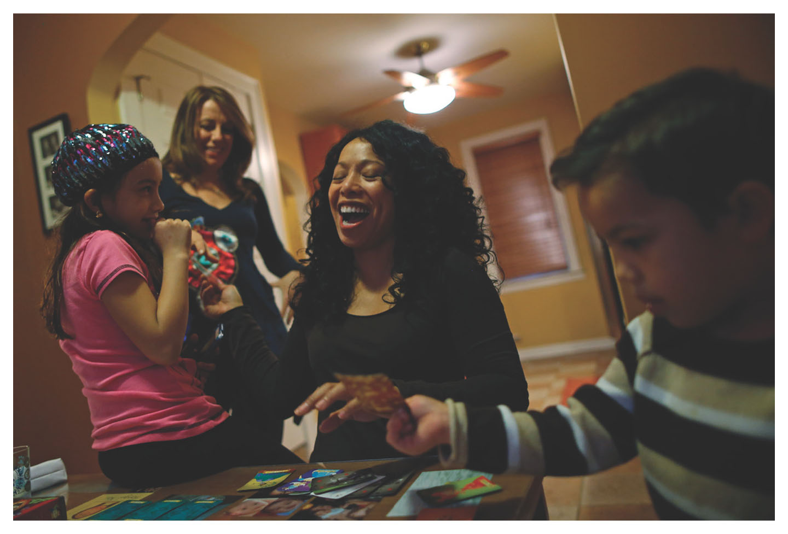
New Family Diversity (1960s–Present)
Notes:
Many changes to the family after the 1950s
Individuals and families were arranging their lives and relationships in different ways at an accelerated rate.
Two institutional factors changed the family: market forces and state forces.
Market forces in the twentieth century allowed women to work outside the home in greater numbers than ever before, just as market forces in the nineteenth century had done for men.
Labor previously performed in the home was now being done outside the home in the workplace by more women.
For the first time in history, the majority of women’s work was done as part of the paid labor force (Thistle 2006).
State forces promoted family diversity with programs that allowed more family choices.
Marriage became less of a necessity.

Slide 46
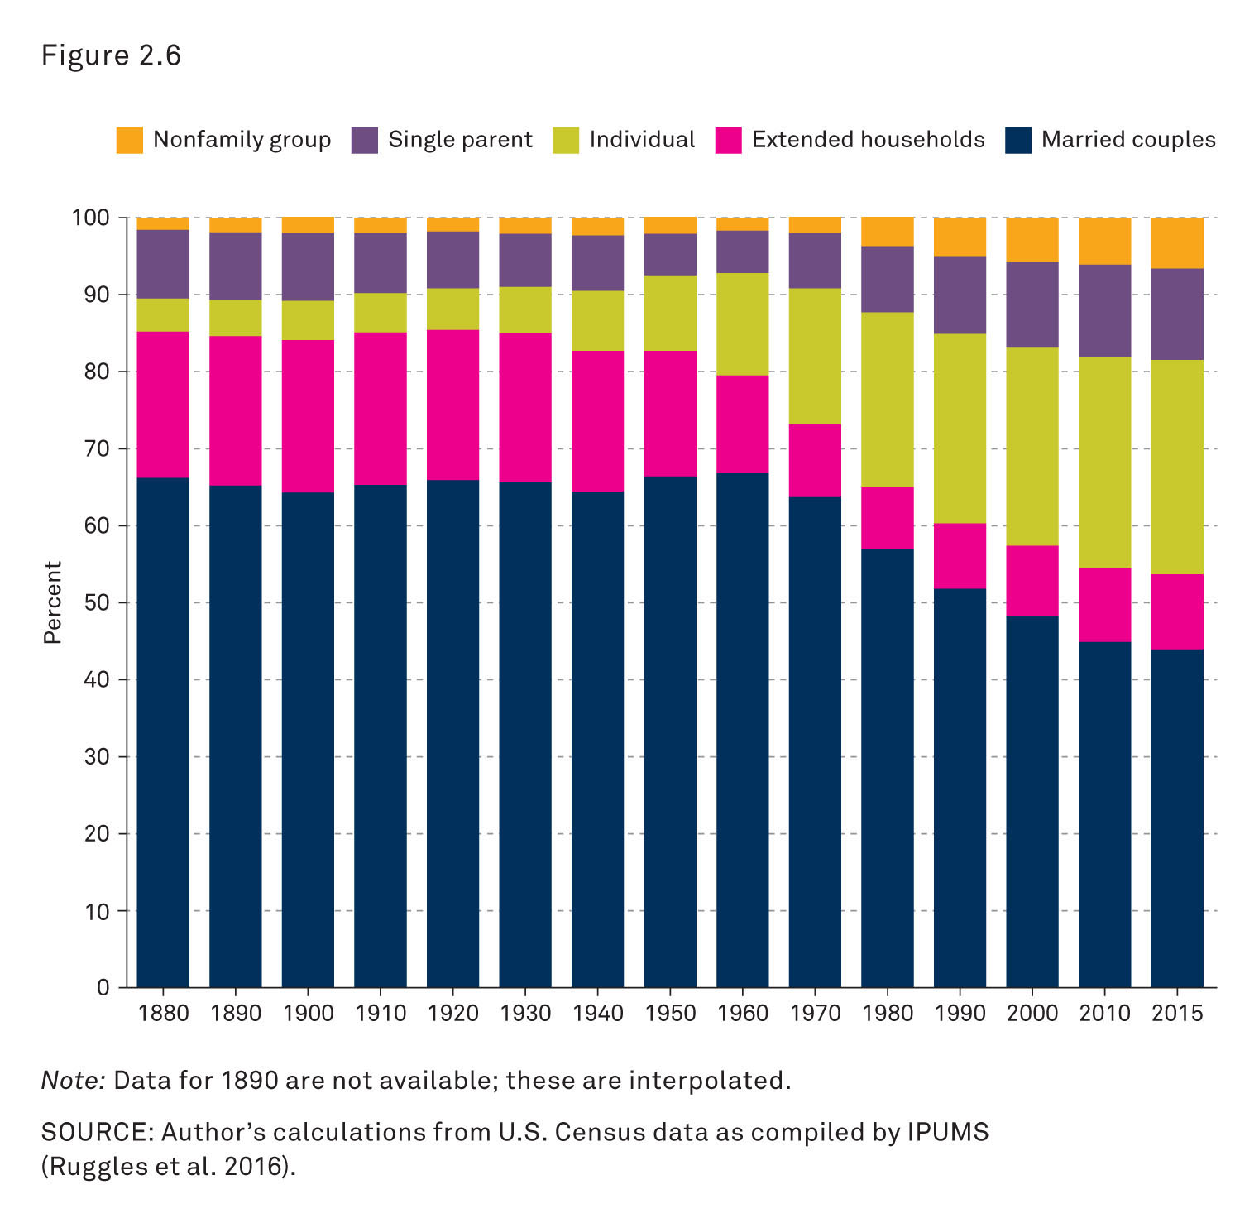
New Family Diversity (1960s–Present): Distribution of Household Types
Notes:
This figure shows the distribution of household types from 1880 to 2015.
Source: Cohen’s calculations from the U.S. Census data as compiled by IPUMS (Ruggles et al. 2014)

Slide 47
New Family Diversity (1960s–Present): Modern Relationships and Identities
Marriage: Out with the Old
Modern Relationships, Modern Identities
Notes:
The increase in women’s paid work changed marriage.
Increasing equality in the companionate marriage, but still high levels of gender inequality and stratification
Even though women worked outside the home, the jobs were less prestigious and earned less than jobs for men.
Marriage still influenced by separate spheres
The companionate marriage was less bound by tradition and economic factors, so there was more pressure on compatibility between men and women.
Marriage became elevated to a true love relationship and included expectations of love and affection.
If a marriage lacked love, divorce became increasingly seen as more logical and acceptable.
The decline of the traditional nuclear family and the rise of family diversity helped create a new, modern identity.
By the end of the twentieth century, Americans spent less of their time in marriage than at any other point in history.
An increased sense of freedom, but also an increased sense of individual security and isolation

Slide 48
New Family Diversity (1960s–Present): Independence
Marriage: Out with the Old
Modern Relationships, Modern Identities
Independence
Notes:
Forms of independence developed in each of the three institutional arenas, which affected individual choice.
In the state arena, the rights and responsibilities of individual citizenship increased.
In the market arena, more individuals became workers with their own incomes, leading to increasing consumer independence.
In the family arena, the development of love-based marriage represented marriage choice.
Independence brings freedom, but also increased responsibility.

Slide 49
New Family Diversity (1960s–Present): Children and Families
Marriage: Out with the Old
Children and Families: Emotional Bonds
Notes:
Marriage is becoming more emotional and less essential.
Changing relationship between parents and children
Parents having few children
Interactions between parents and children more emotional and intense
The period of parenting is also becoming longer, with young adulthood being extended by more years of education.
More on parenting in Chapter 9

Slide 50
New Family Diversity (1960s–Present): Name
Marriage: Out with the Old
Children and Families: Emotional Bonds
What’s in a Name?
Notes:
Modernity theory suggests that individuality emerged as a socially constructed product of the modern era.
This is reflected in the practice of choosing family names (surnames) and names for children.
Before the 1970s, many, if not most, American women assumed the surname of their husband upon marriage.
Today, that practice is less common and many women now choose to keep their maiden name (or create a combination of their maiden and their husband’s surname).
Similarly, naming children has also became a matter of personal preference rather than family tradition.
The result is a large diversity of modern names.

Slide 51
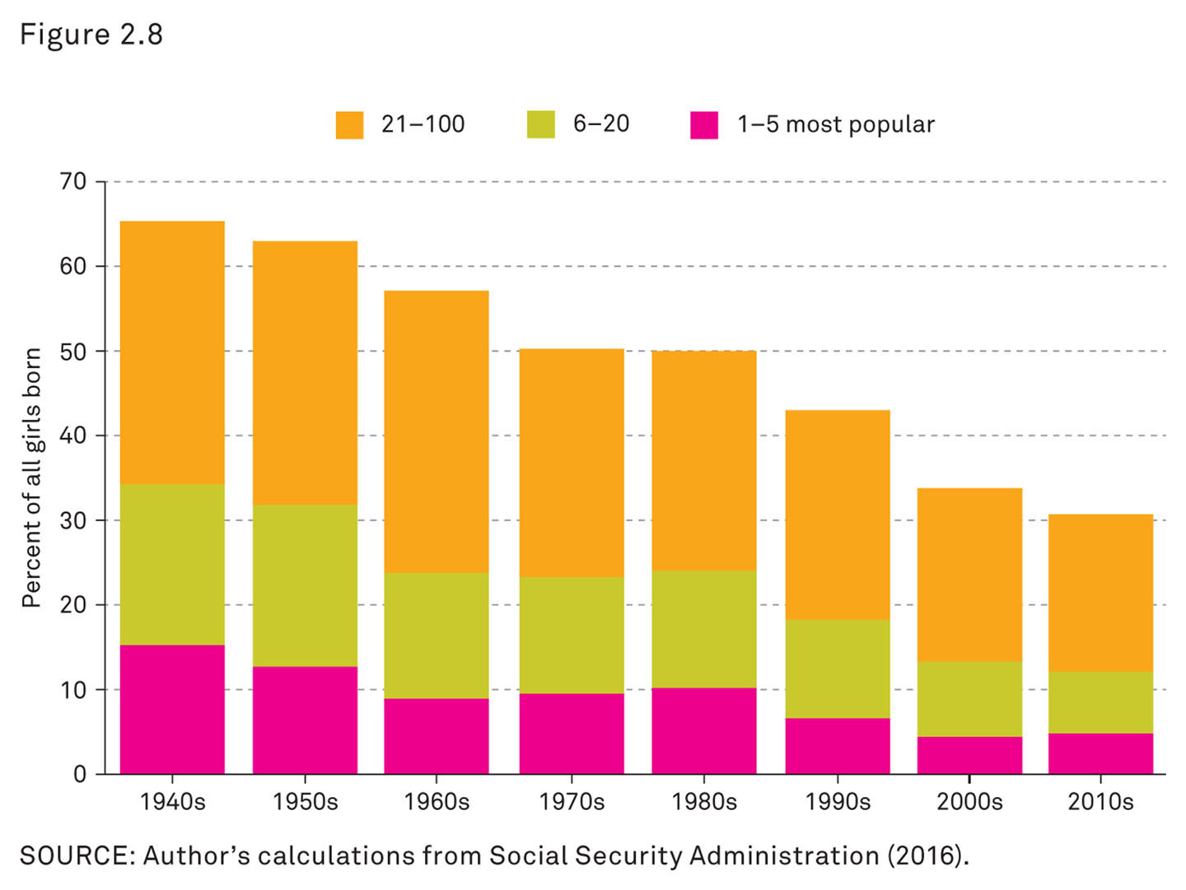
New Family Diversity (1960s–Present): Top 100 Girls’ Names as Percentages of All Girls Born
Notes:
This figure shows the top 100 girls’ names as percentages of all girls born between the 1940s and the 2010s.
In the 1940s, the top 100 names for girls made up almost two-thirds of all names.
Now the top 100 account for only about one-third of all girls’ names.
These figures underscore that individuals are now making active choices instead of merely following tradition.
Source: Cohen’s calculations from Social Security Administration (2014).

Slide 52
Urban Transformations
Young, single adults are increasingly drawn to cities
Older people are finding it easier to live in small apartments in urban areas
What will city life be like for the next generation?
Notes:
Today’s cities are changing again. Especially attractive are cities where single, young adults can live close to work, walk and bike around their neighborhoods, and socialize with like-minded peers.
That dense social life allows people to use hookup apps like Tinder and Grindr to find partners nearby.
Some older people are finding it easier to live in small apartments in urban areas, provided they have helpful and convenient amenities nearby.

Slide 53
Class Activity: What’s in a Name? 1.1
1. How many individuals in the United States share your first name?
none
1–100
100–1,000
more than 1,000
Notes:
Classroom activity
Have students visit the following website and input their first and last name: http://howmanyofme.com/search/
Results should resemble the following format:
There are ______ people in the United States with the first name ______.
Statistically it is the ______th most popular first name.
There are ______ people in the United States with the last name ______.
Statistically it is the ______th most popular last name.
There are ______ people in the United States named ______ ______ (their first and last names).
Have students either send the results to the instructor electronically or bring a copy of the results to class.
Have each student answer the clicker question so everyone can see the overall results for the class.
How do other students in the class compare?
What does this say about modern individuality?
After all the clicker questions have been answered as a class, have students divide into small groups to compare individual results (optional).

Slide 54
Class Activity: What’s in a Name? 1.2
1. Statistically, my first name is the ______ most popular.
1st–100th
101–1,000th
1,001th or more
not even on the charts!
Notes:
Classroom activity
Have students visit the following website and input their first and last name: http://howmanyofme.com/search/
Results should resemble the following format:
There are ______ people in the United States with the first name ______.
Statistically it is the ______th most popular first name.
There are ______ people in the United States with the last name ______.
Statistically it is the ______th most popular last name.
There are ______ people in the United States named ______ ______ (their first and last names).
Have students either send the results to the instructor electronically or bring a copy of the results to class.
Have each student answer the clicker question so everyone can see the overall results for the class.
How do other students in the class compare?
What does this say about modern individuality?
After all the clicker questions have been answered as a class, have students divide into small groups to compare individual results (optional).

Slide 55
Class Activity: What’s in a Name? 1.3
1. How many individuals in the United States share your last name?
none
1–100
100–1,000
more than 1,000
Notes:
Classroom activity
Have students visit the following website and input their first and last name: http://howmanyofme.com/search/
Results should resemble the following format:
There are ______ people in the United States with the first name ______.
Statistically it is the ______th most popular first name.
There are ______ people in the United States with the last name ______.
Statistically it is the ______th most popular last name.
There are ______ people in the United States named ______ ______ (their first and last names).
Have students either send the results to the instructor electronically or bring a copy of the results to class.
Have each student answer the following clicker question so everyone can see the overall results for the class.
How do other students in the class compare?
What does this say about modern individuality?
After all the clicker questions have been answered as a class, have students divide into small groups to compare individual results (optional).

Slide 56
Class Activity: What’s in a Name? 1.4
1. Statistically, my last name is the ______ most popular.
1st–100th
101–1,000th
1,001th or more
not even on the charts!
Notes:
Classroom activity
Have students visit the following website and input their first and last name: http://howmanyofme.com/search/
Results should resemble the following format:
There are ______ people in the United States with the first name ______.
Statistically it is the ______th most popular first name.
There are ______ people in the United States with the last name ______.
Statistically it is the ______th most popular last name.
There are ______ people in the United States named ______ ______ (their first and last names).
Have students either send the results to the instructor electronically or bring a copy of the results to class.
Have each student answer the following clicker question so everyone can see the overall results for the class.
How do other students in the class compare?
What does this say about modern individuality?
After all the clicker questions have been answered as a class, have students divide into small groups to compare individual results (optional).

Slide 57
Class Activity: What’s in a Name? 1.5
1. How many individuals in the United States share your first and last name?
none
1–10
10–20
more than 20
Notes:
Classroom activity
Have students visit the following website and input their first and last name: http://howmanyofme.com/search/
Results should resemble the following format:
There are ______ people in the United States with the first name ______.
Statistically it is the ______th most popular first name.
There are ______ people in the United States with the last name ______.
Statistically it is the ______th most popular last name.
There are ______ people in the United States named ______ ______ (their first and last names).
Have students either send the results to the instructor electronically or bring a copy of the results to class.
Have each student answer the following clicker question so everyone can see the overall results for the class.
How do other students in the class compare?
What does this say about modern individuality?
After all the clicker questions have been answered as a class, have students divide into small groups to compare individual results (optional).

Slide 58
Review Question 1
1. What contributed to the decline of courtship in the process of mate selection?
decreasing exposure to urban life for young adults
increasing freedom for young adults
growing importance of family ties
decreasing disposable income for young adults
Notes:
Answer: B
Discussion: As the ideal for marriage shifted to one based on companionship, friendship, and romance, and young adults became more independent from their parents and gained access to money and cars, dating became the way young adults found a spouse.

Slide 59
Review Question 2
2. Under the ideology of “separate spheres,” what were separated?
work and play
adults at work and children at school
men at work and women at home
marriage and childbearing
Notes:
Answer: C
Discussion: The industrial revolution led to (mostly) men working for wages in factories and other industrial jobs, and the ideal that women would stay home to care for the house and children, and create a haven for their husbands where they could escape from the harsh realities of the economy.

Slide 60
Review Question 3
3. According to the textbook, the decline of the name “Mary” in the United States represents the rising trend of what attitude?
conformity
atheism
Islam
individualism
Notes:
Answer: D
Discussion: The twentieth century brought a focus on individuality and opportunities for parents to choose more unique names for their children. In the past, children often were named after their parents. People now choose unique names for their offspring rather than simply follow tradition. Today, the most common names make up a much smaller percentage of the names given to babies.

Slide 61
Review Question 4
4. In colonial America, Christian doctrine supported the legal concept of coverture, and wives
had to cover their heads in public.
had full rights to citizenship.
had the right to their husbands’ property.
did not have a legal existence but rather were incorporated into their husbands’ citizenship.
Notes:
Answer: D
Discussion: All property that wives brought to the marriage and anything they produced while married became the property of their husbands. Women had essentially no rights as individuals and officials were more often concerned about husbands controlling their wives than whether they abused them or treated them well.

Slide 62
Review Question 5
5. When they were instituted in the early twentieth century, programs like Social Security and Aid to Dependent Children promoted marriage by
giving support to never-married women.
providing benefits only to veterans.
reducing economic incentives.
making women who had never been married or divorced ineligible.
Notes:
Answer: D
Discussion: Because these programs did not provide support to women who were never married or who had gotten divorced, they provided incentive for women to marry.

Slide 63
Review Question 6
6. Which of the following demonstrates the increased likelihood that adults will spend more of their lives outside of marriage than in the past?
higher percentages of adults living with no relatives
decline in the divorce rate
younger average age of marriage
decline in single parenthood
Notes:
Answer: A
Discussion: People tend to be older when they first marry. Divorce is more acceptable and more common, as is single parenthood. Women are more economically independent, and people are more likely than ever before to live on their own, with intimate partners, or with nonfamily members.

Slide 64
Lecture Slides
The Family: Diversity, Inequality, and Social Change, 2nd Edition
This concludes the Lecture Slide Set for Chapter 2
© 2018 W. W. Norton & Company, Inc.
Independent and Employee-Owned

